Slide 1

Germany - INDIA

Slide 2

About Germany
Germany consists of 16 States & the capital and largest city is Berlin.
Berlin is start up Capital of Europe.
Population of Germany is 84.7 million and it is the fourth largest economy in the world and Europe’s largest.

Slide 3

About Germany
German is the official and predominant spoken language in Germany.
Euro is the official currency of Germany.
Some of the famous cities in Germany are
  Berlin
  Munich
  Frankfurt
  Hamburg
  Heidelberg

Slide 4






Renowned German based Companies

Slide 5

Why Study in Germany?
Affordable cost of education.
Quality of Education.
Education in Germany is one of the oldest and best in the world.
German Education guarantees practical knowledge in addition to solid theoretical foundation.
Good Job Prospects.

Slide 6

Why Study in Germany?
Part Time work/Student Jobs
International students are allowed to work for 20 hours per week.
Typically, the student wages range from 12.83 Euros an hour. Students can work on campus or outside the campus.
Students with German language skills are entitled for higher wages as compared to the students having no skills.

Slide 7

Why Study in Germany?
Job Prospects
Germany is home to many of the Fortune 500 companies like Volkswagen, Audi AG, BMW, Bentley Motors Limited, Škoda Auto, Siemens etc.
The German economy is Europe’s strongest. It is the European leader in terms of growth, employment and export.
Non-EU students are allowed to stay up to 1.5 years (18 months) after the completion of the study to search for a job.
Indefinite right of residence to graduates after 5 years of working in Germany.

Slide 8

Intakes & Deadlines
Two Intakes:
Winter – September / October
Summer – March / April
Deadlines for Applications:
Winter – Starts from 15th December to 31st March
Summer – Starts from 15th August to 15th January
The above deadlines are generic and can vary university and course wise

Slide 9

Entry requirements for Bachelor’s
12 years of education is required for entry in a Bachelors program in Germany. Some universities needs 13 years of education.
This can be achieved by successfully completing the first year of a Bachelors program from a recognized university in India in the relevant subject field.
OR
Successfully completing a Foundation year at a university in Germany to compensate for the 13th year of education.
Academic percentage – Minimum 60% & above in 12th
IELTS – Overall 6.5 with no band less than 6
SAT score requirement in Constructor University is 1200

Slide 10
Entry requirements for Master’s
Academic percentage – Above 60% is required in bachelor’s
Minimum IELTS score –
Overall, 6.5 with no band less than 6 OR
Minimum TOEFL score – 80+.
GRE is needed for good and high ranked Universities – 310+ is considered as a good score. GRE is a mandatory requirement for some Automobile and Mechanical courses by high ranked Universities.

Slide 11
Duration & Tuition Fees
Usually, the Master’s course is of 1-2 years and the Bachelor’s course is for 3 years.
Fees – EUR 8,000 – 15,000* (Approx. Per Year)
The fees is excluding living and accommodation costs.

Slide 12

Documents required for Application to Institutions
Passport copy.
Updated Resume.
Mark Sheets of 10th and 12th and Bachelors.
Degree Certificate.
Recommendation letters (if any).
Statement of Purpose.
TOEFL / IELTS score.
GRE score card (Not mandatory).
German Proficiency Certificate (if any).
Work Experience (If any).

Slide 13

Germany student visa Updates

Slide 14

Proof of financial means
Student needs to pay minimum 1st year complete tuition fees before submitting visa file to Embassy/VFS
Blocked account amount has been increased to €11,904
Remaining balance fees is required to be shown in the bank

Slide 15
APS
The Academic Evaluation Center (APS) – part of the German Embassy to India – appreciates your interest in taking up academic studies in Germany.
APS India is the first stop to verify the academic documents of the student.
Fees INR 18,000
Required for Bachelor’s and Master’s students
APS AND TestAS WAIVER
University | APS WAIVER | TESTAS WAIVER
New European college | YES | YES
Lancaster University | YES | NO
EU Business School | YES | YES
Macromedia University of Applied Sciences** | YES | YES
Berlin School of Business and Innovation (BSBI), Berlin and Hamburg | YES | YES
GISMA Business School Hochschule | NO | YES
University of Europe for Applied Sciences | NO | YES (internal examination of UE)
Arden University Berlin Study Center | YES | YES
TestAS
TestAS is a central standardised scholastic aptitude test which measures intellectual abilities particularly important for university studies.
TestAS is intended for international study applicants planning to do undergraduate studies at German universities.
Fees EUR 150
Required for Bachelor’s students
SRH | No | Yes
International University of Applied Sciences | No | Yes

Slide 16

New Germany Consular Portal Information for Student Visas
What is the Germany Consular Portal?
A digital platform designed to manage visa applications.
Centralized online hub for processing student visa requests.
Allows students to schedule appointments, submit documents, and track application status.
Key Features of the Portal
User-Friendly Interface: Easy-to-navigate platform for students.
Document Uploads: Secure document submission feature.
Appointment Scheduling: Directly schedule consular appointments online.

Slide 17
New Germany Consular Portal Information for Student Visas
Eligibility for a Student Visa
Requirements for international students wishing to study in Germany.
  Accepted by a German institution.
  Proof of sufficient financial resources.
  Health insurance coverage.
Common documents required:
  Passport
  University admission letter/Visa letter
  Proof of financial means (Blocked A/C)
  Health insurance details
  1st year full tuition fees confirmation +Balance fees
  SOP
  The student can attach additional documents in OTHER DOCUMENT section

Slide 18
New Germany Consular Portal Information for Student Visas
How the New Portal Works
Step 1: Create an account on the Consular Portal https://digital.diplo.de/studium
Step 2: Fill out the online application form for the student visa.
Step 3: Upload necessary documents (e.g., passport, university acceptance letter, financial proof etc).
Step 4: Pay the consular fee online for verification (depends case to case).
Step 5: Schedule an appointment at the VFS
Step 6: Visit the VFS for Biometrics and pay the visa fees (EUR 75).

Slide 19
New Germany Consular Portal Information for Student Visas
Application Timeline
Step 1 (Portal Registration & Application Submission): 1-2 weeks for verification.
Step 2 (Consular/Embassy/VFS Appointment): Appointments available within a few weeks.
Step 3 (Visa Decision): Decision typically made within 4-8 weeks after consulate appointment.
Tip: Apply early to allow for any unforeseen delays.

Slide 20
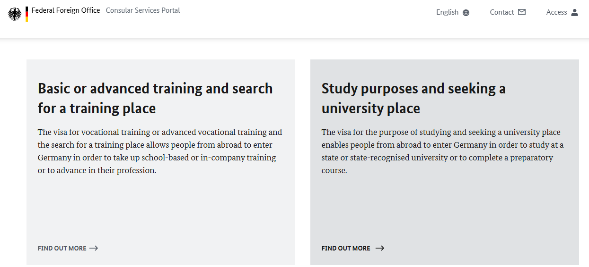
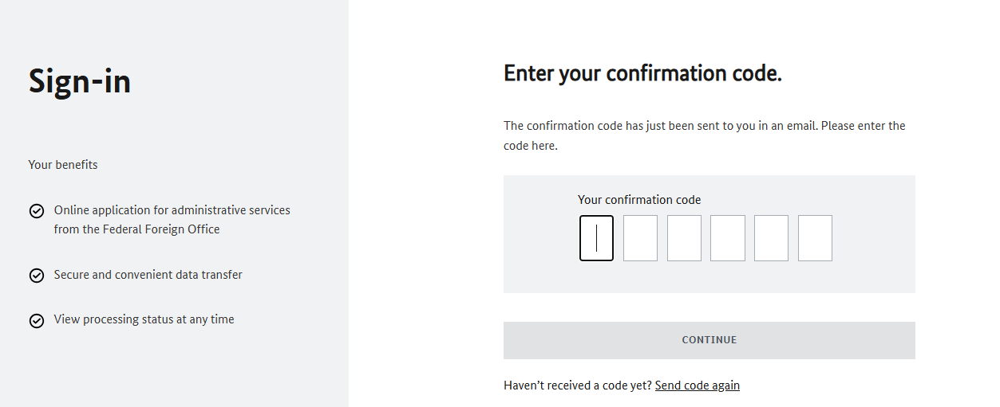

Slide 21
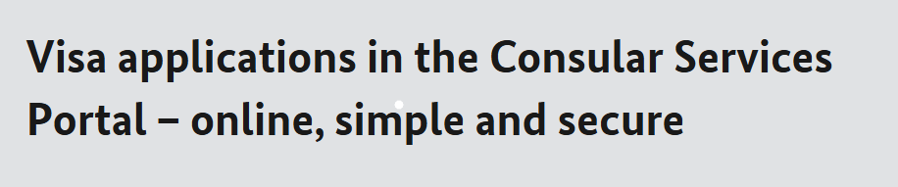
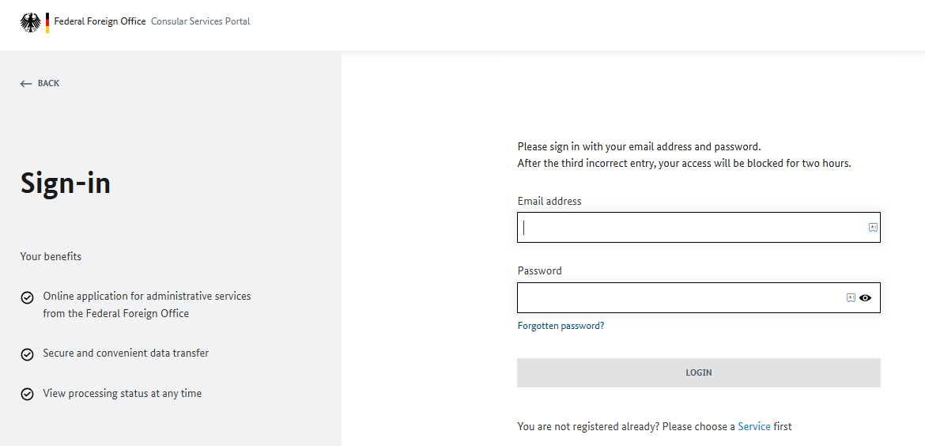

Slide 22
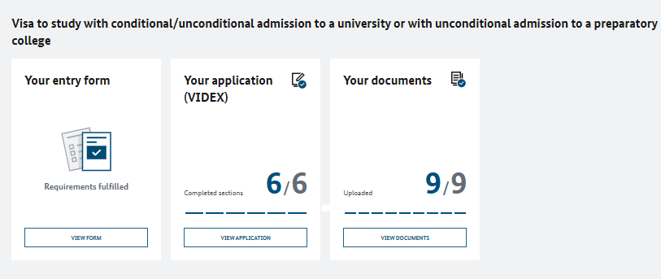
The student will have to fill two forms:
1. Entry Form – This will include all the Personal, Passport, University, English Language test details
2. VIDEX Form – Same as previous the visa application form now has been merged in the CSP portal.
3. Document Upload – The student will have to upload all the visa documents as per checklist in this section.
PLEASE NOTE – The documents should not be carried to the VFS as it will be assessed online through the portal.

Slide 23
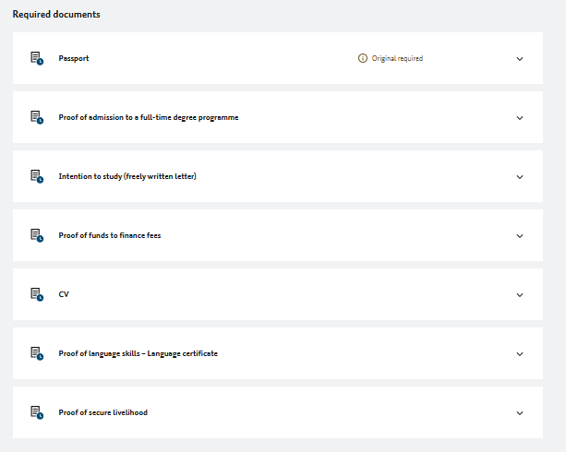
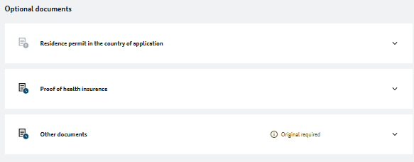
DOCUMENTS
REQUIREMENT

Slide 24
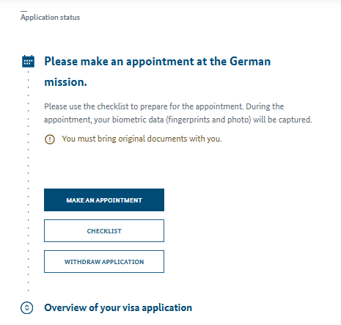
APPOINTMENT OVERVIEW
Once you click on
“MAKE AN APPOINTMENT”
It will be directed to the VFS where the student will have to book an appointment as per the jurisdiction.
GERMAN UNIVERSITIES
WITH APS – BOOK AT VFS
NON-GERMAN UNIVERSITIES
WITHOUT APS – BOOK AT CONSULATE/EMBASSY

Slide 25
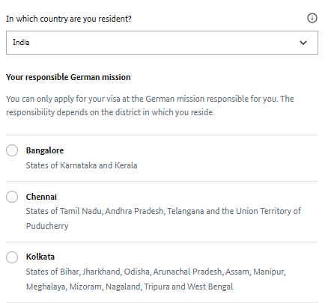
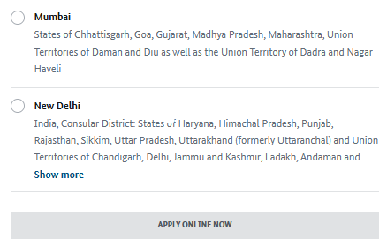
JURISDICTION WISE SEGGREGATION

Slide 26
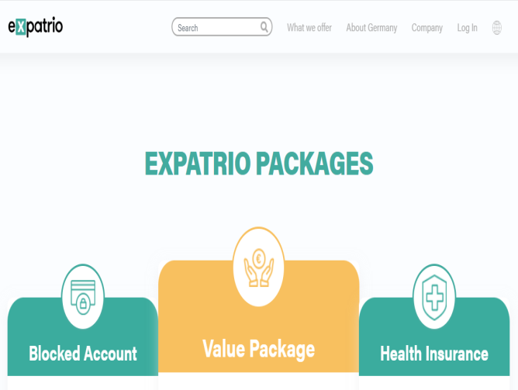
BLOCKED ACCOUNT
The Blocked Account (Sperrkonto) is a special type of bank account required by German law for many internationals to secure their German visa.
PARTNERS – FINTIBA, CORACLE and EXPATRIO
The current blocked amount established by the German government is €992 per month of one’s stay in Germany.
Required blocked amount: €992 * 12 months = €11.904
One time set-up fee: €49
Monthly fee: €5 * 12 = €60
Buffer: €100
Total: €12.005
HEALTH INSURANCE
Everyone living in Germany is required by law to have healthcare coverage.
It is issued as complimentary with the blocked account.

Slide 27
Germany Offer Flowchart
Unconditional Offer Received from the Institution
Sign the Study Agreement and share with the University
Pay 1st Year Fees (Mandatory)
Prepare for APS Certificate (Only for German Universities)
The student can start the APS Process anytime as it is an academic evaluation of documents
APS PROCESS
Register Online at https://aps-india.de/aps-process/
Pay INR 18,000 after registering
Courier academic documents to new Delhi (Gate No. 3, DLTA Complex, R.K. Khanna Stadium, 1 Africa Avenue, 110029 New Delhi, India)
TAT- 2-3 months (The student will receive the APS Certificate on the registered email)

Slide 28
Germany Student Visa Flowchart
Open an account in the German Bank
as soon as the student process the 1st year fee payment
After opening Blocked Account, deposit 11,904 EUR + 100 EUR bank charges = 12004 on the given bank details
Register at Germany Consular Service Portal
Fill up the Entry Form and VISA application form and upload documents
as per VISA checklist in portal
Once the verification is done. Book an appointment at VFS or Consulate/Embassy
Submit Biometrics and visa documents at VFS or Consulate/Embassy
Pay the Visa Fees (EUR 75)
VISA Issued via Courier (TAT – 3-4 weeks)

Slide 29
Below mentioned documents are required for a Student Visa Application:
You can also refer the checklist here
https://india.diplo.de/in-en/service/-/2552164
Valid passport (issued within the last 10 years and with at least 12 months validity left after the scheduled return)
Application form
1 copy of your passport’s data page
3 passport pictures according to biometric specifications
Cover letter from applicant explaining the exact purpose and duration of stay
Letter of admission from German university (electronic version)
Proof of payment of 1 year tuition fees
DOCUMENTS REQUIRED

Slide 30
Proof of language proficiency in English (only IELTS/TOEFL)
APS and TestAS (if required)
Proof of financial means to cover the costs for the time of your studies (Blocked Account for Living expenses)
The remaining balance tuition fees must be shown in the form of savings, FD, sponsorship or Education loan.
Travel health insurance covering the period from your departure to the date of enrolment at the university (Euro 30,000 coverage)
There would be a brief interview of the student by an officer at the consulate to assess the genuineness of the student – case to case basis.
DOCUMENTS REQUIRED

Slide 31


