Slide 1

01
World’s largest international student population – over 1 million students.
02
Home to 5,000+ universities and colleges with cutting-edge research and faculty.
03
Flexible academic curriculum with a wide choice of majors/minors.
04
High Quality Education – Top ranked universities.
Why USA?
05
Scholarship opportunities
06
Excellent post-study work opportunities – CPT, OPT & STEM OPT extension.
07
Access to the global job market and internship opportunities through Co-Op programs.
08
Multicultural environment with global exposure.
The USA is home to some of the largest multinational corporations, such as Apple, Microsoft, and Amazon
09

Slide 2
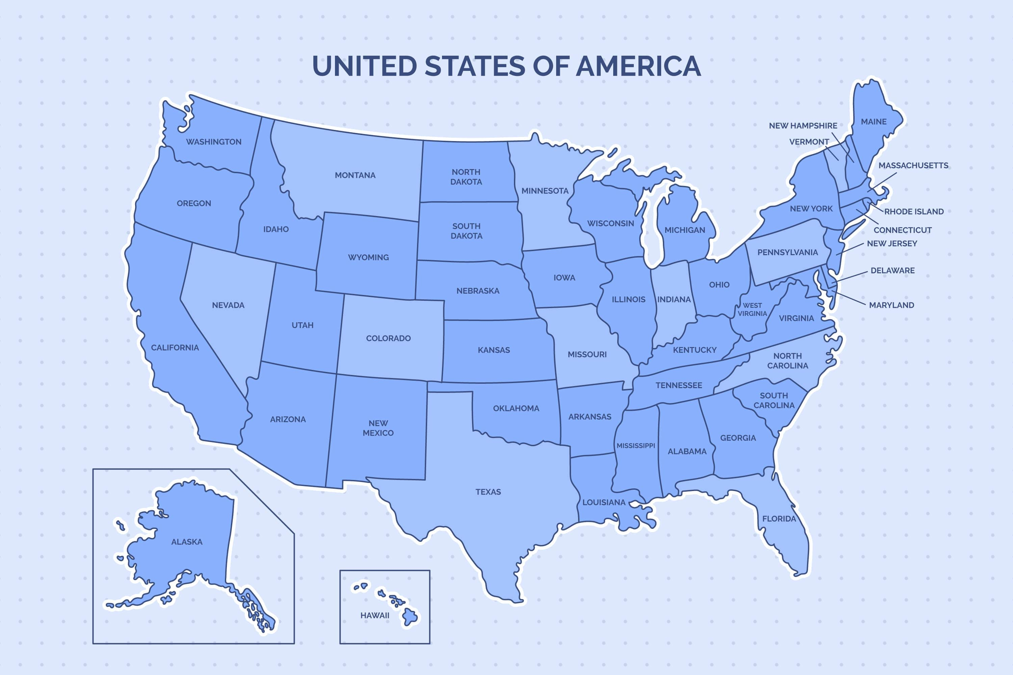
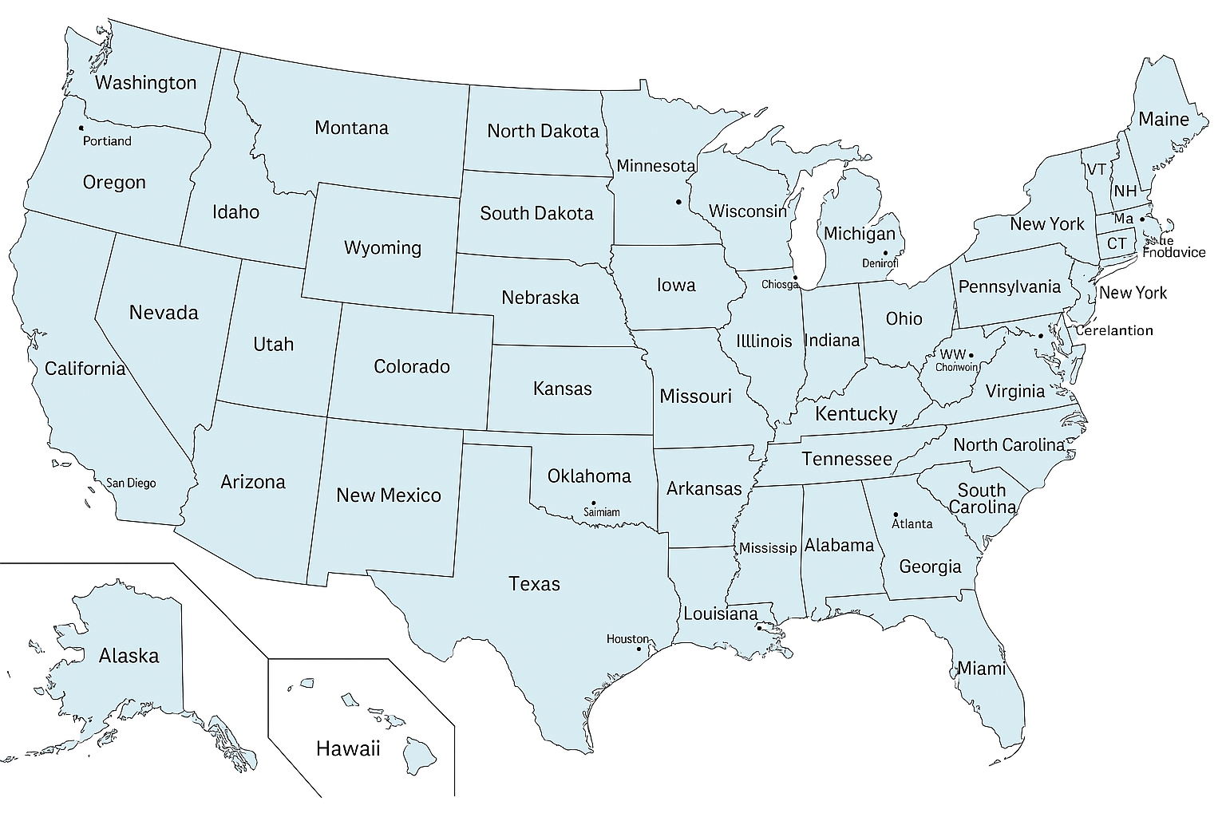
We are bringing overseas education within everyone’s reach

Slide 3
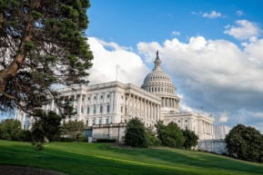
Geography and Basics of USA
Capital: Washington, D.C.
Number of States: 50
Population: around 331 million (2023)
Official Language: English
Currency: US Dollar (USD) Current Rate: 85 – 87 INR
The USA is bordered by Canada to the north, Mexico to the south, the Atlantic Ocean to the east, and the Pacific Ocean to the west
Third-largest country in the world by total area, after Russia and Canada.

Slide 4
Student Hubs in USA
Highlighted Student Hubs:
New York – Finance, Business, Media
California (LA, San Francisco, San Diego) – Tech, Film, Media, Innovation
Texas (Houston, Dallas, Austin) – Engineering, Business, Energy
Massachusetts (Boston) – Top Universities, Research
Illinois (Chicago) – MBA, Engineering, Finance
Florida – Aviation, Hospitality, Health Sciences
Washington State (Seattle) – Tech, Cloud Computing
Pennsylvania (Philadelphia) – Medicine, Technology, and Law
Michigan (Detroit, Ann Arbor) - Engineering, Business, Medicine, Law, and the arts
Virginia (Fairfax) – Tech Hub

Slide 5
Types of Institutions in USA
Community Colleges
Ivy League Schools
Public Universities
Private Universities
A group of 8 prestigious private universities in the Northeastern U.S. Known for academic excellence, elite status, and highly selective admissions
Renowned for strong Business, Law, and Research programs
8 Ivy Leagues are –
Harvard University, Princeton University, Yale University, Columbia University, University of Pennsylvania, Dartmouth College, Brown University & Cornell University.
State Funded
Low Tuition Fees
Wide Range of Degree’s available
Examples – Arizona State University, George Mason University, University of California, Riverside, The University of Arizona, University of South Florida
Oregon State University
Alumni Funded OR Organization Funded
Comparatively Higher Tuition Fees
Smaller Range of Degree’s available
Some may be Specialized and focused in a particular stream
Examples – Drexel University, Hofstra University and Suffolk University.
Is a type of public institution
Offers Associate Degrees
Low Tuition Fees
Low Admission Criteria
Examples: Green River College and Settle Central Community College.

Slide 6
Types of Degrees offered in USA Education System
Post Doctoral Study & Research
Ph.D., Advanced or
Professional Degree
Doctoral Degree
Professional Schools (Medicine, Law etc.)
(1 – 6 years)
Masters Degree Study (1 – 2 years)
Masters Degree
Senior
Bachelor's Degree
Junior
Sophomore
Associate Degree
Freshmen
High School Diploma (Year 12)

Slide 7

Degrees Offered in USA
Master’s Degrees:
Majorly 2 years of full-time study (Some degree can 1 year or 3 years for completion.
awarded by universities or colleges
Requires 30-60 credit hours
Types of Master's Degree Programs
High School Diploma
Options available to pursue high school from 9th grade to 12th grade.
Associate Degrees:
Two-year undergraduate academic degree
Awarded by community colleges
Requires completion of 60 to 65 credit hours
Benefits of an Associate Degree:
Transfer to a 4-Year University
Lower cost than a 4-year college.
Shorter time to completion.
Bachelor’s Degrees:
Four-year undergraduate academic degree
Awarded by universities or colleges
Requires 120 credit hours
Master’s Degrees:
Majorly 2 years of full-time study (Some degree can 1 year or 3 years for completion).
Awarded by universities or colleges
Requires 30-60 credit hours
Types of Master's Degree Programs
Doctoral Degrees:
Usually takes 3 years and above
Typically requires completion of 60 to 90 credit hours.
Involves research and the completion of a dissertation or thesis.

Slide 8
Types of Master's Degree Programs
Graduate program designed to provide advanced technical knowledge and practical skills in engineering disciplines.
Emphasizes on applied learning, preparing graduates for leadership and managerial roles in the engineering industry.
Graduate-level degree that emphasizes practical, career-focused education in specific fields.
These require students to conduct research and write a thesis on a specific topic within their field of study.
It’s ideal for students who plan to pursue a doctoral degree or careers in academia or research.
In some fields, students may complete a final project or capstone instead of a thesis.
In these programs, students take advanced courses in their field of study.
But may not be required to conduct research or write a thesis.
Masters in Professional Studies
M Engineering
Capstone or Project-Based Programs
Thesis-Based Programs
Coursework-Based Programs

Slide 9
Professional Programs
🔹 1. Medicine (MD)
Cannot be pursued directly after high school.
Students must first complete a 4-year bachelor’s degree, usually with pre-med coursework (biology, chemistry, physics, etc.).
Then they take the MCAT (Medical College Admission Test).
After that, they apply to medical school (MD).
🔹 2. Law (JD)
Also a postgraduate degree.
Requires a bachelor’s degree first, in any major (though many choose political science, philosophy, etc.).
Students take the LSAT (Law School Admission Test) or GRE (some schools accept it).
Then they apply for a Juris Doctor (JD) program.
🔹 3. Nusing
To apply for Nursing, Student has to complete bachelors in any related degree in USA like BS Biology, BS Biomedical Science, BS Pre Nursing or BS Nursing (Traditional) then has to give NCLAT Exam, after that they can apply for Nursing Schools.
🔹 Why This System?
The U.S. favors a broad undergraduate education. The idea is to:
Give students time to explore interests.
Build critical thinking and writing skills.
Make sure they're mature and committed before entering demanding professional programs.

Slide 10
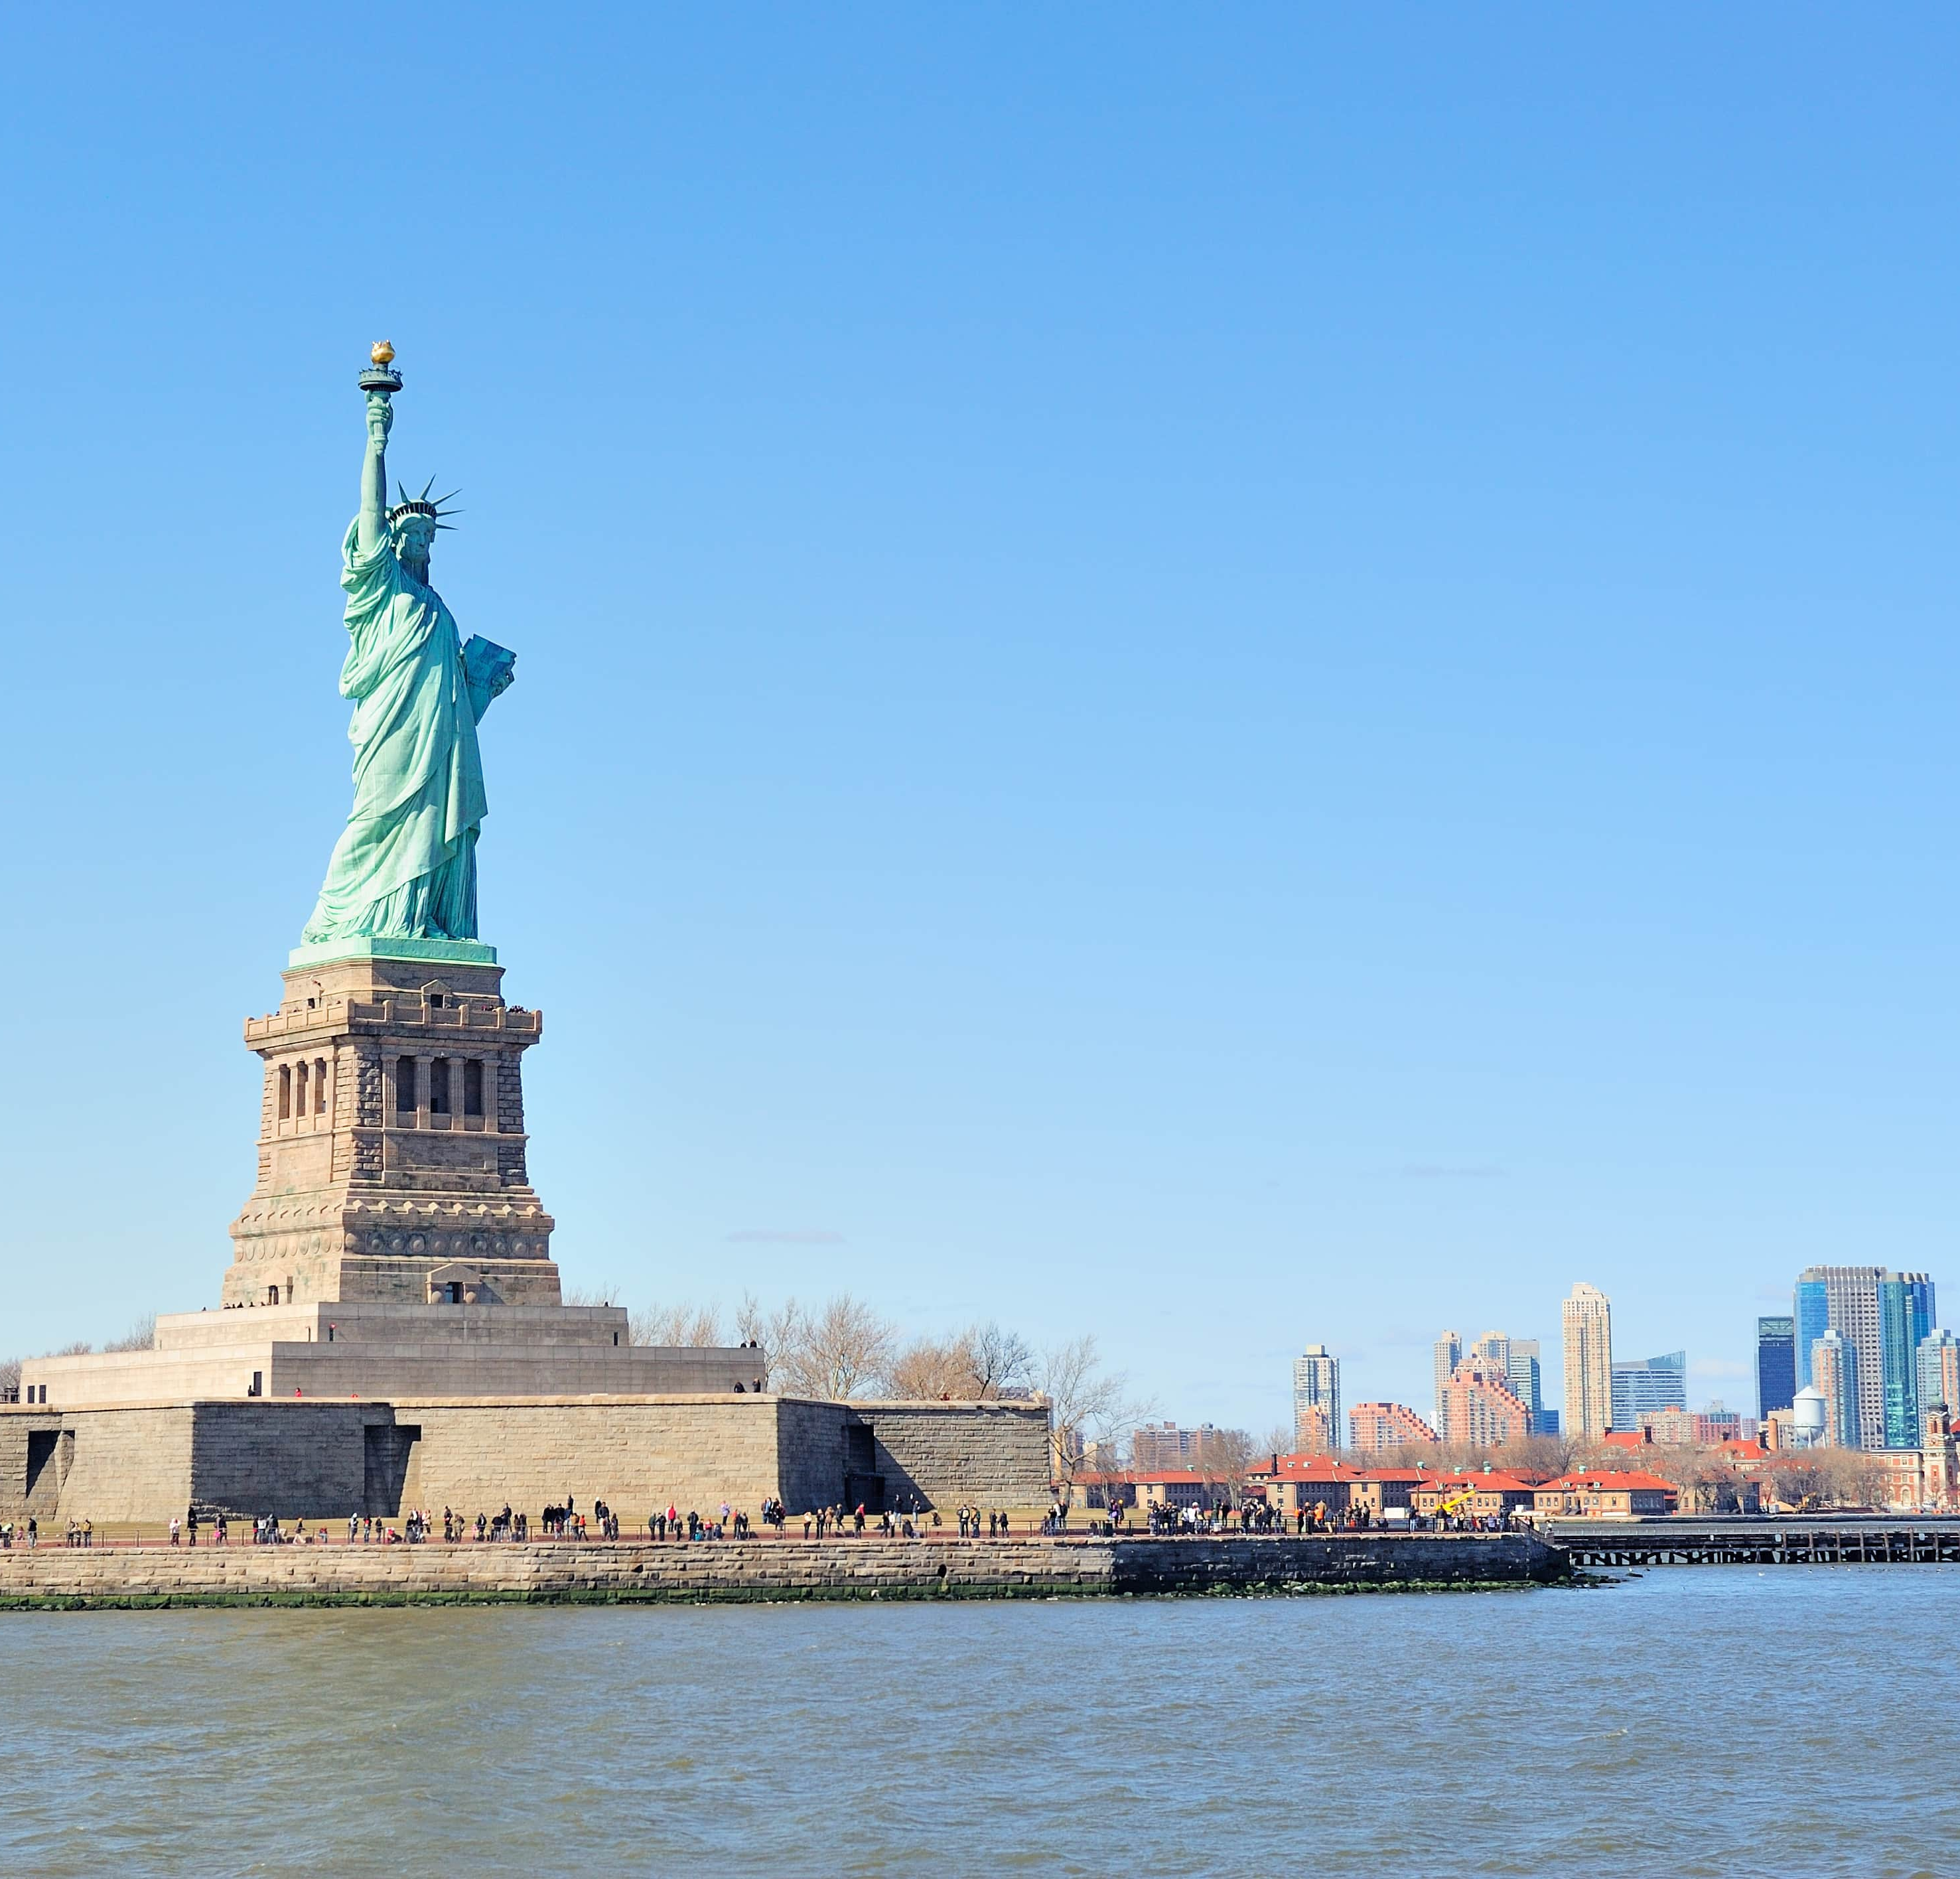
Intakes in USA
Major Intakes
01
Fall (August), Spring (January). This holds good for lot of USA Universities.
02
Few universities have 3 intakes Fall (August), Winter (January) and Spring (March).
03
There are few more Intakes like
Spring 2(March),Summer (May), Fall 2 (October) for limited programs.
04
Few University have every month as new intake.

Slide 11
Popular Universities
Lehigh University
Arizona State University
Stevens Institute of Technology
Rochester Institute of Technology
State University of New York at Buffalo
University of South Florida
San Jose State University
Washinton State University
University of North Texas Denton
New York Institute of Technology
The University of Alabama, Tuscaloosa
Southern Illinois University Edwardsville
Drexel University
Lawrence Technological University
Worcester Polytechnic Institute
Central Michigan University
New Jersey Institute of Technology
Purdue University – Northwest
Indiana University of Pennsylvania
University of Albany, The State University of New York, Albany

Slide 12
Top 150 ranked universities
University Name | US News National Ranking
Johns Hopkins University | #6
University of Pennsylvania | #10
Dartmouth College | #15
University of California, Los Angeles | #15
University of California, Berkeley | #17
Lehigh University | #46
UMass Amherst | #58
University of Connecticut | #70
University of California, Riverside | #76
Stevens Institute of Technology | #76
University at Buffalo (SUNY) | #76
New Jersey Institute of Technology | #84
University of Delaware | #86
Worchester Polytechnic University | #86
Marquette University | #86
Drexel University | #86
University of South Florida | #91
Rochester Institute of Technology | #91
Florida International University | #98
Yeshiva University | #98
Saint Louis University | #105
University of New Hampshire | #109
George Mason University | #109
University at Albany-SUNY | #121
Arizona State University | #121
Miami University, Oxford | #136
University of Alabama at Birmingham | #136
University of Maryland, Baltimore County | #144
Oregon State University | #144
James Madison University | #148
Colorado State University | #148

Slide 13

Entry Requirements
Undergraduate:
Mandatory Requirements:
Academic: 55%+ in 10th & 12th
IELTS: 6.0+, TOEFL: 70+, PTE: 53+, DET: 100+
Optional Requirements:
Scholastic Assessment Test (SAT), Minimum score of 1150+
American College Testing (ACT), Minimum score of 25+
Graduate:
Mandatory Requirements:
  Academic: 56%+ in Bachelor’s (Check if student has completed 3years bachelor's degree or 4 years bachelors degree)
  Check for the backlogs (Varying as per university)
  IELTS: 6.5+, TOEFL: 8+, PTE: 56+, DET: 110+
Optional Requirements:
  Graduate Record Examination (GRE), Minimum score of 290 to 300+
  Graduate Management Admission Test(GMAT), Minimum score of 550+

Slide 14

Exceptions for Graduate Entry Requirements
Not all the universities in USA accept 3 years bachelors degree. To accept the 3 years bachelors degree, they look for either of the below conditions:
Student’s previous college or university should be ‘NAAC A’ accredited and student must have scored grades in Division I.
Student must have done the NACES approved External Credential Evaluation to convert the score reports to USA Equivalent grades to determine USA Equivalency

Slide 15
Pathways and their Unique selling points
An opportunity a student gets to apply to a High Ranked University for the reasons mentioned below
Not meeting the direct entry requirements
Low GRE/TOEFL/
IELTS scores
Low Academics Scores
Missed the application deadline
USP’s of Pathways :
Student gets a chance to apply to a high ranked university.
Additional support to the International students.
GRE and SAT waivers for PG and UG students, respectively.
As most of the universities direct admission deadline is passed, they can apply through pathway.
Groups/Universities offering Pathways: INTO, Kaplan, Shorelight, Drexel University, Virginia Tech Language and Culture Institute, Washington State University

Slide 16
Introduction to Groups
Some universities, pathway colleges, satellite campuses, or private colleges outsource their recruitment processes to private entities.
These private entities carry out the entire admission process, from marketing and applications to commissions.
These private entities are called groups.
Groups represented by KC for USA institutions:
Shorelight
Study Group
Kaplan
INTO
Navitas

Slide 17
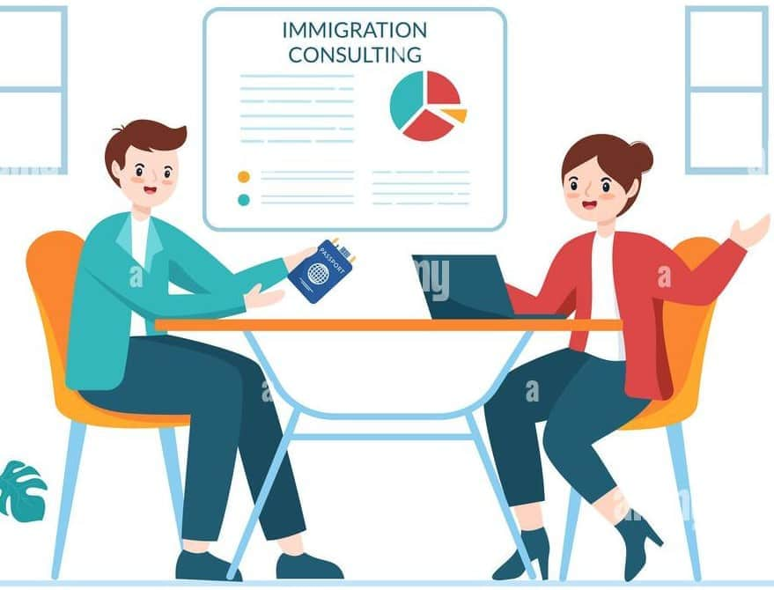
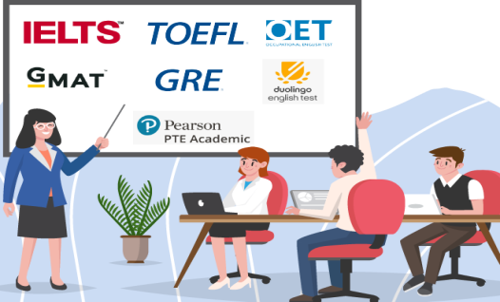




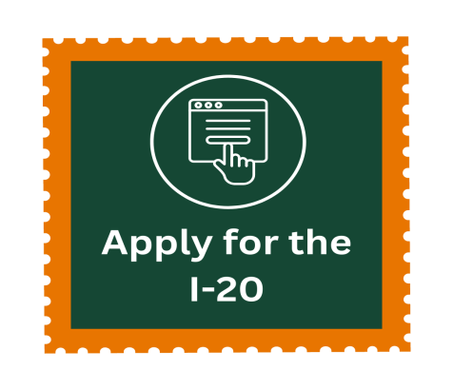
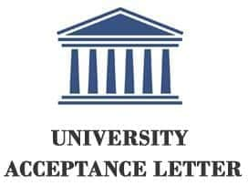
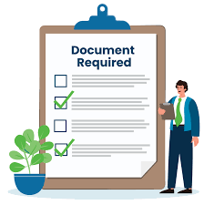

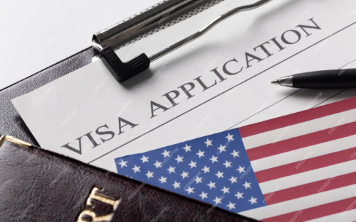
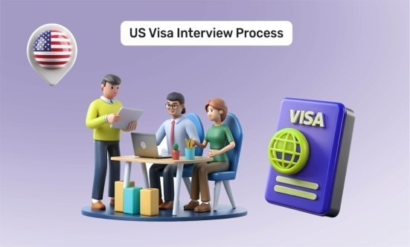

Application Process Flow

Slide 18

Documentation Checklist
Academic Documents
Academic Marksheets:
  Submit 10th, 11th, and 12th-grade marksheets
  If currently pursuing 12th grade: submit 9th, 10th, and 11th marksheets
  Some universities may also request predicted 12th-grade scores
For IB Board:
  Schools can send official transcripts via email directly to the university
English Proficiency
English Proficiency Scorecard (IELTS/TOEFL/PTE/DET)
IB Board Students:
  Some universities may waive English proficiency for admission
  However, scores are recommended for scholarship eligibility
Passport – First and last page
Additional Documents
Letters of Recommendation (LORs) – Not required by all universities
Essay / Statement of Purpose – Optional for many institutions
SAT/ACT Scores – Recommended for high-ranking universities
Undergraduate Admission Requirements

Slide 19

Documentation Checklist
Bachelor’s marksheets (individual & consolidated), degree/provisional certificate
  If pursuing final year: Submit 7th sem marksheet & bonafide certificate
  Some universities accept up to 6th Sem + Bonafide for early decision
English proficiency score (IELTS/TOEFL/Duolingo)
Passport (First & Last page)
2–3 Letters of Recommendation
Statement of Purpose / Essay
GRE/GMAT scores (if required)
Financial documents (may be required at application stage)
Portfolio (for Design, Architecture, MFA programs)
Graduate Admission Requirements

Slide 20

Post-Application Submission Process
Get English proficiency Score reporting done by student if required by university.
Get the online letters of recommendation completed by the professors of the student.
Get any additional documentation like portfolio(Slide room), Supplemental Application, DEW Form, Agent Authorization letter completed.
Get the Offer Letters
Submit financial documents for I-20
Track I-20 issuance
Refer Procedure Guides of respective universities for specific process.

Slide 21

TRANSITION PLAN
English Proficiency Score Reporting
Letters of Recommendation (LORs)
Submission of Additional Documents
Offer Letter Tracking
Financial Document Submission
Track I-20 Issuance
University-Specific Procedure Guides
Action: Ensure the student reports their English proficiency test scores (TOEFL, IELTS, PTE, Duolingo, etc.) directly to the university, if not already done during application.
When Required: Only if the university mandates it as part of their admissions requirement.
How to Check: Verify via Procedure Guide or the university's official website.

Slide 22

TRANSITION PLAN
English Proficiency Score Reporting
Letters of Recommendation (LORs)
Submission of Additional Documents
Offer Letter Tracking
Financial Document Submission
Track I-20 Issuance
University-Specific Procedure Guides
Action: Follow up with the student to complete and submit online LORs by student's professors.
Tips: Make sure professors receive the system-generated email and links.
Remind them of deadlines to avoid processing delays.

Slide 23
TRANSITION PLAN
English Proficiency Score Reporting
Letters of Recommendation (LORs)
Submission of Additional Documents
Offer Letter Tracking
Financial Document Submission
Track I-20 Issuance
University-Specific Procedure Guides
Includes, but not limited to:
Portfolio: Via SlideRoom or equivalent platform.
Supplemental Application Forms
Agent Authorization Letter/ (DEW) Form/Consent Form

Slide 24
TRANSITION PLAN
English Proficiency Score Reporting
Letters of Recommendation (LORs)
Submission of Additional Documents
Offer Letter Tracking
Financial Document Submission
Track I-20 Issuance
University-Specific Procedure Guides
Action: Monitor and follow up on issuance of Offer Letters.
Tool: Use your internal CRM system or the flow chart process created by the institution.
Next Steps: Move to financial documentation stage once offer is received.

Slide 25
TRANSITION PLAN
English Proficiency Score Reporting
Letters of Recommendation (LORs)
Submission of Additional Documents
Offer Letter Tracking
Financial Document Submission
Track I-20 Issuance
University-Specific Procedure Guides
Action:
Collect and submit:
Student’s/Parent’s bank statements
Affidavit of Support (if applicable)
Sponsor letters (if needed)
Note: Must meet the minimum financial threshold stated by the university for I-20 issuance.

Slide 26
TRANSITION PLAN
English Proficiency Score Reporting
Letters of Recommendation (LORs)
Submission of Additional Documents
Offer Letter Tracking
Financial Document Submission
Track I-20 Issuance
University-Specific Procedure Guides
Action:
Monitor the university portal or coordinate with admissions teams to track when the I-20 is issued.
Next Steps:
Coordinate with the student for visa appointment booking once I-20 is received.

Slide 27
TRANSITION PLAN
English Proficiency Score Reporting
Letters of Recommendation (LORs)
Submission of Additional Documents
Offer Letter Tracking
Financial Document Submission
Track I-20 Issuance
University-Specific Procedure Guides
Action:
Always refer to the official Procedure Guide of the respective university.
Why It Matters:
Each university has unique processes and documentation requirements which must be followed precisely.

Slide 28


Work Rights
Types of Employment Available to F‐1 Students
while studying or after studies
1. On Campus Employment
2. Off Campus Employment through
a. Curriculam Practical Training (CPT) b. Optional Practical Training (OPT)

Slide 29






Work Rights
On – Campus Employment:
• Can work on campus 20 hrs./week during study time
• Can work full time (i.e., 40 hrs./week) during holidays
• Positions include:
Teaching Assistantship
• Research Assistantship
• Fellowship
• Hourly Employment- Food Services, Library,
• Event Coordinator, Laboratory Assistant, etc.

Slide 30


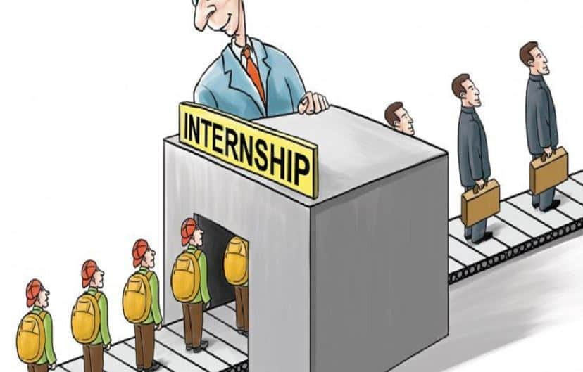
Work Rights
Curricular Practical Training (CPT)
Provides opportunity to gain actual employment experience.
“An integral part of an established curriculum”.
Defined as “alternate work/study, internship, cooperative education,
or any other type of required internship or practicum which is offered by sponsoring employers through cooperative agreements with the school."
To be eligible for CPT, student must have completed 9 months in lawful status and currently be on F‐1 status.
CPT can be full time (>20 hours week) or part time (20 hours or less per week).

Slide 31




Work Rights
Optional Practical Training (OPT):
• Available to students who are lawfully enrolled on a full – time
basis &have completed at least 1 full academic year.
• Eligible student may request OPT in order to be employed in
a position related to the major area of study.
• 12 (Non STEM)/36 (STEM) months of OPT available after each degree level completion.

Slide 32
Notes for OPT
01
OPT must be directly related to your field of study
02
You can apply for OPT up to 90 days before your program end date and no later than 60 days after it ends
You must not have used more than 12 months of full-time CPT (Curricular Practical Training), or you might lose OPT eligibility
03

Slide 33
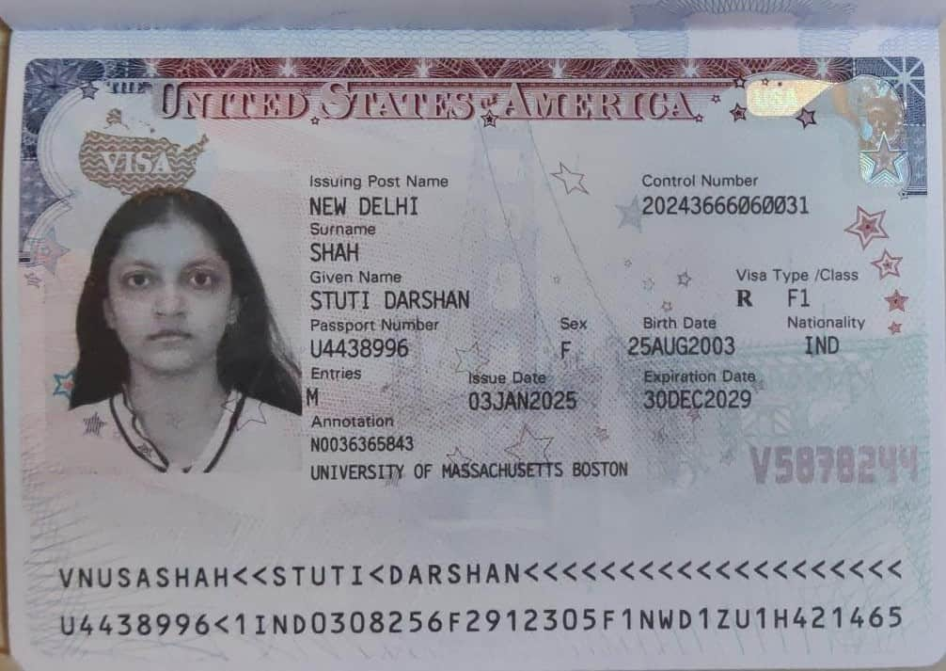
Steps for VISA
What is the U.S. Student (F-1) Visa?
The F-1 Visa is a non-immigrant visa that allows international students to study full-time at an accredited U.S. college or university.
It is issued to students who have received an admission offer and an official Form I-20 from a U.S. institution.
The visa is typically valid for the duration of the academic program and allows entry into the U.S. within a month before the course start date.
Students on an F-1 visa are eligible for:
  On-campus employment
  Optional Practical Training (OPT) after graduation
  Curricular Practical Training (CPT) during studies (if applicable)

Slide 34
Steps for VISA
Receive a Confirmed I-20
Issued by an SEVP-approved U.S. university after admission acceptance
Includes your SEVIS ID, program details, and financial estimates
Complete the DS-160 Form
Fill online at: ceac.state.gov
No fee for DS-160, but required for the visa process
Save the confirmation page with barcode
Pay the SEVIS I-901 Fee
Fee: $350 USD
Pay at: fmjfee.com
Use your SEVIS ID from the I-20
Save the payment receipt
Schedule Visa Appointments
Book 2 appointments:
VAC (Biometrics)
Visa Interview at U.S. Embassy/Consulate
Visa Application (MRV) Fee: $185 USD
India: usvisascheduling.com
Other countries: ustraveldocs.com
Attend the Visa Interview
Carry all documents:
I-20, DS-160 confirmation, SEVIS receipt, passport
Financial documents, academic records, test scores (if applicable)
Be confident and honest in explaining your program, university, and career plans
STEP 1: DS 160 is a 22 pages online form, in which student will need to fill all the details about his academics, work experience, Family background and details about the USA university student will be applying. While filling the DS 160 form application ID starting with “AA” will be generated. This application ID will be required to entered in “US Visa Scheduling” portal.
STEP 3: SEVIS fee payment, student going for an F1 VISA for USA, is required to Pay $350 SEVIS fees using credit card only. SEVIS ID is mentioned in the I20 .

Slide 35
Why the SEVIS fee payment is necessary:
Tracking and Monitoring: The SEVIS fee helps fund the system used by U.S. immigration authorities to monitor international students, exchange visitors, and their dependents while they are in the U.S. The system keeps track of their enrollment status, academic progress, and ensures they comply with U.S. visa rules.
Visa Processing and Administrative Costs: The SEVIS fee helps cover the costs of maintaining and updating the SEVIS database, processing visa applications, and administering the system that supports the overall visa process for students and exchange visitors.
Security and Compliance: By collecting the SEVIS fee, the U.S. government ensures that schools and institutions comply with federal regulations regarding international students. It also enables authorities to easily verify that students are enrolled in a legitimate academic program and are attending classes as required by their visa.
Prevention of Immigration Violations: The SEVIS fee helps to reduce the risk of students overstaying their visas or engaging in activities outside the scope of their visa category. By monitoring students throughout their stay, the U.S. can identify and address any violations of immigration law.
Student and Exchange Visitor Support: The SEVIS system provides support to students and exchange visitors, helping them navigate their visa status, maintain legal status, and communicate with U.S. authorities if needed.
Overall, the SEVIS fee is part of the U.S. government’s system to ensure that international students comply with the terms of their visas and to maintain the integrity of the U.S. immigration system.

Slide 36

Financial Documents required for I-20
Bank Balance Certificate (savings/fixed deposits)
Loan Sanction Letter
Affidavit of Support/University specific financial form
Required fund: 1 year tuition + living

Slide 37
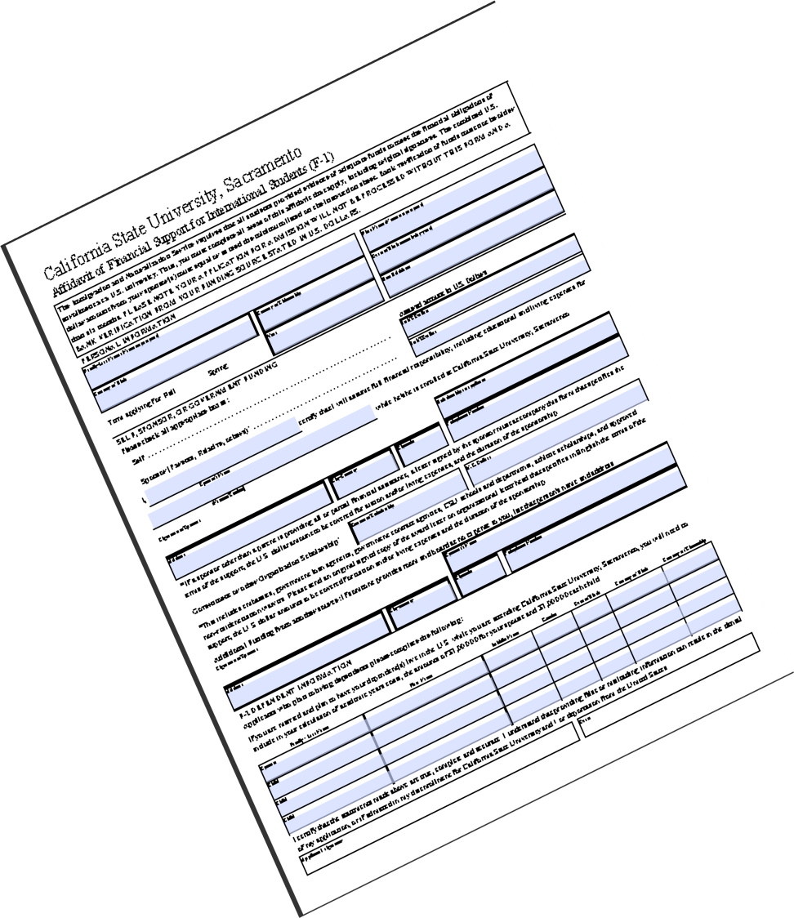
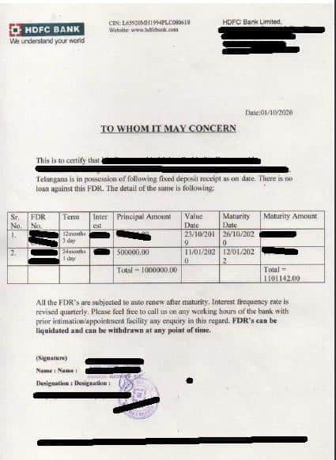
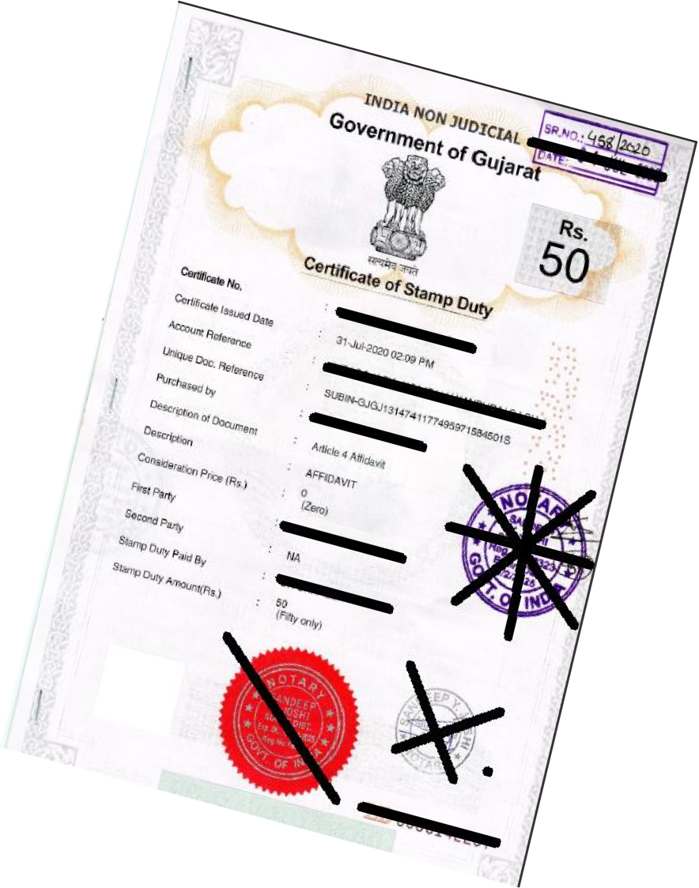
Financial Documents to be sent to obtain the I20

Slide 38

Funds to be shown for I-20 Issuance
The I-20 form will provide an estimate of the cost of attendance, which you should use as a guide (This amount is for 9 months (1 academic year) which includes tuition + living + other expenses)
For I-20 we need a bank balance certificate which shows the required amount for 1 year study cost. Always keep 500-1000 USD more than the I-20 required amount.
Annual scholarships can be deducted from the total amount.
When filling out sponsor details, use parent or family funds instead of listing yourself as the sponsor.
You can combine different funding sources, such as bank statements, scholarship letters, and loan approval documents.
Bank balance certificates of multiple banks can be combined to arrive at the required amount.
One day old funds are accepted by most US universities.

Slide 39
What is I20
In the United States, the Form I-20 is a critical immigration document issued by a SEVP-certified (Student and Exchange Visitor Program) school to international students who have been accepted to study there. It is officially called the "Certificate of Eligibility for Nonimmigrant Student Status.“
Key points about the I-20
Purpose: It allows a student to apply for an F-1 (academic student) or M-1 (vocational student) visa.
Issued by: The Designated School Official (DSO) at the U.S. school.
Contents: Includes details like the student’s SEVIS ID number, program of study, duration of the program, and financial resources.
Use
Apply for an F-1 visa at a U.S. embassy or consulate.
Enter the U.S. in student status.
Maintain legal status while studying in the U.S.
Travel internationally and return to the U.S.
Apply for benefits like a driver’s license or work authorization (e.g., CPT or OPT).

Slide 40
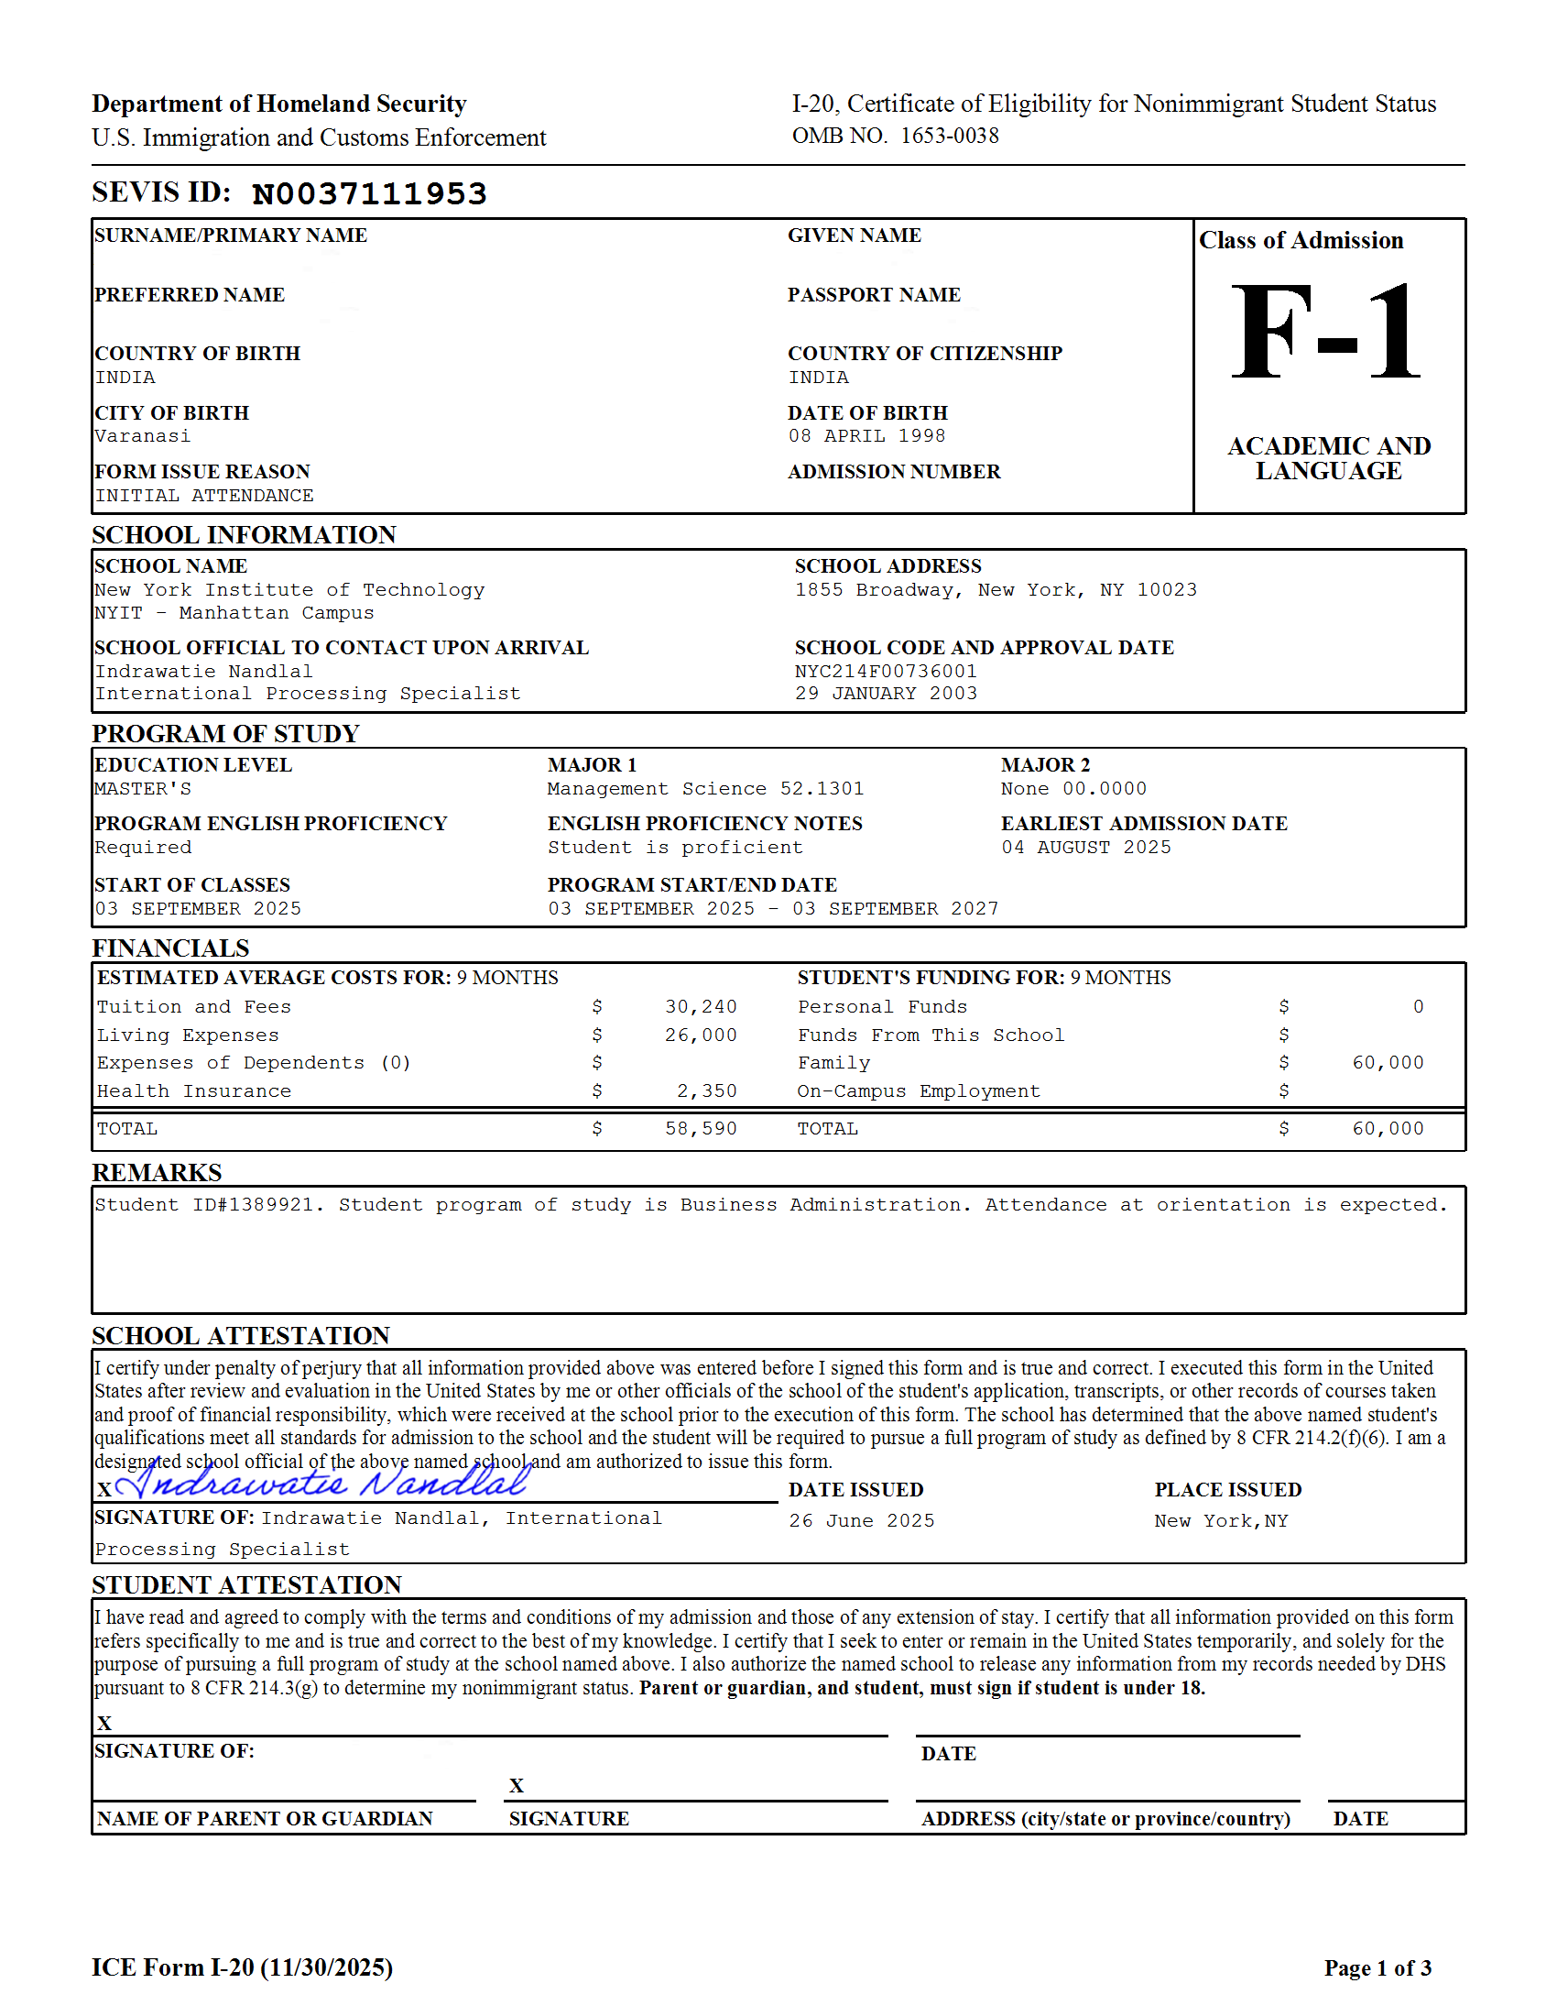
Acceptance Letter/I-20
You will receive an I-20 along with an acceptance letter from US Institute.

Slide 41
Popular Courses in USA
Popular Courses
Information Technology
Business & Management
Architecture
& Construction
Nursing & Health
Psychology &
Social Work
Engineering
Computer Science & Data Science
Hospitality & Tourism
Pharmacy
Media & Communication

Slide 42
Estimated cost of Education in the USA
Bachelors Program
Sr. No. | Course Duration | Requirements for Bachelor’s | Cost of Education, Living & Accommodation (₹) | Less Part-Time Earnings (₹) | Net Education Cost (₹) | Processing Time | Part-Time Work Hours / Week | OPT / Post Study Work Visa Duration
1 | 4 Years | SAT/ACT + PTE/TOEFL/IELTS/DET Academics – Above 55% | ₹70 L – ₹100 L | ₹20 L | ₹50 L – ₹80 L | 9 – 12 Months | 20 Hrs | 12 Months for all programs+ 24 Months Extension for STEM (Science, Tech, Engg & Math)
2 | 2 Years (Associate Degree) | PTE/TOEFL/IELTS/DET Academics – Above 55% | ₹30 L – ₹35 L | ₹10 L | ₹20 L – ₹25 L | 6 – 9 Months | 20 Hrs | 12 Months for all programs
Master’s Program
Sr. No. | Course Duration | Requirements for Master’s | Cost of Education, Living & Accommodation (₹) | Less Part-Time Earnings (₹) | Net Education Cost (₹) | Processing Time | Part-Time Work Hours / Week | OPT / Post Study Work Visa Duration
1 | 2 Years | GRE/GMAT + TOEFL/IELTS/DET Academics Above 55% | ₹40 L – ₹65 L | ₹12 L | ₹28 L – ₹53 L | 9 – 12 Months | 20 Hrs | 12 Months for all programs + 24 Months Extension for STEM (Science, Tech, Eng & Math)

Slide 43
Graduate Timeline to Apply For USA
Steps | Fall Intake | Spring Intake | Summer Intake
Coaching, preparing, appearing for GRE/GMAT & TOEFL/IELTS exams | 8–12 weeks duration | 8–12 weeks duration | 8–12 weeks duration
Get scores by | Oct – Nov | May – June | Nov – Dec
Selection of Course, Finalization of Universities and reporting of scores | 2 weeks duration | 2 weeks duration | 2 weeks duration
Gathering Documents and applying to the Universities | 2 weeks duration | 2 weeks duration | 2 weeks duration
Arranging funds (through Education Loan or Self) / IT Returns | 2 weeks duration | 2 weeks duration | 2 weeks duration
Receipt of Offer Letters, Activation of university account, Enrollment deposit, etc. | April – June | Oct – Nov | Mar – Apr
Schedule date for VISA Interview, Visa Documentation, Application & get VISA | 2-3 weeks duration | 2-3 weeks duration | 2-3 weeks duration
Get Visa Approval | June – early August | Dec – early Jan | May – early June
Pre-departure (Forex, Accommodation, Tickets, SIM Card, etc.) | July – August | Dec – early Jan | May – early June
Enroll with the University | Mid August | Early Jan | May – June

Slide 44
Undergraduate Timeline to Apply For USA
Steps | Timeline/Details
Coaching & preparing for SAT/ACT exam after 10th Std. | 8–12 weeks duration
Plan SAT/ACT test in any of the following months | SAT: May, Aug, Oct, Dec (When in 11th Std) Mar, May, Aug, Oct, Dec (When in 12th Std) ACT: Sept, Oct, Dec, Feb, April (When in 11th Std) June, July (When in 12th Std)
Free score reporting can be done | SAT: Within 9 days of exam ACT: Within 5 days of exam
Get SAT/ACT scores | Within 2 weeks after the exam
Take TOEFL/IELTS | Before September (12th Std)
Identifying and curating the college list | September – November
Gathering Documents & Applying to Universities | October – December
Receive Acceptance & Pay the Enrollment Deposit | April – May
Time required for Visa Documentation & Application | 2-3 weeks
Get Visa Approval | June – August
Enroll with the University | By August (Fall Intake)

Slide 45
Thank You

