Slide 1



Version – Apr. 2026
1
General Presentation – UK
- for India
Study In
We are bringing overseas education within everyone’s reach

Slide 2
Points for Today’s Discussion
1
UK in a Nutshell
Why Study in UK ?
Student Work Rights
Academic Entry Criteria
Academic Calendar (Term Time & Structure)
Top Up & Credit Transfer
Learning Styles
Assessment & Grading
Types of Universities in the UK
Program Options (UG, PG, Foundation, Pre-Masters)
We are bringing overseas education within everyone’s reach

Slide 3
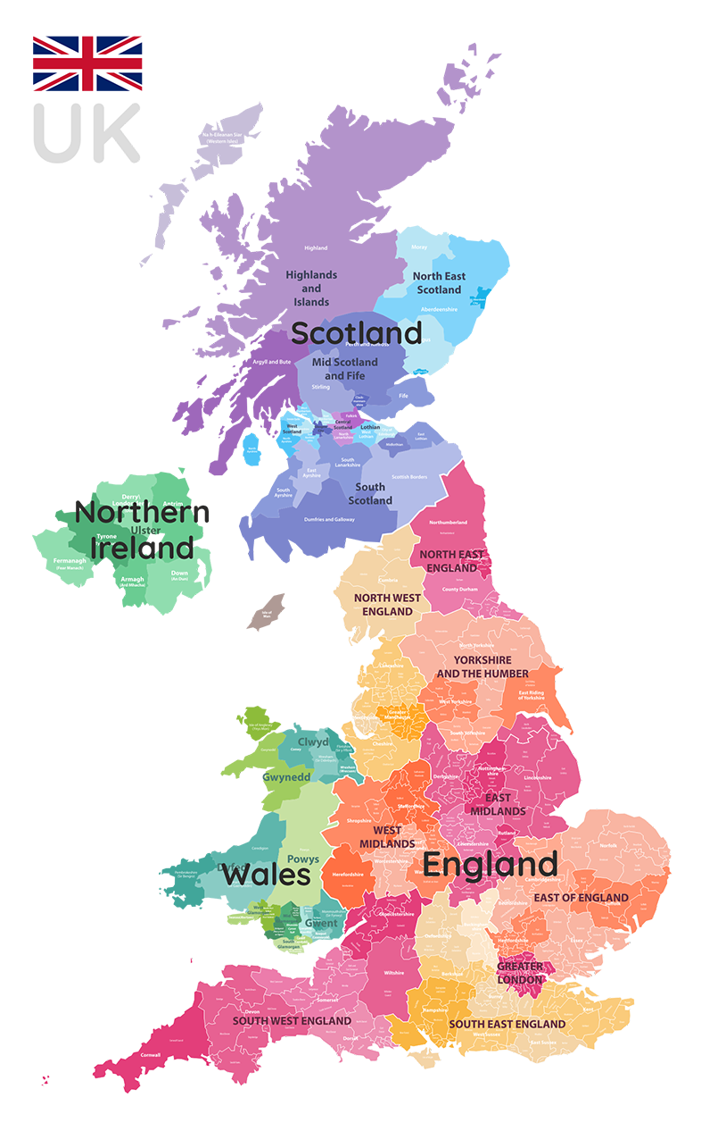
Map of the United Kingdom
1
Key Facts: United Kingdom
Capital
Popular Cities
Travel Time from India
Currency
London
London
Manchester
Sheffield
Cardiff
Birmingham
Edinburgh
Newcastle
Glasgow
Belfast
9 hours by flight (Direct)
Pound Sterling ‘£’, GBP (Great Britain Pound)
Edinburgh
Belfast
Cardiff
London
We are bringing overseas education within everyone’s reach

Slide 4
UK-India Time Difference
1
UK Time and India Time
The time difference between the UK and India varies depending on whether the UK is observing British Summer Time (BST) or Greenwich Mean Time (GMT).
During BST (Summer): India is 4 hours and 30 minutes ahead of the UK.
The UK observes Daylight Saving Time (BST) during the summer months. This means that clocks are moved forward by one hour.
As India does not observe daylight saving time, the time difference between the UK and India is reduced by one hour during the summer months when the UK is on BST.
During GMT (Winter): India is 5 hours and 30 minutes ahead of the UK.
We are bringing overseas education within everyone’s reach

Slide 5
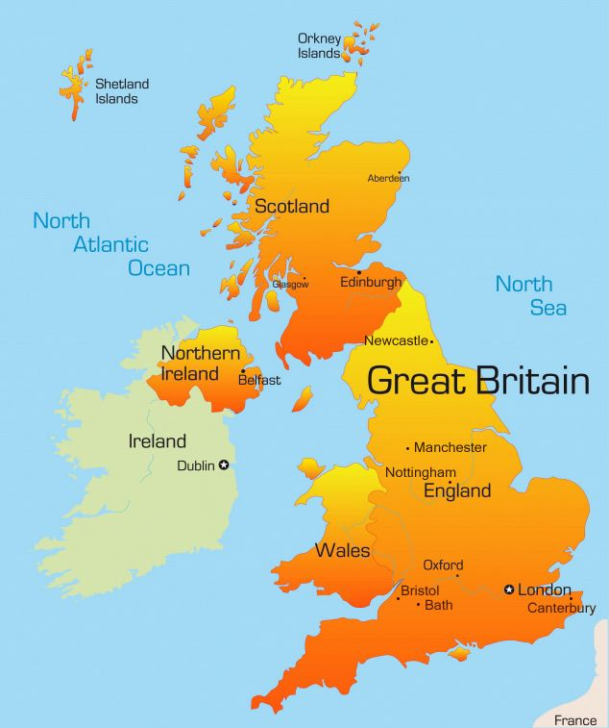
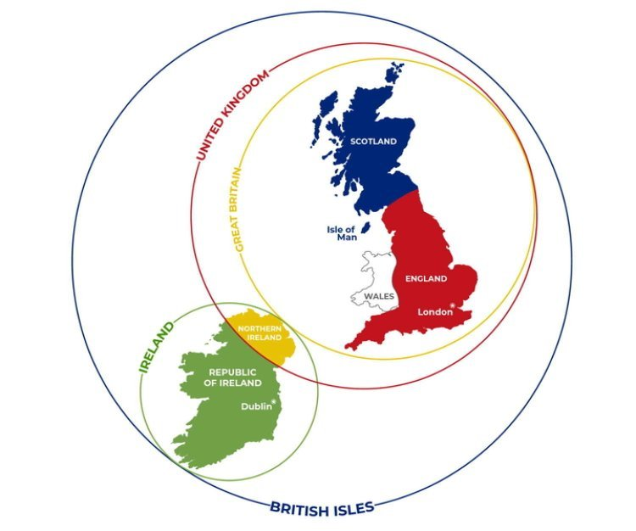
Classification of the United Kingdom
1
We are bringing overseas education within everyone’s reach

Slide 6
1
World-Class education and academic facilities.
Institutions consistently ranked amongst the best in the world.
Numerous options of specializations to study.
Admission possible without IELTS.
Affordable and value for money as course duration are short.
Scholarships and Bursaries available.
Master's courses with paid placements or internships.
Why Study in UK?
We are bringing overseas education within everyone’s reach

Slide 7
Key Points for Studying in the UK
Class Size
Teaching Methods
Financial Support
Class sizes at UK universities can vary considerably, ranging from intimate seminars with just a handful of students to large lecture halls hosting hundreds. The size often depends on the program and level of study.
UK universities are known for their emphasis on interactive teaching methods. You can expect a lot of student participation through discussions, presentations, and group work, rather than just passive lecturing.
If your studies are fully funded by a scholarship that covers all living expenses, you may not need to provide evidence of additional financial support for your student visa application.

Slide 8
Student Work Rights
1
Type of Institution | Post Graduate Degree | Undergraduate Degree | Below UG Degree Level i.e. Diploma | Student’s Dependent
Universities with Tier 4 License | Can work 20 hrs. per week during study time and full-time during holidays | Can work 20 hrs. per week during study time and full-time during holidays | Can work 10 hrs. per week during study time and full-time during holidays | Can work full time if course of student is research based at master's level with at least NQF Level 7
NOTE:- NQF Level 7 means Courses at PG Level (Masters / PG Diploma / PG Certificate).
From Jan’24 onwards, the spouse will not be able to apply for dependent VISA, for the taught Master's program.

Slide 9
Types of Universities in the UK
1
There are around 150 Universities in the UK which can broadly be classified into two categories:
Traditional Universities
Old and ancient universities also known as Red Brick Universities
Prestigious and High Ranked
Research Focused
Offering a wide variety of subjects and specializations
Ex. Durham University, University of Sheffield, University of Bristol, University of Glasgow, University of Birmingham, University of Leicester
Modern Universities
Polytechnics or other educational institutions which were given university status post 1992
Focused on applied learning rather than research with excellent industry tie-ups
Ex. Anglia Ruskin University, Coventry University, University of East London, Northumbria University, Middlesex University)
From April 2012 onwards, only Universities and Colleges having Tier 4 Sponsors License can recruit international students.
We are bringing overseas education within everyone’s reach

Slide 10
Russell Group of UK Universities
UK Rank | University | QS World Rank 2026
1 | Imperial College London | 2
2 | University of Oxford | 4
3 | University of Cambridge | 6
4 | University College London (UCL) | 9
5 | King's College London (KCL) | 31
6 | University of Edinburgh | 34
7 | University of Manchester | 35
8 | University of Bristol | 51
9 | London School of Economics (LSE) | 56
10 | University of Warwick | 74
11 | University of Birmingham | 76
12 | University of Glasgow | 79
13 | University of Leeds | 86
14 | University of Southampton | 87
15 | University of Sheffield | 92
16 | Durham University | 94
17 | University of Nottingham | 97
18 | Queen Mary University of London | 110
19 | Newcastle University | 137
20 | University of Liverpool | 147
21 | University of Exeter | 155
22 | University of York | 169
23 | Cardiff University | 181
24 | Queen's University Belfast | 199
1
RUSSELL GROUP UNIVERSITIES
The Russell Group is a self-selected association of 24 high ranked, public research universities in the UK, many of which are considered to be among the top universities in the country and the world.
The group was formed in 1994 with it’s headquarter in London.
It was established to represent its member university’s interests with the government and parliament.
These Russell Group universities are also referred to as the “British Ivy League”, similar to the Ivy League of universities in the USA which includes prestigious institutions like Harvard and Yale.
University of Bristol, University of Birmingham and University of Glasgow are some of the Russel Group universities represented by KC
We are bringing overseas education within everyone’s reach

Slide 11















Top World Ranked Non-Russell Universities
1
We are bringing overseas education within everyone’s reach

Slide 12
DURATION OF PROGRAMS
1
The biggest advantage of UK education in comparison to other educational destinations worldwide is that UK provides programs of shorter duration.
Bachelors
3 years (4 years in Scotland)
Masters
1 year ( 2 years with placement / internship also available)
Bachelors with Sandwich year
4 years ( 1 year of internship after completing the 2nd year)
Integrated Masters
4 years (5 years in Scotland)
Integrated Masters with a Sandwich Year
5 years (UG and PG Combined with 1 year of internship)
We are bringing overseas education within everyone’s reach

Slide 13
LEVEL OF PROGRAMS
1
Foundation Course and Foundation Degree
A Foundation course is a one-year preparation course for international students who need additional English language and academic preparation for entry into the first year of a Bachelor’s degree at a UK university .
A Foundation degree is a two-year combined academic and vocational qualification, equivalent to two years of a Bachelor's degree and is a stand-alone degree.
Diploma
International Year 1 (IY1 Diploma): IY1 is a one-year program for students who are not eligible for direct entry to a Bachelor’s program and it leads to 2nd year of a Bachelor's degree.
HNC: An HNC (Higher National Certificate) is a one-year course, equivalent to the first year of a bachelor's degree.
HND: An HND (Higher National Diploma) is a two-year course, equivalent to the first two years of a bachelor’s degree. This qualification can be used to gain entry into universities in the final year of a Bachelor’s degree.
Pre-Masters
A Pre-Masters program is for international students who need to improve and develop their academics, research and seminar skills ahead of a Master's degree. This course varies in length from ten weeks to twelve weeks. It offers a route to a postgraduate degree in several disciplines and is suitable for students who:
Do not meet the academic requirements for admission into a postgraduate course.
Want to change the discipline from undergraduate degree to postgraduate degree.
We are bringing overseas education within everyone’s reach

Slide 14
Entry Criteria for Pathway Courses
1
Foundation Course and Foundation Degree
Minimum 40-50% in standard 12th.
IY 1 Diploma – (Leading to 2nd year of Degree)
Minimum 50-55% in standard 12th.
Pre-Masters
Minimum 50% required in Bachelor’s degree.
IELTS Requirements
Student needs to have a UKVI IELTS for all the above-mentioned courses. (Except for Navitas & OIEG, which requires IELTS score of 5.5 with no band less than 5.5)

Slide 15
Extended Degree & Accelerated Degree
1
Extended Degree- Extended degree offer an alternative entry-route with lower entry requirements into higher education than traditional undergraduate programs. A degree with foundation year is known as Extended Degree and is usually of 4 years.
Extended Masters Degree- An Extended Masters provides a bridging route for students who don't meet the initial entry requirements for a Master's degree.
Once completed, student will progress to a Masters which usually takes a full academic year to study.
Accelerated Degree- Accelerated degrees let student fast-track their study and graduate in just two years.
Accelerated degrees (also known as two-year degrees, or three-year degrees in Scotland) are full bachelor’s degrees (undergraduate courses) student can complete in a condensed time period.
They have the same amount of course content as traditional degrees, but student will have shorter and fewer holidays so they can complete the course quicker. Course structures will vary from university to university.
We are bringing overseas education within everyone’s reach

Slide 16
Academic Year at UK Universities
Term Structure:
The UK academic year is divided into three terms, often referred to as semesters or trimesters:
• Autumn Term: September - December (10-12 weeks)
• Spring Term: January - March/April (10-12 weeks)
• Summer Term: April/May - June/July (10-12 weeks)
Breaks and Holidays:
• Each term is separated by breaks of 2-3 weeks, allowing for short holidays like Christmas and Easter.
Assessment Schedule:
• Assessments like exams and coursework are spread throughout the year, typically at the end of each term.
• This structure allows focused study periods and facilitates effective workload management.
Program length in an academic year:
• UG Programs (Typically 3 Years): Students will complete these terms for three consecutive years to earn their full undergraduate degree. Two terms in a year.
• PG Programs: PG programs, particularly Master's programs, might informally adopt a term-based approach.
• Trimester System: A program might be divided into three trimesters (around 10-12 weeks each) with assessment points spread throughout.
• Semester System: Less common, some programs might utilize a two-semester system with longer durations (around 15-20 weeks each).
We are bringing overseas education within everyone’s reach

Slide 17

Term Time in UK University
UK universities typically divide the academic year into three terms across two semesters. The first semester runs from the start of the new school year in September through the winter holidays in December. The second semester then begins in January and concludes in the summer, usually around June.
Term One (Autumn): Starts in September and ends in mid-December, with a break for the holidays.
Term Two (Spring): Runs from January to late March, with potential "reading weeks" for students to catch up on coursework.
Term Three (Summer): Takes place from April to June, leading up to the summer break.
Many universities also incorporate "reading weeks" - short breaks during the term to allow students time to focus on their studies and get caught up. This structured academic calendar provides a clear framework for students to plan their studies and activities throughout the year.
We are bringing overseas education within everyone’s reach

Slide 18

Studying in the UK: Undergraduate vs. Postgraduate
Choosing Your Path
The UK offers a vibrant academic landscape for both undergraduate and postgraduate students
Undergraduate Studies (3 years):
• Focus: Building a broad knowledge base in the chosen field.
• Learning Style: Emphasis on lectures, seminars, and a mix of assessments.
• Experience: Structured and supportive environment with a focus on foundational skills.
Postgraduate Studies (1-2 years):
• Focus: Specialization and in-depth study within a specific area.
• Learning Style: More independent learning with research projects and dissertations.
• Experience: Requires higher level of independence, time management, and advanced research skills.
Ultimately, the best choice depends on student’s learning goals and preferred academic approach.
We are bringing overseas education within everyone’s reach

Slide 19

Postgraduate Study in the UK
The UK is a top destination for postgraduate studies, offering shorter durations compared to other countries, making it an attractive option for international students.
Shorter programs: Earn a Master's degree in just 12-18 months compared to programs in other countries.
  15 Months: This is a typical duration for many taught Master's programs in the UK.
  18 Months: Some programs, particularly those with more practical components or research elements, may extend to 18 months.
However, there are important considerations around English language requirements and preparatory programs to ensure a smooth transition.
We are bringing overseas education within everyone’s reach

Slide 20
Top Up Programs & Credit Transfer
1
Top Up Programs
A Top-up degree is equivalent to the final year of a Bachelor’s degree. These one-year courses are aimed at students who have previously completed a related foundation level degree or an HND and provide a route for students to directly enter the final year of a Bachelor’s degree.
Credit Transfer
Credit transfer or advanced standing are the terms used by colleges and universities for the procedure of granting credit to a student for courses already undertaken at another institution in the same or different country.
We are bringing overseas education within everyone’s reach

Slide 21
IB & IGCSE BOARDS
1
IB (International Baccalaureate)
The International Baccalaureate (IB), formerly known as the International Baccalaureate Organization (IBO) is an internationally recognized Swiss Education board headquartered in Geneva for 10th and 12th standard students.
IB Diploma: In order to receive an IB diploma, candidates must receive a minimum of 24 points out of 45 points
IB score requirement for getting an admit to a Bachelor’s degree may range from 28 - 39 points out of 45 points depending on the ranking of universities.
IGCSE (International General Certificate of Secondary Education):
The International General Certificate of Secondary Education (IGCSE) is the international equivalent of General Certificate of Secondary Education (GCSE) UK. It is an examination which is widely accepted in the UK equivalent to O level (Ordinary level) or 10th standard.
Grading is done from A- G.
GCSEs and IGCSEs lead on to A levels (Advanced) equivalent to 12th standard. In the UK, A levels are the standard qualification for applying to a university.
We are bringing overseas education within everyone’s reach

Slide 22
Masters of Business Administration
1
TYPES OF MBA
Fresher’s MBA
MBA for students having work experience
Mature Entry MBA
FRESHER’S MBA
Recent graduates with no work experience can apply for an MBA for freshers
MBA FOR STUDENTS HAVING WORK EXPERIENCE
Students with a Bachelor’s degree and work experience of 2 to 5 years can apply for these MBA courses
MATURE ENTRY MBA
Students who do not have a formal Bachelor’s degree qualification can still pursue an MBA in the UK
The entry requirement for such students is
Pass in Standard 12
Students age should be minimum of 25 years
Work experience of at least 7+ years at managerial level
We are bringing overseas education within everyone’s reach

Slide 23
Learning at UK Universities: Lectures and Seminars
Lectures:
• In-depth Knowledge: Delivered by expert academics, lectures provide a foundation in your chosen subject through research, insights, and key concepts.
• Large or Online Settings: Lectures can take place in large halls or online platforms, offering flexibility and diverse learning experiences.
• Active Note-Taking: While participation isn't always required, taking detailed notes is key to grasping complex topics:
Seminars:
• Interactive Discussions: Explore lecture content in smaller groups with classmates. Share ideas, ask questions, and gain different perspectives.
• Active Engagement: Seminars encourage active participation through tasks like presentations, discussions, or answering questions.
• Collaboration & Exploration: These sessions create a safe space to dive deeper into the material, collaborate with peers, and ask questions freely.
Combined, lectures and seminars provide a comprehensive learning experience at UK universities.
We are bringing overseas education within everyone’s reach

Slide 24


Assessment at UK Universities
UK universities utilize diverse assessment methods to evaluate the understanding of the course material.
• Coursework & Exams: These test the knowledge and analytical skills through essays, reports, presentations, and various types of examinations.
• Program Requirements: Credit requirements vary depending on the program level. Undergraduate programs typically require 120 credits per year, reaching 360 credits for a full honours degree (three years). Postgraduate programs may require 180 credits total, often completed within 1-2 years.
• Rigorous Evaluation: Students work is meticulously marked and moderated to ensure fair and consistent assessment across the program.
• Preparation is Key: Student will receive ample notice about assessment details, allowing you to prepare effectively.
We are bringing overseas education within everyone’s reach

Slide 25

How UK Grades Work
Earning the Degree:
The final UK university degree classification is determined by the marks students receive throughout their studies.
• Modules and Credits: Each course is broken down into modules, each worth a specific number of credits.
• Weighted Marks: Modules with more credits contribute more to your overall grade for a particular year (stage) of study.
• Focus on Core Modules: Strong performance in core modules with higher credit value will significantly impact the final degree classification.
First Year (Stage One):
• Marks from the first year typically don't count towards the final degree classification.
• This allows time to adjust to university-level studies, develop academic skills, and prepare for the crucial "Honours stages."
Final Degree Calculation:
• The final degree classification is based on the combined marks from Stages Two and Three of the studies.
• Certain postgraduate programs, like research degrees (PhDs), may have a separate dissertation or thesis component that significantly impacts the final classification.
We are bringing overseas education within everyone’s reach

Slide 26
INTAKES
1
UK Universities have two major intakes
September / October – Fall Intake
January / February – Spring Intake
However, many universities offer courses commencing in
April/ May/ June/ July – Mid Intake
We are bringing overseas education within everyone’s reach

Slide 27
ENGLISH LANGUAGE REQUIREMENTS
1
In general, the English Language requirement as per UKVI is CEFR (Common European Framework of Reference for Languages) Level B2 which is equivalent to a minimum 5.5 overall with 5.5 in each section in IELTS.
Types of English tests accepted
Applicants must achieve this level of English by completing a successful ‘Secure English Language Test’ or SELT.
English Language Test which are accepted in UK are IELTS, PTE, TOEFL and many more.
Which English language test is accepted in UK?
For entry to University programmes students would be required to take the Academic IELTS test. If students want to take a pre-sessional English course or a Foundation course, they must take the IELTS test at an approved UK Visas and Immigration (UKVI) test center.
IELTS waiver is available in many of the universities if the student has secured more than 65% - 70% marks in 12th Standard English.
Pre-Sessional English Language program is also offered for students who do not meet the IELTS requirements of a particular course at a University.
We are bringing overseas education within everyone’s reach

Slide 28
ENGLISH LANGUAGE REQUIREMENTS
1
SELT (Secure English Level Test) is required for students seeking to study, work, and live in the UK.
It is used by students applying for tier 1, 2, and 4 visas for short courses and pathway programs. Various platforms administer this test at authorized testing centers for immigration and visas to the UK worldwide.
A variety of sections are included in the test, such as Reading, Writing, Listening, and Spoken English, to determine your level of English proficiency.
UKVI PTE is also an approved SELT for UK Visa
Below is the conversion chart for IELTS scores equivalent to TOEFL and PTE scores:
CEFR Level | IELTS | PTE | TOEFL
C2 | 8.5 | 80 | 117
C1 | 7.0 – 8.0 | 67 – 79 | 96
B2 | 5.5 – 6.5 | 51 – 66 | 92
B1 | 4.0 – 5.0 | 36 – 50 | 62
We are bringing overseas education within everyone’s reach

Slide 29
Entry Criteria for Bachelor’s
1
Type of University | Entry Requirements
High Ranked Universities | 70% & above in 12th Standard
Middle Ranked Universities | 60%-70% in 12th Standard
Low Ranked Universities | 55% - 60% in 12th Standard
Subject specific Requirement:
For Engineering degrees, a score of 60% - 85% is required in Mathematics and Physics in 12th Standard depending on the university.
For Business degrees a score of 55% - 85% is required in Mathematics depending on the University and other relevant subjects in 12th standard with few exceptions where the Mathematics score in 10th Standard is considered.
Similarly, for other degrees minimum subject specific scores may be required in 12th Standard.
IELTS Requirements
IELTS requirement ranges from 6.0 / 6.5 with no band less than 5.5 depending upon the course and the University.
We are bringing overseas education within everyone’s reach

Slide 30
Entry Criteria for Master’s
1
Type of University | Entry Requirements
High Ranked Universities | 60% & above in Bachelors
Middle Ranked Universities | 55-60% in Bachelors
Low Ranked Universities | 50-55% in Bachelors
IELTS Requirements
IELTS requirement ranges from 6.0 / 6.5 with no band less than 5.5 depending upon the course and the University.
Some UK Universities also accepts MOI –Medium of Instruction from graduating University to waive off the IELTS. MOI is not accepted to waive off IELTS for Bachelors.
We are bringing overseas education within everyone’s reach

Slide 31
UCAS
1
The Universities and Colleges Admissions Service is a UK-based organization whose main role is to operate the application process for British universities.
It is a common application portal majorly for undergraduate applications and some postgraduate one’s as well.
The single application fee will no longer be available so the fee for all 2026 undergraduate applications will be £28.95
The deadline to submit applications is 14th January and 30th June for the upcoming September intake of a calendar year.
Following are some of our partnered universities whose applications need to be done through UCAS:
University of Bristol (UG)
University of Glasgow (UG)
University of Birmingham (UG)
Newcastle University (UG)
Queen Mary University (UG)
University of Bradford (UG)
University of Surrey (UG)
University of Stirling (UG)
Heriot Watt University (UG)
University of Liverpool (UG)
University of Leicester (UG)
University of Strathclyde (UG)
University of Salford (UG)
Brunel University (UG)
Kingston University (UG)
We are bringing overseas education within everyone’s reach

Slide 32
Undergraduate Entry Requirements
1
UK A Level Grading- Indian Equivalence
UK Requirement (A-level) | ICSE/CBSE/ ISC Boards | West Bengal Board | Other Boards
 | Standard XII equivalent
A*AA | 90% | 80% | 92%
AAA | 85% | 75% | 90%
AAB | 80% | 70% | 85%
ABB | 75% | 65% | 80%
BBB | 70% | 60% | 75%
O Level | GCSE | 10th
A Level | GCE | 12th
AS Level | - | 11th
We are bringing overseas education within everyone’s reach

Slide 33
Postgraduate Entry Requirements
1
UK UG Level Grading- Indian Equivalence
Grades in UK University | Indian Equivalent Grade
2:1 | 60% or 65% in Degree
2:2 | 55% or 60% in Degree
First Class Degree | 65% or 70%
Requirements
The Entry requirements may slightly change from course to course and university to university.
For Delhi University, Mumbai University, Pune University and Calcutta University, some relaxations in entry requirements is possible.
We are bringing overseas education within everyone’s reach

Slide 34








Time Schedule for UK for September Intake
1
IELTS Coaching
February
Give IELTS Exam
IELTS Results
Applications
Start of March
End of March
Jan to April
Prepare & Apply for VISA
CAS Request
Offer Letters
April Onwards
February to June
July, August
Fly to UK
September
We are bringing overseas education within everyone’s reach

Slide 35
Time Schedule for UK for January Intake
1
IELTS Coaching
May, June
Give IELTS Exam
IELTS Results
Applications
Start of July
End of July
July to October
Prepare & Apply for VISA
CAS Request
Offer Letters
October Onwards
August to November
November, December
Fly to UK
January
We are bringing overseas education within everyone’s reach

Slide 36
Cost to study in the UK (In London)
1
Estimated cost to be incurred by a student for a year of study | 1 £ = INR 125/- (Approx.)
Particulars | Amount in £ | Amount in Rs.
Exam Fees (IELTS- General/ Academic) |  | 19,000 (For UKVI IELTS 19,250)
Tuition Fees | 17,000 | 21,25,000
Living Cost (In London) | 13,761 | 17,20,125
Visa Fees | 558 | 69,750(approx.)
National Health Service (£776 per year + £388) | 1164 | 1,45,500
Total |  | 40,79,375
Less Part Time & Vacation Earnings | 10,000 | 11,60,000
Net Cost |  | 29,19,375
Assistantships/Scholarships | Yes
Nature of Part Time Jobs | Off campus 20 hrs. per week During Vacation 40 hrs. per week
We are bringing overseas education within everyone’s reach

Slide 37
Cost to study in the UK (Outside London)
1
Estimated cost to be incurred by a student for a year of study | 1 £ = INR 116/- (Approx.)
Particulars | Amount in £ | Amount in Rs.
Exam Fees (IELTS- General/ Academic) |  | 19,000 (For UKVI IELTS 19,250)
Tuition Fees | 17,000 | 21,25,000
Living Cost (Outside London) | 10,539 | 13,17,375
Visa Fees | 558 | 69,750(approx.)
National Health Service (£776 per year + £388) | 1164 | 1,45,500
Total |  | 36,76,625
Less Part Time & Vacation Earnings | 10,000 | 11,60,000
Net Cost |  | 25,16,625
Assistantships/Scholarships | Yes
Nature of Part Time Jobs | Off campus 20 hrs. per week During Vacation 40 hrs. per week
We are bringing overseas education within everyone’s reach

Slide 38

Financial Requirement for UK Student Visa
We are bringing overseas education within everyone’s reach

Slide 39
Acceptable Funds
Self Funded & Parents
Fixed Deposits and Funds in Savings Bank accounts are the only acceptable modes.
28 days of maturity are required
Avoid showing recent large deposits
Education Loans
Loans from nationalized or private sector banks.
A guarantor or Collateral Security is required.
Education loan sanction letter on bank’s letterhead with bank’s contact details mentioned
Loan should be a part of the “Education Loan Scheme”.
Funds to be shown
Remaining Tuition fees of First Year of Study
Living Expenses for 9 months
Living Expenses
Inside
London
Starting from November 11, 2025
Outside
London
Starting from November 11, 2025
£13,761 (£1529 x 9 months)
£ 10,539 (£1171 x 9 months)
https://www.ukcisa.org.uk/news/student-update-changes-to-the-student-and-graduate-rules/
We are bringing overseas education within everyone’s reach

Slide 40

Source of Funds
Explanation of major receipts into the account by providing necessary evidence.
If applicant is taking loan, please confirm the collateral (Recent FD or Property) used for this loan.
If the student or student’s sponsors have Fixed Deposits that were prepared recently, then the student may have to submit source of funds for these FDs.
If there have been any major recent deposits in the sponsors’ savings accounts in the last 28 days, then they may require to submit sources of these deposits.
Some acceptable sources of recent funds:
Liquidating shares or mutual funds
Transferring funds from cooperative banks to acceptable financial institutions (e.g., nationalized banks)
Liquidating an old Fixed Deposit (more than 5-6 months old) and depositing the amount in a savings account.
Sale of immovable property the transaction should be tally with the cheque not given in the sale deed (supported by sale deed and valuation report of the property)
Transferring funds from Provident Fund Accounts (GPF/PPF)
Transfer of funds from Post Office Account to acceptable Banks
Agricultural sale bill, and deposit date and amount should corelate with sale bill, J-Forms
We are bringing overseas education within everyone’s reach

Slide 41

Acceptable Financial Documents
Once we received payment confirmation of student. This has been shared with the university in appropriate way. The required financial documents to us must be prepared using the following guidelines, Students also required to undergo a TB test from a panel physician, a list of which is available for your reference.
Funds must be 28 days old if they are in the form of savings or fixed deposit
Funds should be in the name of student or student’s parents (sponsors any other than these, such as grandparents, uncle/aunt, siblings, etc. are strictly not allowed)
If funds are available in the parents’ account, then a ‘Parent Consent Letter’ (format attached) and birth certificate of the applicant must be submitted
Following types of funds are accepted for UK student visa lodgement
  Education Loan or / and
  Saving Account or/ and
  Fixed Deposits
Self Funded & Parents (Fixed Deposits and Funds in Savings Bank Account are the only acceptable modes).
Education Loans: Loan from nationalized or private sector banks. A guarantor or Collateral Security is required. Interest rates are low, and repayment begins after completion of program.
Employment: Current immigration regulations permit students to work part-time 20 hours a week during study time and 40 hours a week during vacation.
Scholarships: Students also receive scholarships depending on academic achievements and the overall profile.
We are bringing overseas education within everyone’s reach

Slide 42
NOT-Acceptable Financial Documents
Funds kept in the bank which is not RBI regulated or do not maintain their records electronically.
FD and saving accounts which are lien marked, and loan taken against this accounts.
Bank statements electronic print outs but which are not on letter head, if not on letter-head then it MUST be supported by the balance certificate which is provided on the letter head with the logo, address of the bank on it along with the seal and signature from the bank officer.
Conditional Education loan sanctioned letter.
Any of the following is not accepted:
  Bank accounts with the post-office
  RD account
  PPF account
  Invest in share bond
  Gold loan, Crop loan, Mortgage loan
  Overdraft facility
  Loan against FD
We are bringing overseas education within everyone’s reach

Slide 43
When student do not need to prove that they have funds:
Student do not need to prove the financial requirement to meet living expenses if:
student had a UK visa for 12 months prior to the date of your Student visa application -you must currently be in the UK
student applying as a student union sabbatical officer
student applying as a postgraduate doctor or dentist on a recognised foundation programme
We are bringing overseas education within everyone’s reach

Slide 44

New UK Graduate Immigration Route
Key Aspects You Need to Know

Slide 45

Post Study Work Visa: New UK Graduate Immigration Route
1
UK has re-introduced a Post Study Work Visa of 2 years after completing a Bachelors or Masters course.
Students who will complete their degrees after June 2021 will be eligible for the Post Study Work Visa.
We are bringing overseas education within everyone’s reach

Slide 46
Eligibility Criteria to apply for the Graduate Route
1
To apply for UK Graduate Immigration Route, international students must meet the following criteria:
One must have completed the qualification mentioned on one’s Confirmation of Acceptance for Studies (CAS) at Bachelor, Master's, or Doctorate level.
One must have a valid Tier 4 or student visa required to study at UK at the time of lodging the graduate route application.
How long you can stay? A Graduate visa lasts for 2 years. If you have a PhD or other doctoral qualification, it will last for 3 years
A Graduate visa gives a permission to stay in the UK for at least 2 years after successfully completing a course in the UK.
Student must be in the UK when they apply.
If Visa application is submitted on or after January 1, 2027, the validity periods are:
Bachelor’s or Master’s graduates: Reduced to 18 months.
PhD or other doctoral graduates: Remains 3 years.
We are bringing overseas education within everyone’s reach

Slide 47
Fees for the Graduate Route
1
At the time of applying for the UK Graduate Route, graduates will be required to pay the Immigration Health Surcharge along with the fees for a graduate route as a part of the application process. Check out the fees below:
Graduate Route: £937 application fee (from 8th Apr.2026)
Immigration Health Surcharge: £1,035 per year
Healthcare Surcharge
If you’re eligible for a Graduate visa for:
2 years - it will cost £2,070
3 years - it will cost £3,105
18 Months- it will cost £1152.50
*From 1st January 2024, International students will only be able to bring dependents if they are government-sponsored or are studying for a Ph. D., doctorate, or a research-based higher degree. Dependents who are already in the United Kingdom can still extend their leave if they are eligible to do so.
We are bringing overseas education within everyone’s reach

Slide 48
1
6 Easy Steps to Apply for the UK Graduate Route
Start Your Application
Visit https://www.gov.uk/graduate-visa/apply
and create a UK Visa and Immigration account.
1
Verify Your Identity :
Verify the identity using ‘The UK Immigration ID Check App’ on your phone or laptop.
2
Fill in all the Asked Details in the Application
Fill the form by inserting all the details about one’s educational qualification, family, travel history, and other required details.
3
Attach Documents
Attach the required documents and tick the checklist boxes.
4
Declaration
Tick on the declaration box and proceed further with the payment.
5
Do the Payment
Time to pay the graduate route fee of £880 and health surcharge of £1035.
6
We are bringing overseas education within everyone’s reach

Slide 49
Ranking of UK Universities
1
Ranking of UK universities can be determined by referring to the following
QS World Ranking
https://www.topuniversities.com/world-university-rankings
Guardian League Table
https://www.theguardian.com/education/ng-interactive/2025/sep/13/the-guardian-university-guide-2026-the-rankings
Times Good Rankings
https://www.timeshighereducation.com/world-university-rankings/latest/world-ranking
We are bringing overseas education within everyone’s reach

Slide 50

Any Questions

