Slide 1


New Zealand

Slide 2
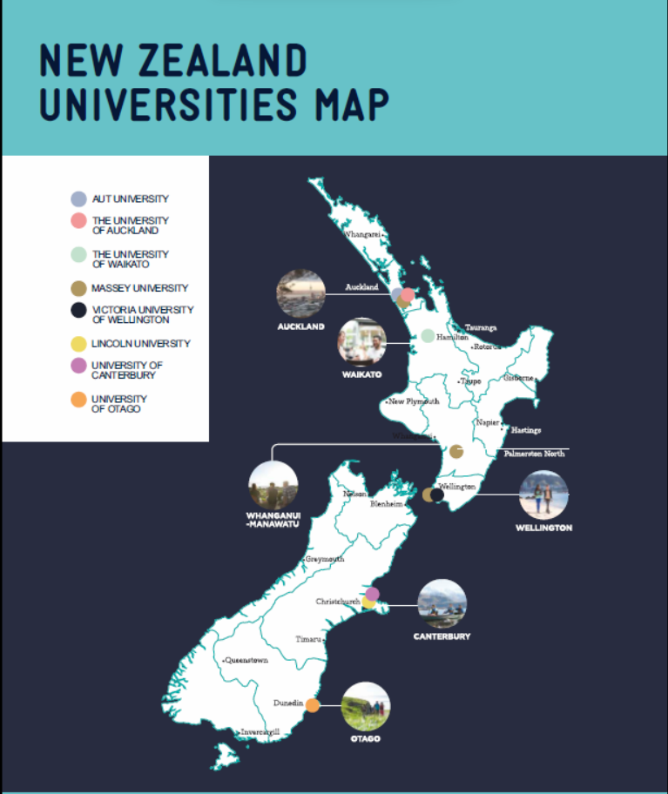
Map of New Zealand

Slide 3
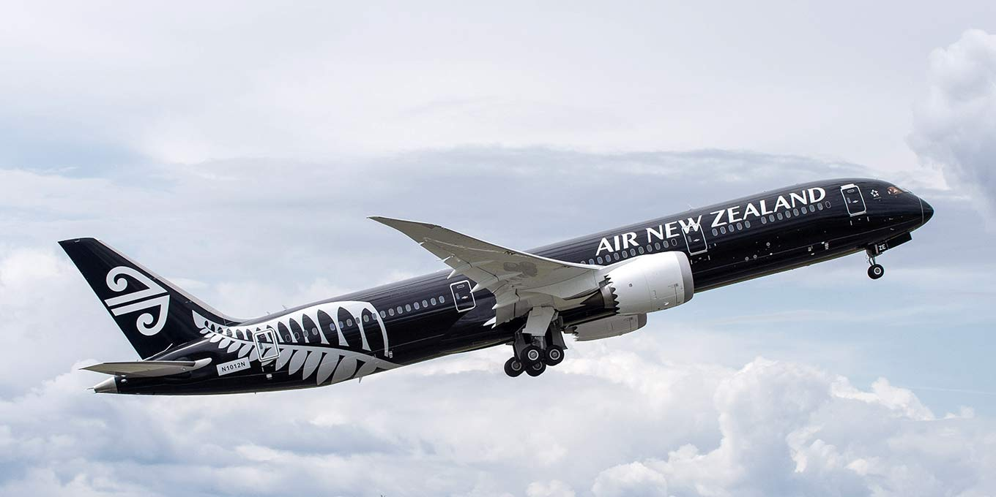
Travel Time from India to New Zealand
Average travel time from New Delhi/Mumbai to Auckland is 16 hours 30 mins

Slide 4
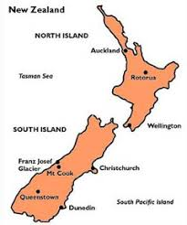

Facts about New Zealand
New Zealand is located in the Southwest Pacific Ocean and consists of two main Islands, the North Island and South Island which are separated by the Cook Strait.
Capital of New Zealand is Wellington but the most popular and happening city is Auckland.
The total population of New Zealand is approximately 5 Million while the population of Auckland is 1.7 Million. Hence one third of New Zealand's total population resides in Auckland.
The official languages of New Zealand are English and Maori.

Slide 5

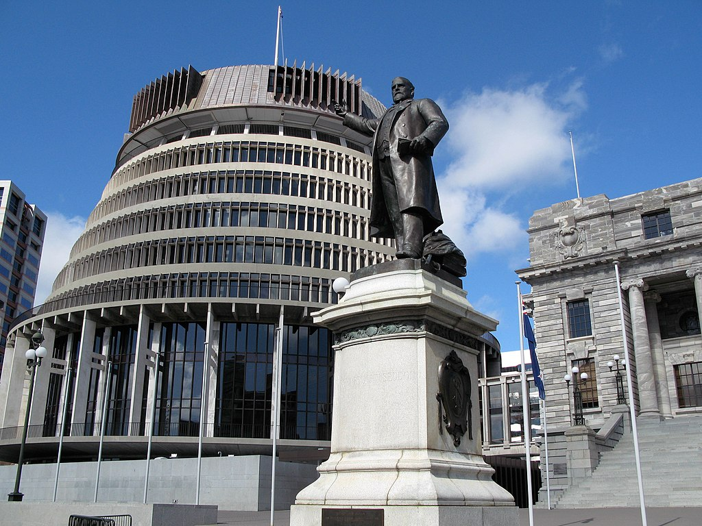
Why Study in New Zealand?
British based education system
International reputation as a provider of quality education
Lenient admission requirements
15 years of education is acceptable
Warm and welcoming environment.
Up to 3 years Open Post-study Work Visa.
PR (Permanent Residency) opportunity.

Slide 6
All the New Zealand Universities are ranked in the Top 500 as per the QS world ranking 2025
New Zealand is the fourth-most peaceful country worldwide, as per Global Peace Index 2024
Official languages of New Zealand are English and Māori
Students can work during holidays. The min. wage rate is NZD20 hours/week part time during classes and 40 hours/week Popular Programs offered 23.15 per hour

Slide 7

Popular Programs
Science
Nursing
Health Sciences
Civil Engineering
Engineering
Tourism and Hospitality
Business & Commerce
Management
Digital Business
Supply Chain and Logistics

Slide 8



Types of Educational Institutions
Institutes of Technology
and Polytechnics (ITP’s)
Private Tertiary and
Training Establishments
Universities

Slide 9








Some popular Universities in New Zealand

Slide 10







Institutes of Technology and Polytechnics

Slide 11






Institutes of Technology and Polytechnics

Slide 12

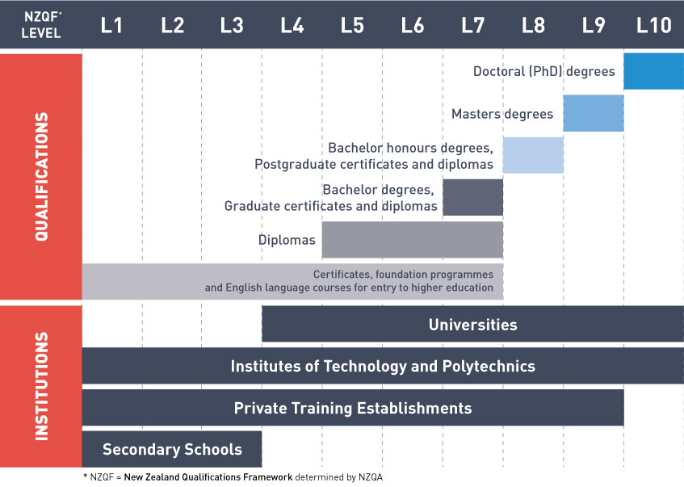
The Education System

Slide 13

Intakes and Deadlines
There are generally two Intakes in New Zealand: February and July
However, ITPs and Private Institutes have multiple Intakes for different courses
Hence, practically there is an intake almost every month in some or the other institution resulting in recruitment throughout the year
There is no deadline as such in New Zealand, but it is recommended to make applications at least 6 months prior to the start date to avoid last-moment hassles

Slide 14
Entry Requirements – Universities
Sr. No. | Name of University | Bachelor Degree (3 years) | Graduate Diploma (1 year) | PG Diploma (1 year) | Master Degree (1-2 years)
1 | University of Auckland | 75% & above in std. 12 | 55% and above | 60% and above | 60 - 65% and above
2 | University of Waikato | 75% & above in std. 12 | 55% and above | 60% and above | 60 - 65% and above
3 | University of Canterbury | 75% & above in std. 12 | 55% and above (As per NOOSR guidelines) | 55-60% and above (As per NOOSR guidelines) | 60-75% and above (As per NOOSR guidelines)
4 | Lincoln University | 75% & above in std. 12 | 55% and above | 60% and above | 60 - 65% and above
5 | Auckland University of Technology | 75% & above in std. 12 | 55% and above | 60% and above | 60 - 65% and above
6 | Victoria University of Wellington | 75% & above in std. 12 | 55% and above | 60% and above | 60 - 65% and above

Slide 15

Entry requirements for ITPs
2 Years UG Diploma – 50 – 55% in 12th Standard
Bachelor Degree (3 years) 60% and above in 12th Standard
Graduate Diploma (1 year) – 50% and above in Bachelor Degree
PG Diploma (1 year) - 60% and above in Bachelor Degree
Masters Degree (1-2 years) – 65% and above in Bachelor Degree

Slide 16
English Proficiency Requirements
Qualification | IELTS requirement
Undergraduate Diploma - Level 6 | 6.0 with no band less than 5.5
Bachelors - Level 7 | 6.0 with no band less than 5.5
Graduate Diplomas - Level 7 | 6.0 with no band less than 5.5
Postgraduate Diplomas - Level 8 | 6.5 with no band less than 6.0
Masters – Level 9 | 6.5 with no band less than 6.0
Note: IELTS requirements may be higher for certain areas of study like Nursing, Teaching and Law.

Slide 17

Student Work Rights
Eligible students can work up to 20 hours in any given week during study time and 40 hours during holidays.
Students undertaking a course of 12 months or more may work full-time during the holidays.
The spouse of a student is eligible to work full time for the duration of the study course, only if the student is studying a full-time course of Level 7 or 8 in areas as specified in the Long-Term Skill Shortage List/Green List. However, partners of students on study course of Level 9 and above can work full time without any such condition.

Slide 18
Duration of Post Study Work Visa
Qualification | Post study work visa duration
Undergraduate Diploma - Level 5 & 6 and Graduate Diploma Level 7 | Duration of program (If the qualification is linked to an occupation on the Green List)
Bachelors - Level 7 | 3 Years
Postgraduate Diplomas - Level 8 | 1 Year
Masters – Level 9 | 3 Years
PhD – Level 10 | 3 Years

Slide 19
Cost of Education
Particulars | For Diploma in INR | For Masters in INR
IELTS Coaching | 5,050 | 5,050
IELTS Exam Fees | 18,000 | 18,000
Tuition Fees per year | 15,00,000 | 18,00,000
Living Costs per year | 10,00,000 | 10,00,000
Airfare from India to New Zealand | 50,000 | 50,000
Total Expenses | 25,73,050 | 28,73,050
Less Part Time Earning (Approx.) (minimum wage rate NZD 23.15 equivalent to INR 1204 per hour) | 9,80,000 | 9,80,000
Net Cost | 15,93,050 | 18,93,050
Duration of Part Time Jobs | 20 hrs. per week during study time and 40 hrs. per week during vacations
Total expenses to be incurred approx. | 16 lacs | 19 lacs
1 NZ$ = Rs. 52/- approx.

Slide 20

Scholarships in New Zealand
University scholarships are offered on a limited basis and are awarded based on the student’s academic and extracurricular profile.

Slide 21

Popular Scholarships in New Zealand
Education New Zealand – Manaaki Scholarships
  Full Scholarship for Tuition fees and Living Expenses
University of Auckland India High Achievers Scholarship
  Upto NZD 20,000 towards tuition fee
University of Waikato International Excellence Scholarship
  Up to NZ$10,000 towards tuition fees
AUT International Scholarships – South Asia
  Upto NZD 7,000 towards tuition fee
University of Otago - Vice-Chancellor's Scholarships for International Students -
  Upto NZD 15,000 towards tuition fee
Victoria Tongarewa Scholarship
  NZD 5,000 or 10,000
Wellington International Excellence Scholarship
  NZD 20,000 over three years paid towards tuition fees.

Slide 22
Average range of fees per annum
University | NZD | INR
Diplomas | $25,000 - $33,000 | 12.50 lacs to 16.50 lacs
Bachelors | $25,000 - $40,000 | 12.50 lacs to 20 lacs
Bachelors of Engineering in University | $40,000 | 20 lacs
Graduate Diplomas | $25,000 - $30,000 | 12.50 lacs to 15 lacs
Masters | $30,000 - $55,000 | 15 lacs to 27.50 lacs
ITPs | NZD | INR
Diplomas | $17,000 - $20,000 | 8.50 lacs to 10 lacs
Bachelors | $18,000 - $22,000 | 9 lacs to 11 lacs
Masters | $19,000 - $25,000 | 9.5 lacs to 12.50 lacs
1 NZ$ = Rs. 52/- approx.

Slide 23
Courses offered with Internships
Sr. No. | Institution | Course | Internship | Intakes
1 | University of Waikato | Master of Digital Business (Level 9) | 8-13 weeks of internship | February & July
2 | PIHMS, New Plymouth | Postgraduate Diploma in Hotel Management (Level 8) | 40 weeks study + 6 months paid internship | February, April, July & September
3 | Ara Institute of Canterbury, Christchurch | All Graduate Diplomas (Level 7) | 12 months course includes estimated 450 hours of internship | February & July
4 | WITT, New Plymouth | Diploma in Professional Cookery (Level 5) | 18 months course includes 100 hours internship | February, July & October

Slide 24
Chart for Comparison of Scores of IELTS/TOEFL iBT/PTE
Program Level | IELTS test | TOEFL Internet-based (iBT) | Pearson Test of English (Academic)
Diploma at Level 6 | Academic score of 6.0 with no band lower than 5.5 | Score of 79 (with a writing score of 20) | PTE (Academic) score of 51
Bachelor Degree at Level 7
Graduate Diploma at Level 7
Bachelor Honours Degree at Level 8 | Academic score of 6.5 with no band lower than 6.0 | Score of 90 (with a writing score of 21) | PTE (Academic) score of 59
Post-graduate Diploma Level 8
Masters Degree at Level 9
Doctoral Degree at Level 10

Slide 25

Application & Visa Process

Slide 26
Application & Visa Process
Application is received on Course Finder
Accept the Offer once received
Pendency if any will be intimated through comments section of Course Finder for completion
Application will be reviewed
Arrange the finances and visa documents
Visa will applied by KC HO
Application will be processed by KC if and when complete
Receive Approval in Principle (AIP)
Any further shortcomings as per institution will be communicated to partner associate for compliance, else the decision will be received between 7-30 days
Transfer tuition fees to institution and provide evidence of transfer of funds
Open an FTS account with ANZ bank and transfer the Living expenses
Get E-visa

Slide 27

NZ Application Process
• Calculate the exact aggregate academic percentage of the last education of the student.
• Check the original academic mark sheets and IELTS score card of the student.
• Check the entry requirements for the particular course from the Course Finder/ website
of the University/Polytechnic.
• Upload the signed application form of the institution where applicable on the
Course Finder.
• Provide scanned copy of all the necessary documents required for application
through Course Finder.

Slide 28
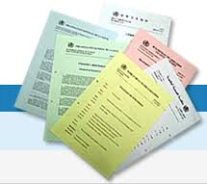
Documents required and their presentation order
• Signed application form if applicable.
• Resume.
• A Statement of purpose (For Masters and PG Diploma only).
•
2 Letters of Recommendation (for Masters and PG Diploma only) and work
experience if any.
• IELTS, TOEFL or PTE score card.
• Duly attested degree/provisional/completion certificate and all the marksheets
of Bachelors.
• Duly attested passing certificates and marksheets of 12th std. and 10th std.
• If the 10th or 12th mark sheets contain only the subject codes, subject key
should be provided as well.
• Copy of Passport (First and last page).

Slide 29

New Zealand Student Visa

Slide 30
Winning Profile for Visa
Good academic record - 60% and above aggregate in Class 10th and 12th and over 50% aggregate in subsequent tertiary qualification with minimal backlogs, if any
IELTS score or equivalent score of TOEFL or PTE as per NZQA requirement
Student’s immediate family’s verifiable evidence of funds to meet the Educational and living expenses in NZ - including paper trail to explain any recent high value deposits in accounts
Verifiable evidence of regular source of sufficient income of financial sponsors/guarantors
Intended course of study relevant to qualifications and/or work experience which shows logical progression
Meet health and character requirements

Slide 31

Funds requirement for New Zealand Student Visa
If the course duration is less than or equal to one academic year, then provide documentary evidence of funds for tuition fee for the entire course duration + NZ$ 20,000 towards living expenses in New Zealand + NZ$ 2,000 for airfare
If the course duration is longer than one academic year, then provide
documentary evidence of funds for tuition fee for 1 academic year + NZ$ 20,000 per annum towards living expenses in New Zealand + NZ$ 2,000 for airfare and a payment plan to show the student has access to funds and has ability to meet the rest of the course cost and living expenses in New Zealand

Slide 32

Documents for Student Visa
• Completed application forms and supplementary information form.
• Visa application fee (Online- 850 NZD)
• Original passport
• Covering letter & SOP
• Financial documents
• Affidavit of support from sponsor
• Evidence of English language ability - IELTS/TOEFL/PTE score card
• E-Medicals acknowledgement of medical test from empanelled doctor which should not be more than 3 months old
• Original police clearance certificate(must be less than 6 months old at the time of visa filing)

Slide 33

Acceptable Evidence of Funds
Education Loan sanction letter from nationalised or multi nationalised bank
Latest bank account statements for the past 3 months. It should not be more than one week old at the time of lodgement of application
Fixed deposits copy and balance certificate from bank
PPF/ PF/ GPF withdrawable amount
**Parents and only immediate relatives (blood relations) should ideally sponsor the student, Only ONE sponsor will be acceptable
**The funds should be at least three months old (with source). If recent funds are to be shown, then documentary evidence in support of every instance of recent deposits should be provided.
** Evidence of source of income of the student’s financial sponsor to be provided.

Slide 34

Payment Plan
Form 16 of the sponsor showing income and saving patterns
EPF or GPF accumulated over a period of 1 year
LIC due for maturity in the following year.
* Please note that Immigration New Zealand (INZ) does not accept land documents
and/or property valuation as payment plan.

Slide 35
Suggestive tips for Student Visa
In the recent past, we have observed that New Zealand Immigration is conducting Telephonic interviews and student visas are refused in many cases.
We have identified major reasons for visa refusal of the students.
Not having sufficient knowledge about the Course/ Institution applied.
Lack of clarity regarding future plans.
Discrepancies in work experience letter/details provided by the student and as cross verified by the visa officer during telephonic verification with the employer.
Funds that could not be verified.
Not mentioning name of primary agent.

Slide 36
Suggestive tips for Student Visa
To minimize visa refusals, please take care of the following points:
Ask the student to go through the contents of the course and website of the institution to get detailed information about the course/institution applied.
Make the student prepare the answers of various questions which he/she should be aware of and which may be asked by the visa officer during the interview.
Ask the student to make his/her future plans i.e. what he/she will be doing after completion of the course (Short term and Long term).
Verify the work experience of the student at your end before submitting the same to New Zealand Immigration to check the genuineness and authenticity of the same.
Co-ordinate with the employer to avoid mismatch of the information during cross verification by visa officer.
Students should co-ordinate with the banks of sponsors to ensure emails or calls made from INZ to verify funds are promptly and appropriately addressed.

Slide 37

NZ High Commission
New Delhi: New Zealand High Commission
Sir Edmund Hillary Marg Chanakyapuri
New Delhi 110 021
Chennai: Honorary Consulate for New Zealand
Maithri, 132 Cathedral Road
Chennai 600 086
Student visa applications are processed in New Zealand. The current average processing time is between four to eight weeks depending on the level of verification and assessment required. Hence please encourage students to apply well in time.

Slide 38
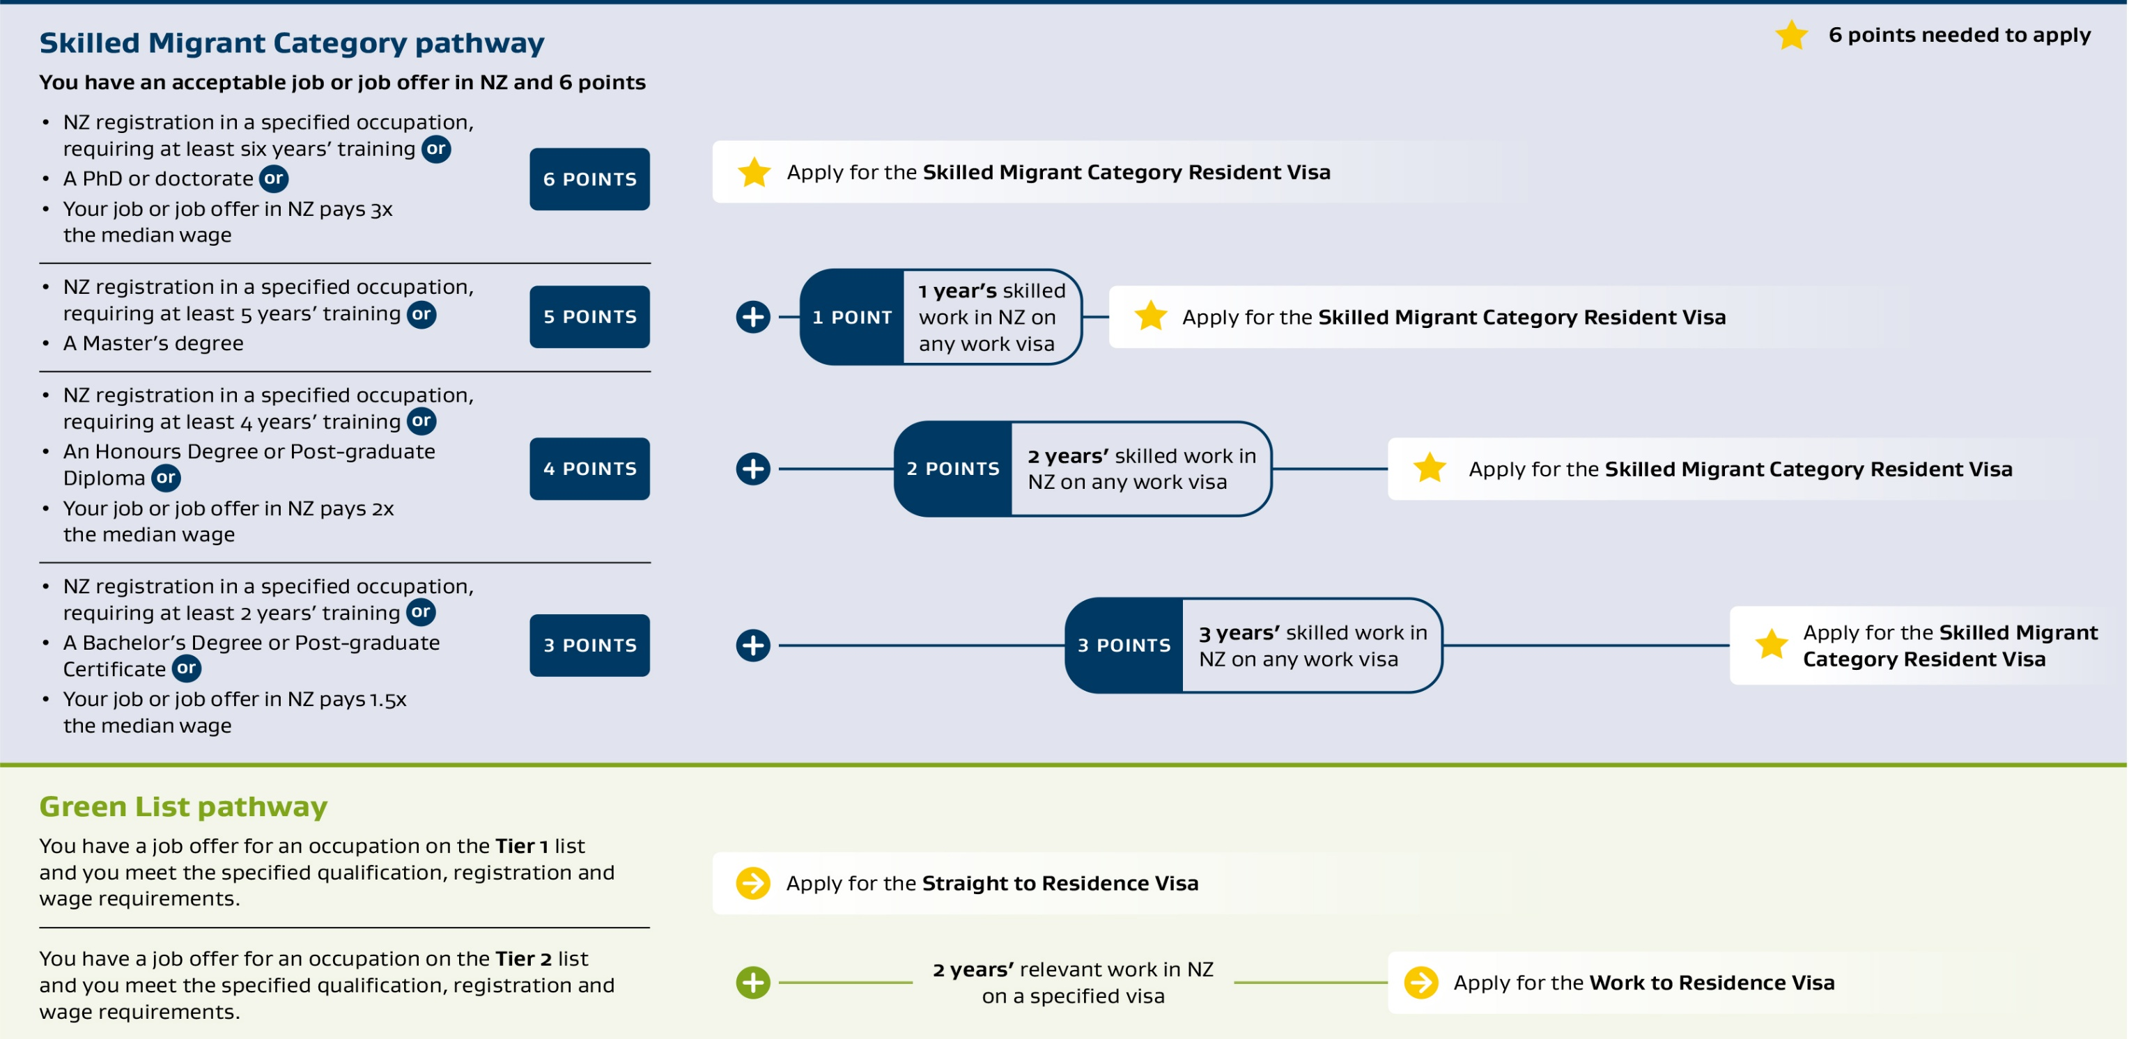
Pathways to Residency

Slide 39
Popular areas of study in New Zealand
Tourism & Hospitality Management
Applied Management, Supply Chain Management
Computing and Information Technology
Marketing and Communication
Construction Engineering, Project Management
Business with specialization in Accounting

Slide 40

Salient Features of some Universities

Slide 41
Universities - Ranking and Location
Name of the University | QS Worlding Ranking (2025) | City
University of Auckland | 65 | Auckland
University of Otago | 214 | Dunedin
University of Waikato | 235 | Hamilton
Massey University | 239 | Palmerston north
Victoria University of Wellington | 244 | Wellington
University of Canterbury | 261 | Christchurch
Lincoln University | 371 | Lincoln
Auckland University of Technology | 412 | Auckland

Slide 42
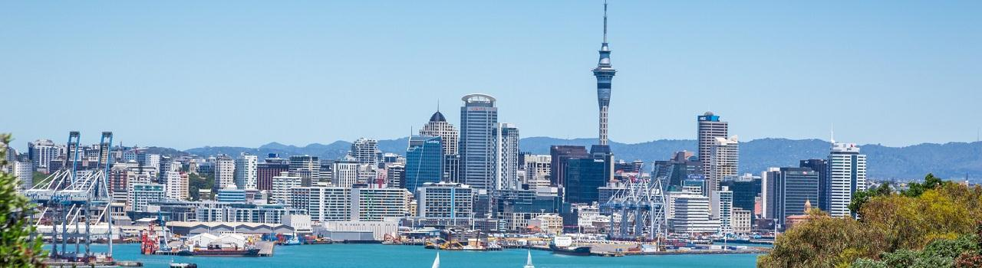
Some ITPs in Popular Destination- Auckland
Unitec Institute of Technology
Otago Polytechnic, Auckland Campus
Manukau Institute of Technology
Eastern Institute of Technology, Auckland Campus
Auckland

Slide 43
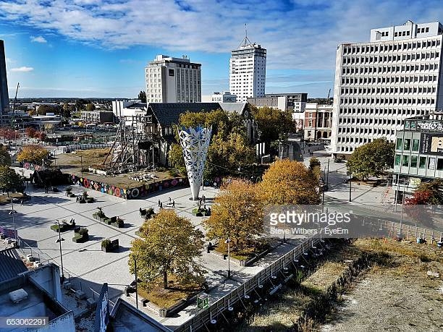
Few of ITPs and PTEs in Popular Destination - Christchurch
Ara Institute of Canterbury
Southern Institute of Technology, Christchurch Campus
UC International College
Aspire2International Group, Christchurch Campus
Christchurch

Slide 44
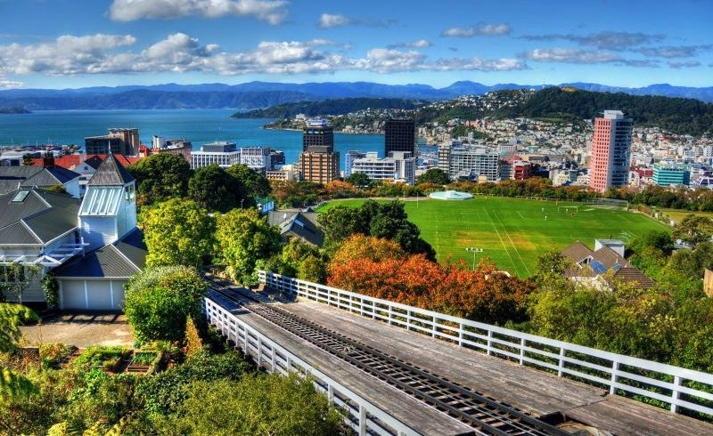
Some of ITPs & PTEs in Popular Destination - Wellington
Wellington Institute of Technology (WelTec)
Whitireia, Wellington Campus
Le Cordon Bleu
Wellington

Slide 45
Universities accepting MOI
For Bachelors :
Students who have completed 12th from IB /CBSE/ICSE board may request for an English Proficiency waiver
For Masters:
English Proficiency waiver is also possible for Masters programs, however it will be completely based on academic profile of the student and the decision is purely at the discretion of the university.

Slide 46

Universities accepting students with Backlogs
Name of the University | Backlogs
University of Auckland | Up to 25
University of Canterbury | Up to 25
Massey University | Up to 10
University of Waikato | Up to 25
Lincoln University | Up to 10
Auckland University of Technology | Up to 20
Victoria University of Wellington | Up to 5
Backlogs are generally not a problem in the ITPs in New Zealand, but the overall profile of the student should be good. A good profile means a qualification completed within the standard period with an overall percentage of 60% to 75% in the previous qualification for Bachelors and Masters and likewise 55% to 60% for Undergraduate and Graduate diplomas.

Slide 47
Salient Features Universities
University of Auckland
QS World Ranking 65
University of Auckland is a public research university based in Auckland, New Zealand. The City Campus, in the Auckland CBD, has the bulk of the students and faculties. There are eight faculties, including a law school, as well as three associated research institutes
Bachelor of Commerce
Bachelor of Science
Bachelor of Engineering with Honours
Graduate Diploma in Commerce
Post Graduate Diploma in Environmental studies
Master of Applied Finance
Master of Business Analysis
Master of Science (Fintec)
Master of Business Administration

Slide 48
Salient Features Universities
University of Otago
QS World Ranking 214
The University of Otago in Dunedin, New Zealand, stands out for its blend of academic excellence, vibrant student life, and beautiful campus environment. It's known for being New Zealand's first university and a leader in education and research, particularly in the health sciences.
Bachelor of Commerce
Bachelor of Pharmaceutical Science
Bachelor of Dental Surgery
Postgraduate Diploma in Health Management
Postgraduate Diploma in Clinical Dentistry
Master of Medical Laboratory Science
Master of Applied Management
Master of Dental Technology
Master of Business Administration

Slide 49
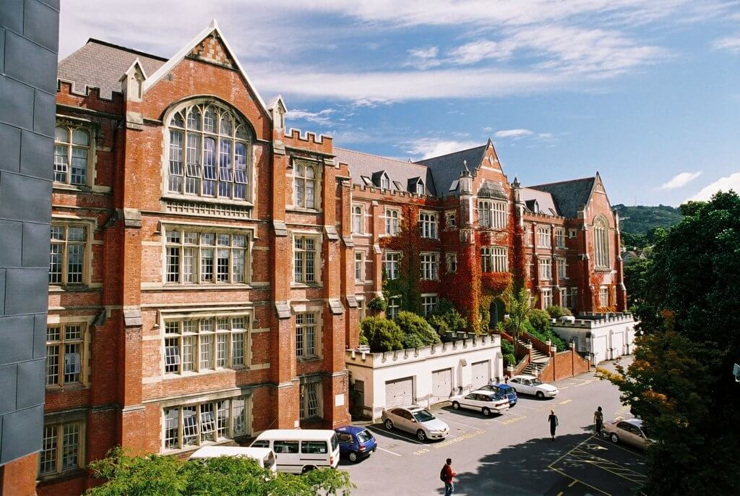
Salient Features Universities
Victoria University of Wellington
QS World Ranking 244
Victoria University of Wellington is one of New Zealand’s oldest and most prestigious tertiary institutions with a proud tradition of academic excellence.
Bachelor of Commerce
Bachelor of Science
Bachelor of Engineering with Honours
Graduate Diploma in Commerce
Graduate Diploma in Design Environment
Post Graduate Diploma in Architecture History and theory
Post Graduate Diploma in Environmental studies
Master of Applied Finance
Master of Global Marketing
Master of Architecture
Master of Business Administration

Slide 50
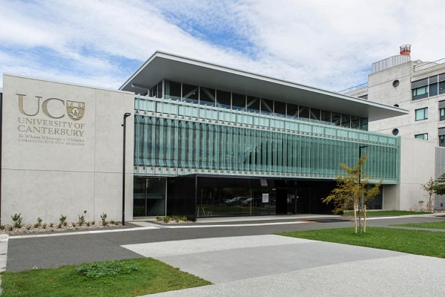
Salient Features of our Represented Universities
University of Canterbury, Christchurch
QS World Ranking 261
University of Canterbury is ranked in the top 1% of universities
Worldwide, located in Christchurch it is one of the top engineering university of New Zealand. Business school of University of Canterbury is Triple Crown Accredited by AACSB. AMBA and EQUIS
Bachelor of Health Sciences
Bachelor of Science
Bachelor of Engineering with Honors
Postgraduate Diploma in Business Information Systems
Postgraduate Diploma in Applied Data Science
Master of Applied Data Science
Master of Applied Finance
Master of Engineering Studies
Master of Engineering in Management
Master of Strategic Communication

Slide 51
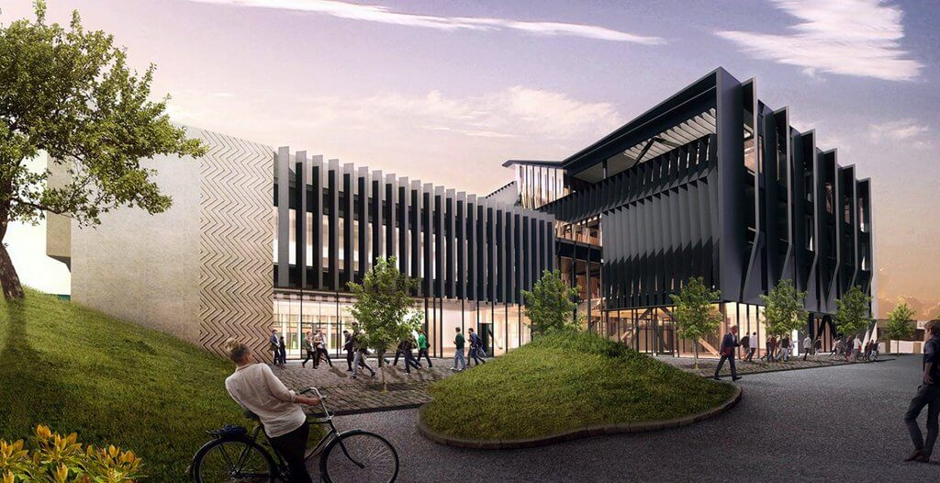
Salient Features Universities
University of Waikato, Hamilton
QS World Ranking 235
The University of Waikato is ranked among the world’s top 1.1% of universities.
Hamilton is the 4th largest city in New Zealand, with a vibrant student community
Bachelor of Business
Bachelor of Design
Bachelor of Engineering with Honors
Graduate Diploma of Teaching
Postgraduate Diploma in Management Studies
Master of Applied Psychology
Master of Information Technology
Master of Professional Accounting

Slide 52
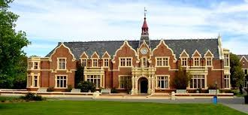
Salient Features Universities
Lincoln University, Canterbury
QS World Ranking 371
Lincoln University is ranked among the world’s top 1.4% of universities.
It is the 3rd Oldest University in New Zealand.
Lincoln is know as the Agriculture University of New Zealand
Bachelor of Agribusiness and Food Marketing
Bachelor of Agricultural Science
Bachelor of Viticulture and Oenology
Graduate Diploma in Business and Sustainability
Graduate Diploma in Recreation Management
Postgraduate Diploma in Landscape Studies
Postgraduate Diploma in Environmental
Management Postgraduate Diploma in Informatics
Postgraduate Diploma in Horticultural Science
Master of Management in Agribusiness
Master of Management in Agricultural Systems

Slide 53
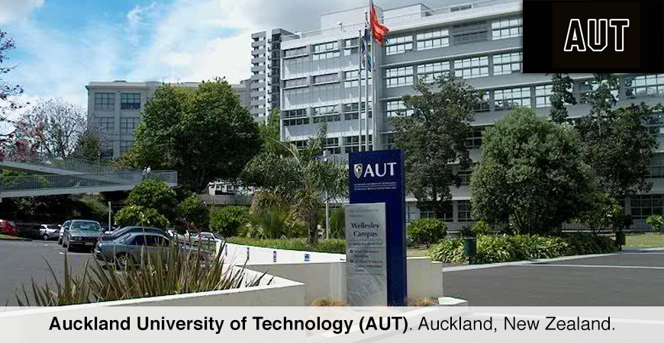
Salient Features Universities
Auckland University of Technology, Auckland
QS World Ranking 412
AUT is ranked in the top 1.2% Universities Worldwide.
Bachelor of Engineering Technology
Bachelor of Computer & Information Sciences
Postgraduate Diploma in Public Health
Postgraduate Diploma in Engineering
Master of Nursing Science
Master of Analytics
Master of Construction Management
Master of Engineering Project Management
Master of IT Project Management

Slide 54

FAQs

Slide 55
What is the correct time to start applying for studying in New Zealand?
Initial Documents
It is recommended to start applying at least six months before the start date of the course.
Visa interview & Result
Application to University
Apply for visa
Arranging financial documents

Slide 56

What is the difference between a Graduate Diploma (Level 7) and Post Graduate Diploma (Level 8)course?

Slide 57
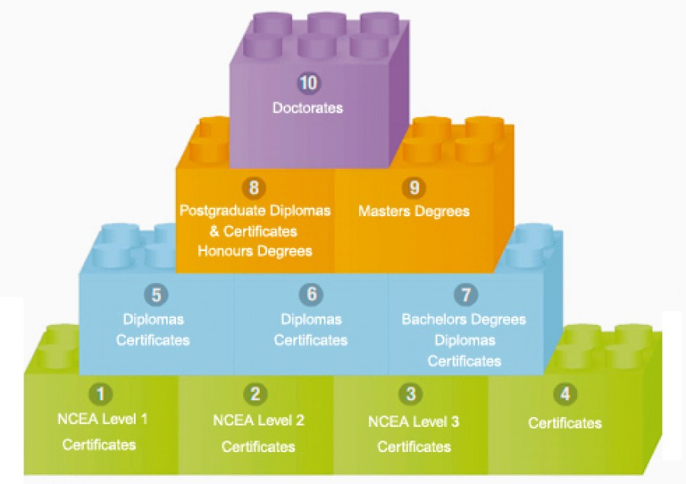
A Graduate Diploma (Level 7) is more of specialised, applied learning coupled with practical knowledge (Industry led) relating to the under graduation field of study already completed by a student. In contrast a Post Graduate Diploma (Level 8) course is more academic learning (Research led).

Slide 58


Slide 59


Backlogs are not a problem in NZ, but the overall profile of the student should be good. A good profile means a degree completed within the standard period with an overall percentage of 60% to 75% in the previous qualification for Bachelors and Masters and likewise 55% to 60% for Undergraduate and Graduate diplomas.
Documentary evidence for work experience. Please include salary statements and work experience certificate for all the positions held.
REMEMBER, WHAT CANNOT BE VERIFIED CANNOT BE ACCEPTED

Slide 60
Who all can be the sponsors ?
Parents, Grandparents
Parents and only immediate relatives (blood relations) should ideally sponsor the student.
The funds should be at least three months old.
If recent funds are to be shown, then
documentary evidence in support of every instance of recent deposits should be provided.
Brother, Sister
Funds
Spouse

Slide 61


You do not have to show flight tickets and medical insurance as part of funds.
Less than 1 year
Tuition fee for entire course.
NZD 20,000 living expenses.
More than 1 year
Tuition fee for 1st year
NZD 20,000 living expenses.
Payment plan for tuition fees for next year and ability to meet living expenses.

Slide 62

Can you describe FTS ?
FTS is an option given at the discretion of the visa officer to students whose parents/sponsors do not have funds which are 6 months old. The student will need to transfer at least 12 months living expenses (NZD 20,000) to a bank account in NZ - ANZ Bank, in addition to paying the tuition fee of one year.
The amount deposited in the bank is locked in a period of 12 months and then drip fed back to the student on a prearranged basis once he/she reaches New Zealand. The student will get NZ $1,667 per month towards living expenses once in NZ.

Slide 63
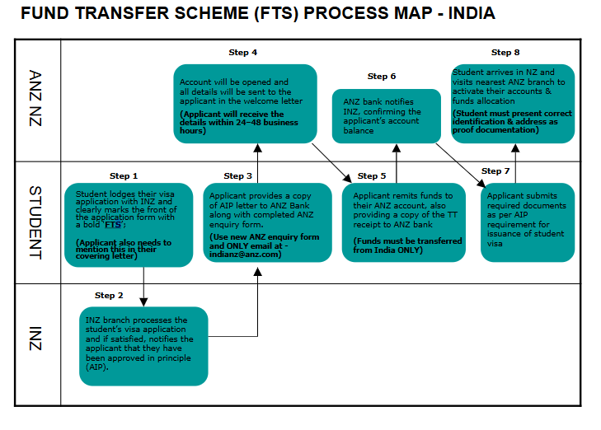
Funds Transfer Scheme

Slide 64

Will my Student get an interview call?

Slide 65

Not every student is interviewed. An interview is conducted to get further information about a candidate and it helps INZ to take a decision on the visa application.
Once visa is applied, how many days does it take to receive the Approval in Principle?
It takes around 4-8 weeks to receive an AIP. If a student receives an interview call,
we may expect the decision within 2-3 working days.

Slide 66

How to get a Police Clearance Certificate?

Slide 67
Locate the regional Passport office
Apply for PCC
Get the original certificate bearing the official seal.

Slide 68


Part time jobs available?
Who can work part time jobs?
What are the types of part time jobs available?
What about part time jobs?
There are numerous part time jobs available for international students.
A student can work for 20 hrs.
per week during study time and up to 40 hrs. per week during holidays.
The minimum wage rate in New Zealand is $23.15 per hour.

Slide 69

What if student visa is Rejected?
If a visa is rejected once, is it possible to reapply?
If the student gets a rejection on grounds that can be rectified, we can make the changes in the visa file and reapply for a positive outcome.
How many times can one apply for Visa if rejected?
There is no limitation on the number of times one can apply but the grounds for rejection should be such that there is a possibility for the previous outcome to be overturned with proper rectification.
If a student has furnished a fraudulent document or lied about a previous visa rejection, we will not entertain the case for reapplication.

Slide 70


