Slide 1
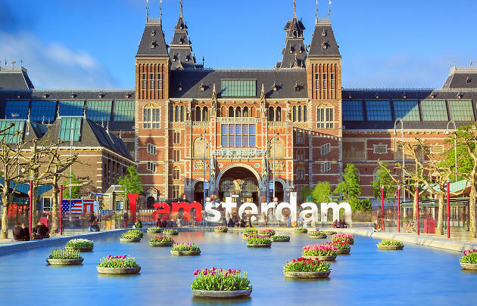
Study Destination Netherlands

Slide 2
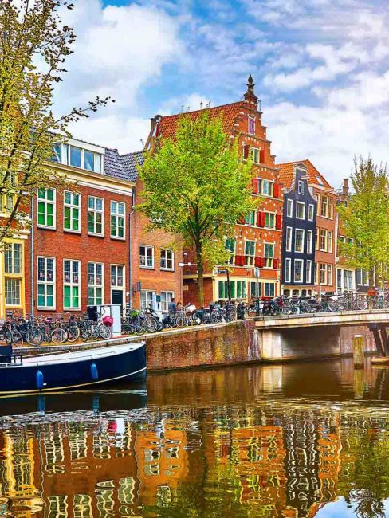
About Netherlands
The name Netherlands literally meaning "Lower Countries" came about due to its low land and flat geography with only about 50% of its land exceeding one meter above the sea level.
Most of the areas are below sea level and are man-made.
Since the late 16th century, large areas (polders) have been reclaimed from the sea and lakes amounting to nearly 17% of the country's current land mass.
The Netherlands covers around 41,000 square kilometers and has a population of about 16 million.
Country with one of the highest English-speaking population in Europe (above 90%).

Slide 3
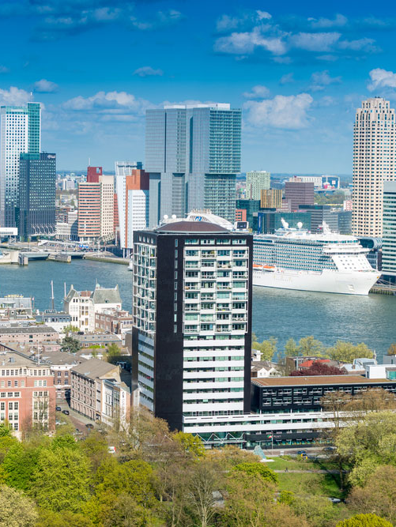
About Netherlands
With a rich cultural heritage the country has been home to many of history’s most famous names in the areas of Art, Literature, Philosophy and Science. It also has a long history of international trade having forged links with countries around the world, bringing together knowledge, skills, business and ideas.
The Netherlands consists of twelve provinces of which two of the provinces North Netherlands and South Netherlands are the most densely populated and encompass the popular cities of Amsterdam, Rotterdam and The Hague.

Slide 4
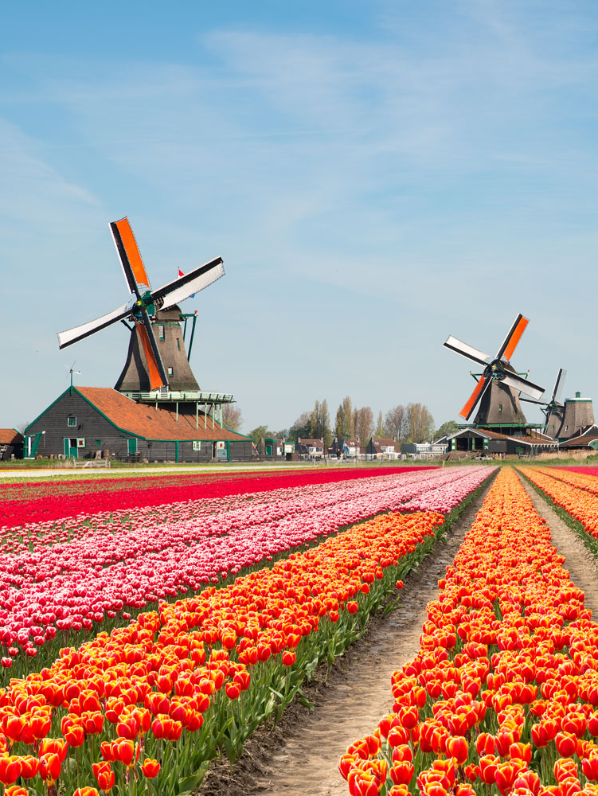
About Netherlands
Dutch is the official and predominant spoken language in Netherlands.
Euro is the official currency of Netherlands.
Some of the famous cities in Netherlands are
  Amsterdam (Capital)
  Rotterdam
  The Hague
  Eindhoven
  Tilburg
  Groningen
  Almere
  Breda

Slide 5
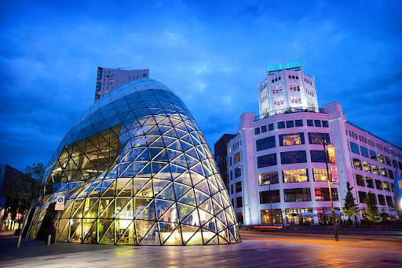
Why Study in Netherlands?
Quality Education- Educational opportunities of the highest standards and a multicultural population.
Post study work visa- 1 year (for all bachelor’s and Master’s program)
Courses taught in English- The Universities of Netherlands charge comparatively low tuition fees from international students and offer Master’s programs exclusively taught in English.
Part time Jobs- Students can work up to 16 hours/week. Typical part time earning are €10 to €15 per hour.
Employment- Netherlands is counted amongst one of the most industrialized countries in the world. Post study work Visa of 1 year is offered to the students to take up a job and gain international exposure after completion of their studies.

Slide 6
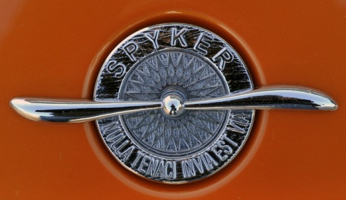


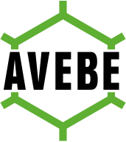

Why Study in Netherlands?
Internship opportunities in Multinational Companies

Slide 7
Intake & Deadline
Intakes:
Winter - September / October
Summer - February
General Deadline for Applications:
Winter - 1st May
Summer - 1st October/1st November

Slide 8
Entry Requirements
Direct Entry to Bachelor’s or Master’s:
Academic percentage–
60-65% and above in previous education. (High ranked Universities may need 70% and above)
Mathematics can be a requirement for applying to a Bachelor’s program in some universities
GMAT is required for an MBA in high ranked universities.
IELTS-
Masters: 6.5 with no band less than 6.0
Bachelors: 6.5 with no band less than 6.0

Slide 9
Popular Courses
Bachelor Courses:
Electrical & Electronic Engineering
Industrial Engineering & Management
Mechanical Engineering
Automotive Engineering
Civil Engineering
Business and Management
Sports Business Management
Business Economics
Psychology
Logistics Management
Master Courses:
MSc in Artificial Intelligence
MSc in Biology
MBA - Master of Business Administration
MSc in Economics
Master International Tourism Management
Master International Hospitality Management
Master in Finance and Accounting
LLM
Master’s in Psychology
MSc in Computing Science
MSc in Chemical Engineering
MSc in Civil Engineering and Management

Slide 10
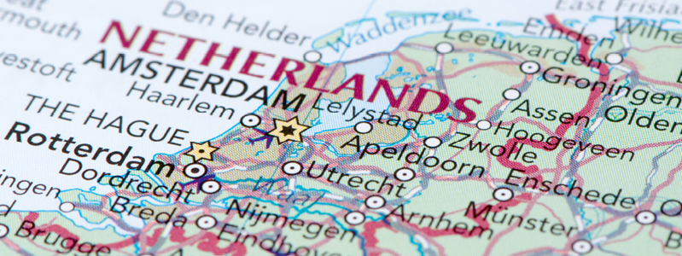
Universities represented by KC in the Netherlands
University of Twente, Enschede
Radboud University
The Hague University of Applied Sciences through The Hague Pathway College
University of Twente through Twente Pathway College
Wittenborg University of Applied Sciences
TIO University of Applied Sciences
Global School for Entrepreneurship, Haarlem Campus

Slide 11
Salient Features
Partnered Institutions

Slide 12
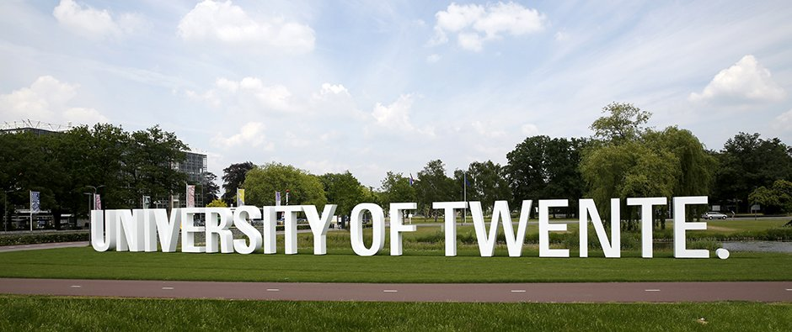
University of Twente
University of Twente is one of the high ranked universities in Europe.It is a public university located in Enschede, Netherlands.
The University was founded in 1961.
The degree programs at the University of Twente range from Business Administration, Psychology, Applied Physics, Engineering and Biomedical Technology.

Slide 13
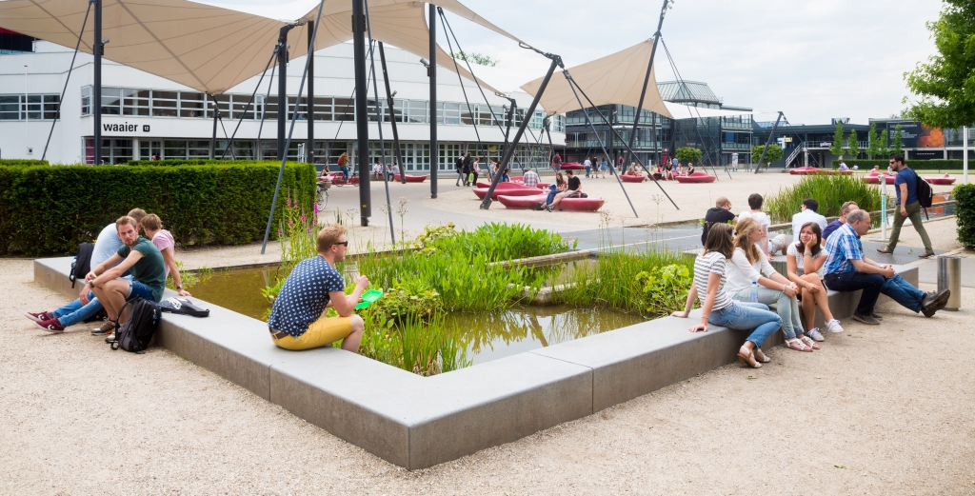
University of Twente
Rankings:
QS Ranking (2024) – 210
ARWU / Shanghai Ranking (2024) – 401 to 500
Times Higher Education Ranking (THE-2024)- 184

Slide 14

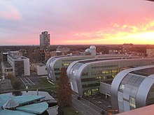
Radboud University
Radboud University is a broad, international oriented university that aspires to be one of the best in Europe.
According to the Dutch university information guide Keuzegids Universiteiten 2020 (for Bachelor's programmes), Radboud Unversity is the best traditional, general university in the Netherlands. Two programmes have received a Top Programme designation, nine programmes are deemed the best in their field by the Keuzegids.
The Keuzegids Masters 2019 awarded nine master's programmes Top Programme status and six were deemed best in their field.

Slide 15
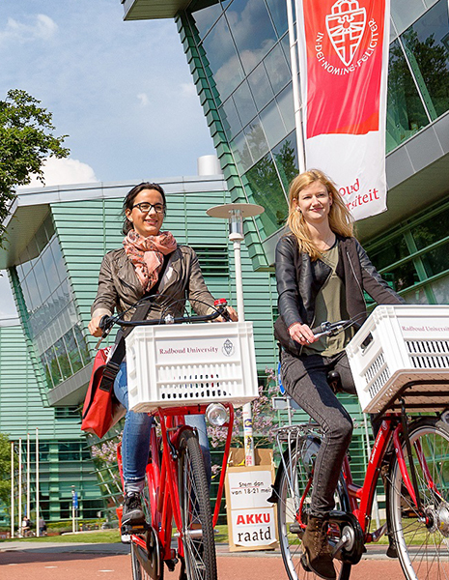
Radboud University
Rankings:
QS Ranking (2024) - 222
ARWU / Shanghai Ranking (2023) – 123
Times Higher Education Ranking – 140 (2024)

Slide 16
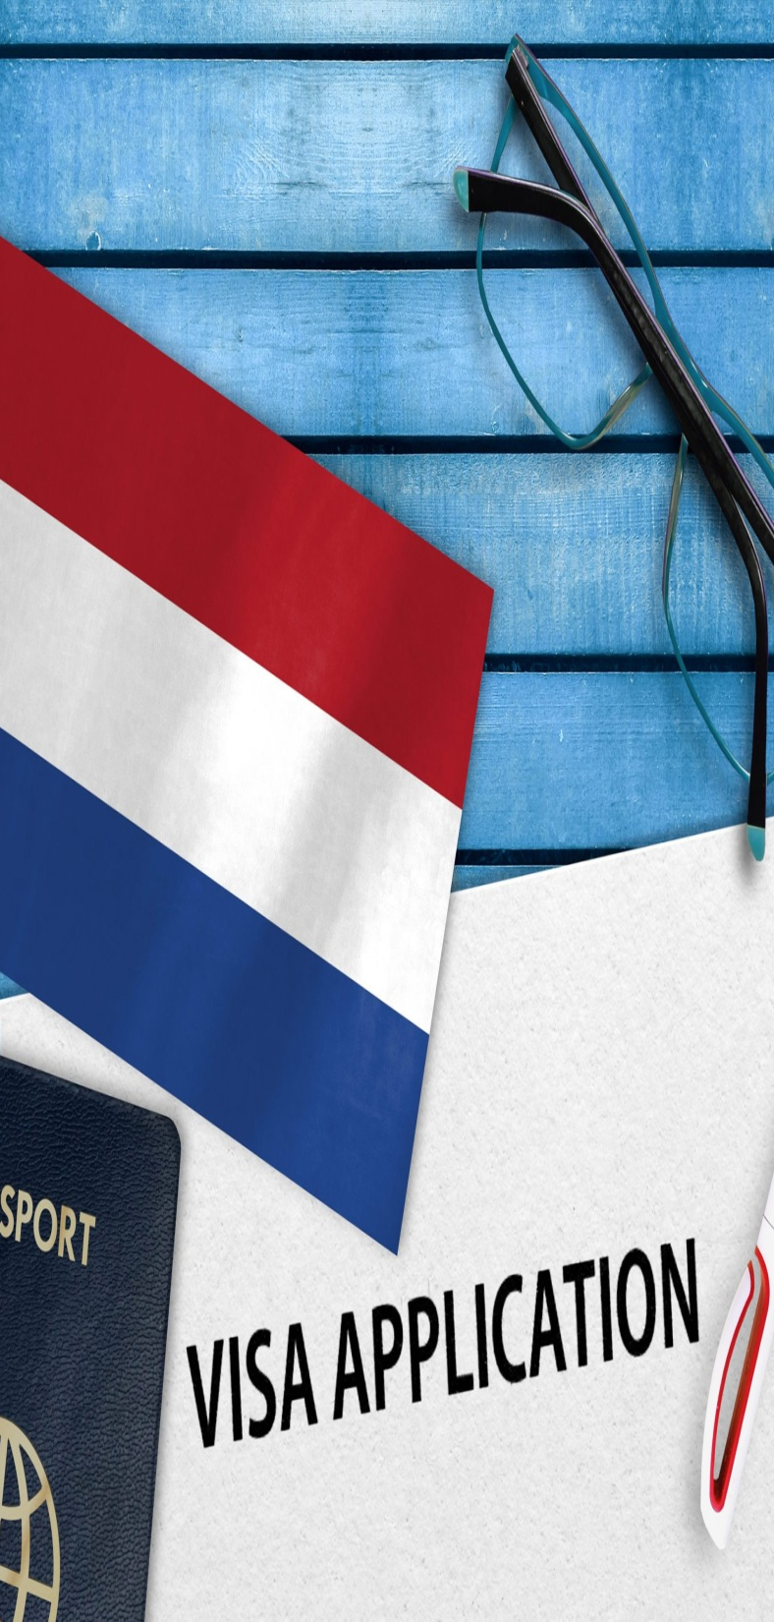
Visa Process
Nationals of countries outside the EU who wish to come to the Netherlands for a stay of more than three months need an authorization for temporary stay (MVV).
The University will process the visa application (MVV) by applying for the same in the Netherlands on behalf of the students.
Visa shall be received in around 4-8 weeks. Student needs to go for Biometrics at the local Embassy/Consulate.
On arriving in the Netherlands, the University will apply for a residence permit on behalf of the student.
The Fees for Visa and residence permit application is usually included in the University Tuition fees package which is approx. € 243

Slide 17

Documents Required for Visa
LEGALISED ACADEMIC DOCUMENTS ARE REQUIRED FOR VISA.
Documents must be translated if not in ENGLISH
You meet the general requirements that apply to everyone.
You have proof of registration or temporary proof of registration as a student at a university or institute of higher professional education (in Dutch: hoger beroepsonderwijs or HBO).
Your study program is accredited: this means that it has been recognized by Accreditation Organization of the Netherlands and Flanders or NVAO (in the Netherlands) or the European Quality Assurance Register for Higher Education or EQAR (Europe).
Your educational institution is a recognised sponsor with the IND.
You will enroll on a full-time study program.
You meet the income requirements.

Slide 18

Documents Required for Visa
FINANCIALS
One year living expense must be shown – EUR 15,000 + Balance tuition fees.
Acceptable means:
Sponsorship – Immediate family members
Education Loan
Savings Account
Fixed Deposits
SOME UNIVERITIES MAY REQUIRE A BLOCKED ACCOUNT
The funds must be 3 months old. Income source will be required.
Every year you make enough progress in your studies. This means that you obtain at least 50% of the credits for each study year. Your educational institution assesses your progress and lets you know if you have obtained enough credits. What if you do not make enough study progress and your educational institution does not think there is a good reason for this? Then your educational institution will register you at the IND. If you want to know more about study progress monitoring, please contact your educational institution.

Slide 19
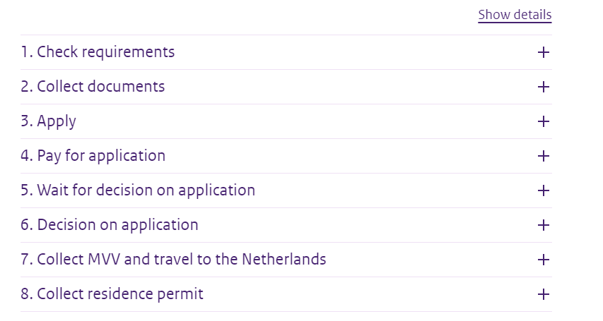
STEP BY STEP PROCESS
Refer to : https://ind.nl/en/residence-permits/study/student-residence-permit-for-university-or-higher-professional-education
Visa Application Form - https://ind.nl/en/forms/7504.pdf

Slide 20
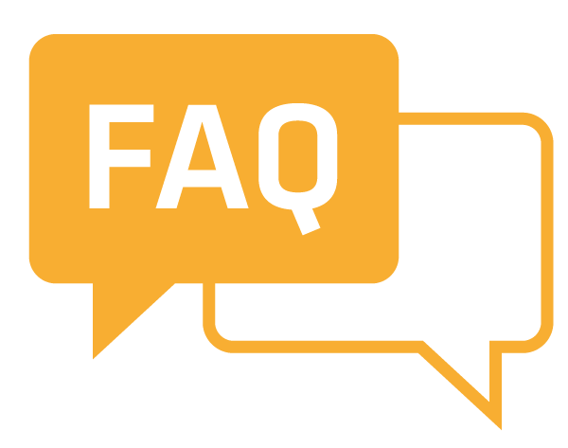
Frequently Asked Questions

Slide 21
Ques: What will be the budget for a student going to study a Masters in Netherlands?
Ans: Euro 20,000 to 25,000 approx.

Slide 22
Ques: Do Institutions accept a 3 years Bachelor’s or 15 years of education for a Master’s?
Ans : Yes, it is accepted.

Slide 23
Ques: Can a student apply without an IELTS score and a final year/12th marksheet for a conditional offer letter?
Ans: No conditional admission is not possible.

Slide 24
Ques: What is the turnaround time for Offer letters from Institutions?
Ans : The turnaround time is around 3 to 6 weeks.

Slide 25
Ques: Are backlogs accepted by Dutch universities?
Ans: No

Slide 26
Ques: A student completed his Bachelor’s degree in 2010 and is working since then. He has a total work experience of 9 years. Can the student apply for a Masters’ course?
Ans: Yes

Slide 27
Ques: Can IELTS be waived off in Netherlands?
Ans: No, IELTS is a mandatory requirement.

Slide 28
Ques : If a student has already completed a Master’s and would like to pursue a second Master’s program in Netherlands, is it possible?
Ans : Yes, a student can apply for a second Master’s in Netherlands.

Slide 29
Ques: How much funds does the student need to show at the time of filing visa ? Which funds are acceptable for filing visa ?
Ans: Total tuition fees + living expenses (Euro 15,000 for a year)
Savings Account, Fixed Deposits and Education Loan.

Slide 30


