Slide 1


Study in
IRELAND

Slide 2
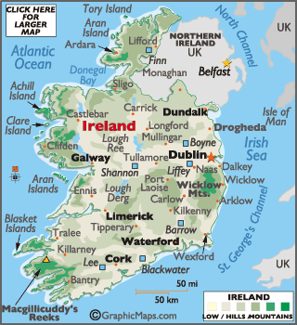
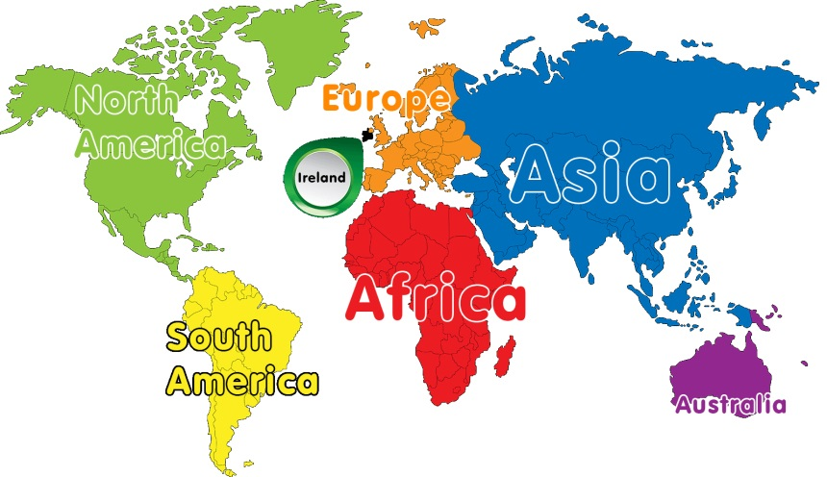
Ireland Map

Slide 3
Facts about Ireland
Ireland is in the north-west of Europe.
Politically, Ireland is divided between the Republic of Ireland and Northern Ireland, a part of the United Kingdom.
The capital of Ireland is Dublin. Cork, Galway, Maynooth & Limerick are some of the popular cities of Ireland.
The official language of Ireland is Irish and English.
Population of Ireland is approximately 5.1 Million.
Currency of Ireland is Euro €
Intakes Available: September, January and April

Slide 4

Why Study in Ireland?
A friendly, safe country.
English-speaking country.
World class Universities.
Low cost of tuition fees & accommodation.
Internationally recognized qualifications & extensive choice of courses.
European Headquarters of many IT & Pharmaceutical companies.
Master’s degree of 1 year.
Post-study work visa of 2 years for Masters.
Post-study work visa of 1 year for Bachelors (Hons).
Chance to get indefinite right to stay (Similar to Permanent Residency).

Slide 5


Where to Study in Ireland?
DUBLIN
GALWAY
LIMERICK
MAYNOOTH
CORK

Slide 6
Tie-up Institutions
Universities
Colleges
Trinity College Dublin
University College Dublin
University College Cork
University of Galway
Dublin City University
University of Limerick
Maynooth University
Technological University Dublin
Atlantic Technological University (Letterkenny, Galway, St. Angela & Sligo)
South -East Technological University (Waterford & Carlow Campus)
TUS: Midlands and Midwest (Athlone & Limerick)
Munster Technological University
RCSI University of Medicine and Health Sciences
National College of Ireland
Shannon College of Hotel Management
Dublin Business School
Griffith College
Dublin International Foundation College
Unihaven College
IBAT College Dublin
Independent College
Galway Business School
American College Dublin

Slide 7
Salient Features of the Universities
Trinity College Dublin
1st ranked in Ireland World Leader in Nanotechnology, Immunology, Engineering, Information Technology
University College Dublin
Largest provider of Graduate Education in Ireland
2nd ranked in Ireland
National University of Ireland

Slide 8

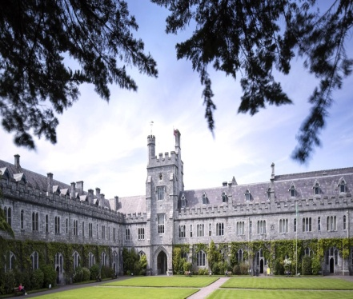
Salient Features of the Universities
  University of Galway
  6th ranked in Ireland
  Popular courses: Business Analytics, Mechanical Engineering, Computer Science and Nursing
  University College Cork
  3rd ranked in Ireland
  Located in Cork-2 hours from Dublin
  Cork is the Pharmaceutical Capital of Europe

Slide 9
Salient Features of the Universities
Dublin City University
University of Limerick
4th ranked in Ireland
5th ranked in Ireland
Popular Courses: MSc Aeronautical Engineering, Meng Mechatronics, MSc International Management and Global Business
Irish Centre for Cloud Computing

Slide 10
Salient Features of the Universities
Technological University Dublin
8th ranked in Ireland
Popular courses: Computing, Supply Chain Management, Sustainable Development etc.
Maynooth University
9th ranked in Ireland
Located in Maynooth-half hour from Dublin
Popular Courses: MSc Data Science and Analytics, MSc Business Management, ME Electronic Engineering etc.

Slide 11

Salient Features of the Universities
Atlantic Technological University (Letterkenny)
Letterkenny is the commercial hub of the Ireland
Popular courses: MSc in Computing in Artificial Intelligence Research, Big Data Analytics, Culinary Arts.
Atlantic Technological University (Sligo)
13th in Webometrics Ireland National Ranking
Popular courses: MSc in Bioprocessing Science, Master of Arts in Social Work

Slide 12


Salient Features of the Universities
South East Technological University (Carlow Campus)
  Popular courses: B.E. in Aerospace/Mechanical /Civil, Data science, Supply Chain Management etc.
South East Technological University (Waterford)
TOP Ranked Institute of Technology in SUNDAY TIMES GOOD UNIVERSITY GUIDE
Excellent reputation for internationalization with 5 campuses.
Popular Courses: MSc in Computing, BSc (Hons) in Pharmaceutical Science, BSc in Information Technology
South East Technological University (Waterford)
TOP Ranked Institute of Technology in SUNDAY TIMES GOOD UNIVERSITY GUIDE
Excellent reputation for internationalization with 5 campuses.
Popular Courses: MSc in Computing, BSc (Hons) in Pharmaceutical Science, BSc in Information Technology

Slide 13


Salient Features of the Universities
Technological University of the Shannon: Midlands Midwest, Shannon (Limerick & Athlone Campus)
10th ranked in Ireland
Popular Courses: Civil, Electrical & Electronic Engineering, Pharmaceutical & Forensic Analysis, Tourism & Hospitality etc.
Munster Technological University
11th ranked in Ireland
MTU operates with six campuses across Cork and Kerry
Popular Courses: Data Sciences, Data Analytics, Cybersecurity, and International Business etc.

Slide 14

Salient Features of the Universities
RCSI University of Medicine and Health Sciences
(Royal College of Surgeons in Ireland )
Offers innovative and future-focused curricula in fields like Medicine, Pharmacy, Physiotherapy, and Advanced Therapeutic Technologies.

Slide 15
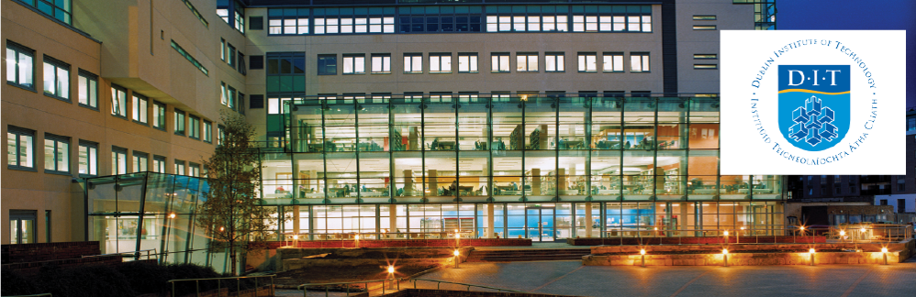

Salient Features of the Private Colleges
National College of Ireland
  NCI has been ranked 15th in Ireland and as Best for Jobs in the Sunday Times University Guide 2015
  Major Intake: September and January
  Popular Courses: MSc Data Analytics, MSc Cloud Computing, MSc Management etc.
Dublin Business School
  19th ranked in Ireland
  Major Intake: September, January, April
  Popular Courses: MBA, MSc Information Systems with Computing, MSc Management

Slide 16


Salient Features of the Private Colleges
UniHaven College
  Popular International Foundation Studies course offers two pathway streams: Business & Social Sciences and Engineering & Science
IBAT College (Institute of Business and Technology)
  Major Intake: September and February
  IBAT offers ATU's MSc in Business Management and MSc in Marketing, which are delivered in Dublin
  A career-focused approach with internships, networking opportunities, and real-world experience

Slide 17
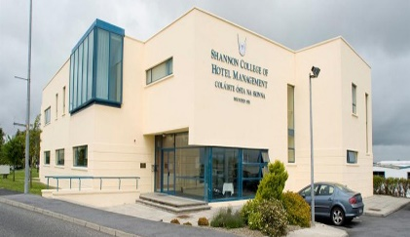

Salient Features of the Private Colleges
Shannon College of Hotel Management
  Popular Courses:
  Bachelors in International Hotel Management and
  Masters in Business and Hospitality
Dublin International Foundation College
Popular for Pathway programs
Major Intake: September and January

Slide 18


Salient Features of the Private Colleges
Griffith College
  3 campuses - Dublin, Limerick and Cork
  Major Intake: September and January
Galway Business School
  Major Intake: September and January
  Programs Offered: Bachelor of Arts (Hons) in Enterprise Management, Bachelor of Business (Hons) in International Business, Bachelor of Business Degree

Slide 19

Salient Features of the Private Colleges
Independent College, Dublin
  Major Intake: September and February
  It has vibrant city centre location near Silicon Docks, QQI accreditation, modern campus facilities
  Dynamic third-level institution specializing in business and law

Slide 20
Upload the following documents on course finder for application process
Application Submitted
Academic Documents (From 10th to latest)
Passport
SOP
2 LORs
Resume
Work Exp.
IELTS/TOEFL/PTE/DET(Any One)
Application Fee
Trinity College Dublin: €40 for MBA and €55 for other courses
University of Galway: €35 (PG)
University College Cork: €50 (UG& PG)
University of Limerick: €50 (UG&PG)
Maynooth University: €50 (PG) €35 (UG)
Atlantic Technological University (All Campus):€30 (PG)
American College Dublin: €30
Application Form (Online/Offline)

Slide 21
Entry Criteria
Bachelors: Minimum 65%-90% in class 12th for Universities
        55%-60% in class 12th for Colleges
Masters : Minimum 55%-75% in Graduation with IELTS 6.5* with no band less than 6.0. IELTS 6 with no band less than 5.5 is also acceptable in some Universities and Colleges.
IELTS equivalents like DET, PTE, TOEFL are also acceptable.
DET and TOEFL (Home Edition) are not accepted by some universities.

Slide 22
Total Cost per Annum (INR)
IELTS Exam Fees | 19000
Tuition Fees | 1275000
Living Cost | 1200000
Visa Fees (Multiple Entry) :-9000 VFS Service Charge:-3518 Check & verify:- 5455 Courier service:- 500 SMS service:- 135 | 18608
Airfare (Mumbai to Dublin) | 50000
Total (Say) | 2561608 2560000
Less Part Time Earnings(min €13.50/hr) | 120960
Net Cost | 1560000
Assistantships/Scholarships | Yes
Nature of Part Time Jobs | Off-Campus 20 hours each week
Money to be spent by student | Approx. 1500000
Note: The Tuition fees may vary depending upon the course and University/Institution

Slide 23
Scholarships
Innumerable scholarships and student grants are available for international students in Ireland from various sources such as the Government of Ireland, the Irish Higher Education institutions and other organizations. The government, educational institutions and the organizations set down their own eligibility criteria. Scholarships are awarded for undergraduate, postgraduate or research students and for various fields of study.
Scholarships in Irish Universities
The Government of Ireland International Education Scholarship
Scholarship Amount: Full fee waiver + €10,000 stipend for one study year
Scholarship Type: Academic qualifications and achievements
Applicability: All QQI approved Institutions
Link: https://hea.ie/assets/uploads/2019/01/Government-of-Ireland-International-Education-Scholarship-Call-2019.pdf
V.V. Giri Global Excellence Scholarship
Scholarship Amount: 100% Tuition Fees
Scholarship Type: Merit-based
Applicability: University College Dublin
Link: http://www.ucd.ie/t4cms/V.V.%20Giri%20Global%20Excellence%20Scholarship%20-%20India.pdf

Slide 24
Scholarships
Global Excellence Postgraduate Scholarships
Scholarship Amount: €5,000
Scholarship Type: Merit-based
Applicability: Trinity College Dublin
Link: https://www.tcd.ie/study/international/scholarships/Postgraduate/gexpg.php
Jim Kemmy India Scholarship
Scholarship Amount: €4279 and will be available to students for the 4 years of the Degree programme
Scholarship Type: Merit-based
Applicability: University of Limerick
Link: https://www.ul.ie/gps/international-student/scholarships-international-students/indian-students-scholarships

Slide 25
Scholarships
Global Excellence Graduate Scholarships
Scholarship Amount: 100% Tuition Fees
Scholarship Type: Merit-based
Applicability: University College Dublin
Link: http://www.ucd.ie/t4cms/Global%20Excellence%20Graduate%20Scholarship%20-%20South%20Asia.pdf
University of Galway Scholarship Link:
https://www.universityofgalway.ie/internationalscholarships/#
Other Universities like DCU, UCC, SETU, TUS offer automatic merit-based scholarships, details of which must be mentioned in the offer letter.

Slide 26
Post Study Work Rights
Degree | Level | Post Study Work Rights
Bachelors Honours Degree | Level 8 | 12 months
Masters Degree/ Postgraduate Diploma | Level 9 | 24 months

Slide 27
Employment Permit Schemes
Work Permit (General Work Permit) | Ireland Green Card(Critical Skill Employment Permit)
Allows a non-EU citizen to work legally in Ireland for an employer in a particular occupation. Individual must have annual Salary above € 30,000 to qualify for work permit. The permit is Initially Granted for 2 years and can be renewed for further period of 3 years. The work permit can be issued indefinitely after a period of 5 years. | Allows skilled individuals to work in Ireland for a specified employer in an occupation where skills shortages exist. Individual must have annual Salary above € 60,000 to qualify for Green Card permit. The permit is Initially Granted for 2 years. After 2 years, immigrants may apply for a Stamp 4 which allows them to live and work in Ireland on a permanent basis.

Slide 28
VISA
Applications must be lodged at the VFS centre at least 8 weeks prior to proposed dates of travel.
Student must have an unconditional offer and he/she should pay a minimum deposit of 6000 Euros.
Student Applications lodged 3 weeks or less prior to proposed date of travel will not be processed. The 3 weeks deadline is for the file to reach visa office in New Delhi and not the time of submission in VFS office.
Note: Due to high volume of visa application, we recommend to apply 8-12 weeks prior to the course start date.

Slide 29
Documents required for Student Visa
A) Application Forms:
Printed and signed summary of online application form. The link is-
https://www.visas.inis.gov.ie/avats/OnlineHome.aspx
Appointment confirmation
Payment confirmation
Visa fee of INR 9000 (Multi entry visa) need to be paid online.
The VFS service fee (INR 3518) need to be paid online.
B) Passport:
Original Passport and photocopy of first and last page of the same.
One recent passport sized photograph not more than 6 months old.
Student should submit all previous passports along with a photocopy of each page of all the passport(s) submitted.
C) Original Police Clearance Certificate from Passport Office. (Recommended)

Slide 30
Documents for Student Visa Contd.
D) Original plus one copy for each of the following documents:
Acceptance Letter & Confirmation of fees paid
Statement of Purpose.
Brief CV.
Class 10th Mark Sheet & Certificate.
Class 12th Mark Sheet & Certificate.
Graduation Mark Sheet & Certificate (In case of PG Course).
Digi Locker Version of all the marksheets (whichever available on Digi locker from 10th till now)
IELTS/TOEFL/DET/PTE score card (any one).
Letter from Current Employer or Experience Certificate (where applicable).
E) Financial Documents:
Affidavit of Support of Sponsored on stamp paper.
Bank Statement & Bank Balance Certificate (Last 6 Months): Total tuition fees + €12,000 living expenses for each year.
Bank Loan Sanction Letter, Disbursement letter and the documents of the property mortgaged with its valuation report (If any).
Income Tax Return Papers of the sponsor for the last 3 years
Fixed deposit receipts should be submitted along with Fixed Deposit bank certificate (On bank letter head) (if any)
LIC surrender value letter (if any)
Provident fund withdrawal limit letter (if any)
Gold Loan or Gold sale with receipts (If any).
Irish Education Bond (Highly Recommended)

Slide 31
Documents for Student Visa Contd.
F) Medical Insurance is mandatory (Private Insurance is also acceptable).
KC can assist the student with the health insurance policy for INR 22000, which includes the premium of the policy € 100, and the student will get a cover of € 2500000 for 1 year
Note 1: Please provide a Photocopy of all documents student wish to have returned to
him.
Note 2: Please provide full contact details for all student sponsors. If they are not directly
related to students, e.g. Mother/Father/Sibling, please explain the relationship and
provide some evidence of this.
Special Note: Spouse is not allowed to apply for Student Dependent Visa.

Slide 32
Details on ISD Registration
Initially, student will be getting visa for 180 days. From 13/01/2025 the responsibility of registering all applicants in the Republic of Ireland will be transferred to Immigration Service Delivery (ISD) and will no longer be carried out by the Garda National Immigration Bureau (GNIB).First time registration for all residents in the Republic of Ireland will be carried out by Immigration Service Delivery (ISD).
The below documents are required:
• Passport
• Student ID card (provided by the school/university in Ireland).
• A letter from the Registrar's office of the school/university stating that student is a registered student and stating the start date and completion date of his/her course.
• A €300 fee (credit/debit card ‐ no cash accepted).

Slide 33
Ireland High Commissions in India
New Delhi: Ireland Embassy, India
C 17 Malcha Marg
Chanakyapuri, New Delhi 110 021
Mumbai: Honorary Consulate of Ireland
7th Floor, The Capital Building
Bandra Kurla Complex, Mumbai 400051, India
Bangalore: Honorary Consulate of Ireland
C/o Biocon Limited, 20th K M Hosur Road, Electronics City PO
Bangalore 560 100, India
Kolkata: Honorary Consulate of Ireland
C/o Keventer Agro Ltd, 2 Clive Ghat Street, Sagar Estate, 8th floor
Kolkata 700 001, India
Chennai: Honorary Consulate of Ireland
Mecheri Centre, Number 49, Eldams Road, Teynampet,
Chennai 600018

Slide 34
Ireland VFS Centers in India
Applications for an Irish visa can be submitted at the locations given below:
Chennai
Cochin
Hyderabad
Bengaluru
Delhi
Chandigarh
Jalandhar
Northern India:-
Southern India:-
Mumbai South
Mumbai North
Pune
Ahmedabad
Goa
East India:-
Kolkata
West India:-

Slide 35
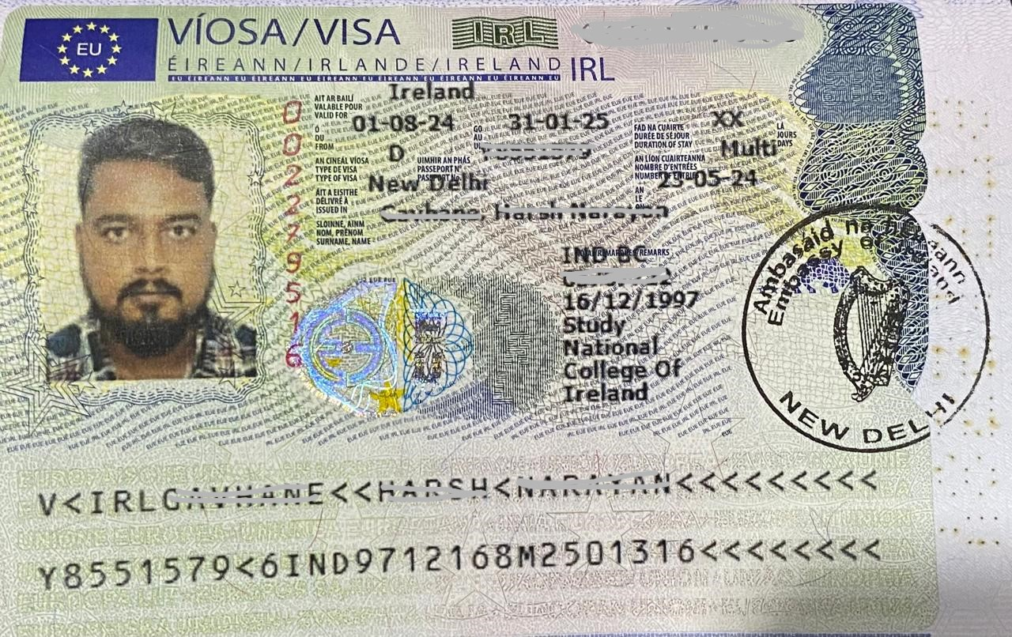
Sample Visa Copy

Slide 36
Evidence of Funds
Evidence that the student has immediate access to Tuition Fees + Living expenses for all the years. €12,000 is the estimated cost of living in Ireland as per Irish Embassy for a student for one academic year. The cost of total duration of study and stay needs to be shown in liquid funds such as Education Loan, Bank Balances and Fixed Deposits.
It is highly recommended that the tuition fee should not be sponsored only through the education loan, which means the sponsor should have 6 months old liquid funds in their account apart from education loan.
To get faster VISA, it is advised to make full fees payment before applying for VISA.
If there are recent large deposits in the account, then a proper source of those funds also needed to be submitted.

Slide 37
Evidence of Funds
Evidence of deposits, registration and tuition fees already paid and evidence of the source of funds used to pay them to be shown.
In case of education loan, the monthly income of parents should be sufficiently more to cover the other living expenses of the sponsors/parents and the EMI of the education loan.
Sponsors should have strong annual income and below listed documentary evidences can be accepted.
  Copy of Income Tax Returns with average annual income of Rs. 8 to 10 Lakhs.
  In case of agricultural income, income certificate from Tehsildar with translated copies of land record and bills of the sales of the agricultural produce.
  Form No. 16 and salary slips in absence of ITRs.

Slide 38


