Slide 1



Slide 2
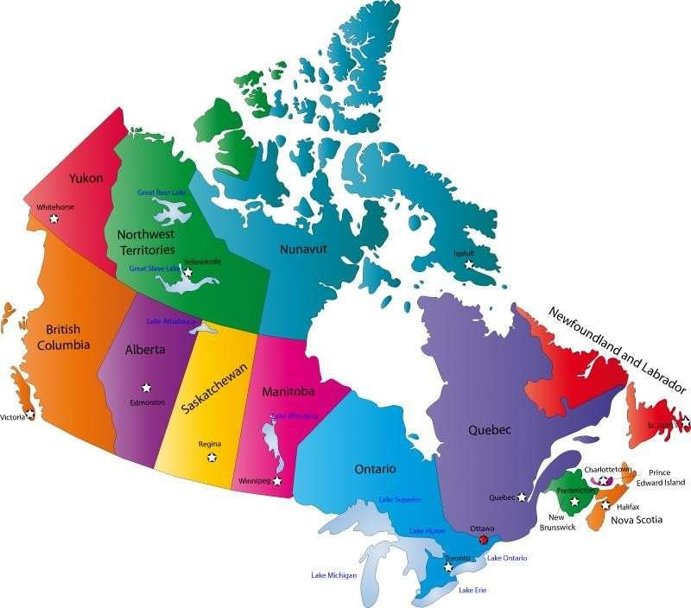

Map of Canada

Slide 3
Q: What is the capital of Canada?

Slide 4

Ottawa is the capital of Canada

Slide 5
Q: How many Provinces are there in Canada?

Slide 6
There are 10 Provinces in Canada

Slide 7
Q: How many Territories are there in Canada?

Slide 8
There are 3 Territories in Canada

Slide 9
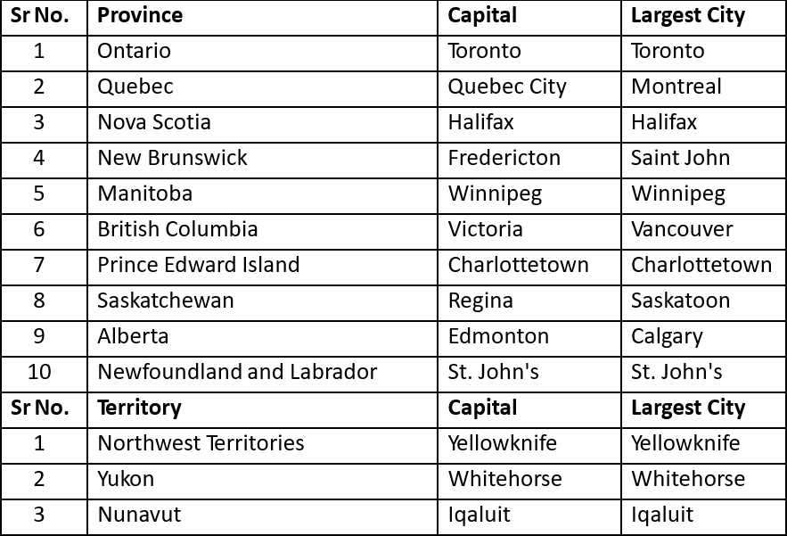
Provinces and Territories of Canada

Slide 10
Q: Which are the popular cities in Canada?

Slide 11




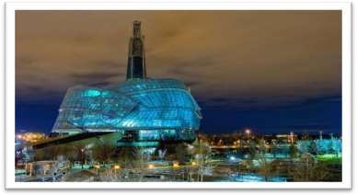
Popular Cities
Vancouver
Halifax
Toronto
Montreal
Calgary
Winnipeg

Slide 12
About Canada
Canada is the second largest country in the world.
Area of 99 lakh square kilometers with a population of around 36 million.
Culture & Society
Land of Immigrants.
Multicultural Society.
One of the most industrialized countries of the world.
Northern Canada is known for gas and oil exploration while Eastern Canada is known for agriculture, forestry and
fisheries.
The provinces of Ontario and Quebec are known for industries.
A world leader in Aerospace, Pharmaceuticals, Telecommunication and Biotechnology.
Currency is Canadian Dollar.
Almost 80% of the population of Canada lives within 250 kilometers of border with the U.S.

Slide 13
Why Study in CANADA?
Qualifications valued around the world.
Affordable education.
Multicultural society.
Healthy and safe communities.
Possibility of paid internships while studying.
Post study work visa and good job opportunities after completion of studies.
Possibility of permanent residency.

Slide 14
Why Canada?
PNP – Provincial Nominee Program –
Provincial Nomination is an important fast-track option for Canadian Permanent Residency.
For e.g. if a student studies a course from any institution from Saskatchewan, then he can apply for PR after
completion of the course under Provincial Nominee Program if the province is participating at that point of time.
Ontario, Alberta, British Columbia, Manitoba, New Brunswick, Newfoundland and Labrador, Northwest Territories, Nova Scotia, Prince Edward Island, Saskatchewan and Yukon are the provinces which periodically participate in the Provincial Nominee Program (PNP).
Facility of Super Visa is offered to parents.
Super Visa (Super Visa) is a temporary resident permit that allows parents and grandparents of permanent residents or citizens of Canada to stay for up to 5 years in Canada per visit. It is valid for up to 10 years. A regular multiple-entry visa is also valid for up to 10 years.

Slide 15
Process Flow for Canada Study Visa
Academic
IELTS
Request for PAL
GIC Process (Optional)
Application
Process
Tuition Fee
Payment
Medical
Examination
Offer Letter
Arranging
Finances
Visa
Submission

Slide 16
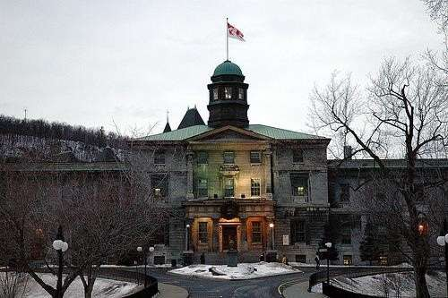

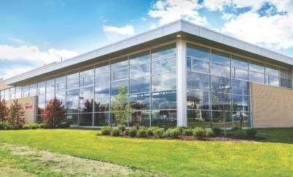
Education System in Canada
Education in Canada is generally funded and managed by the Provincial Governments of Canada
Universities
Community Colleges
Private Colleges

Slide 17
Q: How many Universities are there in Canada?

Slide 18
There are 98 Universities in Canada

Slide 19
Q: Which are the top ranked Universities in Canada?

Slide 20
Top Ranked Universities
Canada has 4 universities which are in the top 100 world ranking.
University of Toronto
McGill University
University of British Columbia
University of Alberta
Apart from the above there are 8 more Universities of Canada which appear in the top 300 universities in world
rankings.
McMaster University
University of Montreal
University of Waterloo
University of Western Ontario
University of Calgary
Queens University
Dalhousie University
University of Ottawa

Slide 21
Universities
Q : What are the level of programs offeredby Universities in Canada?

Slide 22
Universities
UG Diploma, PG Diploma/Graduate Certificate, Bachelors, Masters and PhD programs
Masters and PhD Programs are available at Universities only

Slide 23
Community Colleges
Q: How many Community colleges are there in Canada?

Slide 24
Community Colleges
There are 150 Community Colleges across Canada.

Slide 25
Programs offered by Colleges
Q: What are the level of programs offeredby Colleges in Canada?

Slide 26
Programs offered by Colleges
UG Diplomas, University Transfer programs, Bachelor Degrees and PG
Diplomas

Slide 27
Duration of Qualifications
Q: What are the durations of the Degrees and Diplomas in Canada?

Slide 28
Categorization and Duration of Qualifications
Degrees | Program Duration
Doctoral or PhD | 2 – 5 Years
Masters | 2 Years
PG Diploma / Graduate Certificate | 1 – 2 Years
Bachelors | 4 Years
UG Diploma | 2 – 3 years 2-year program is a Diploma and 3-year program is an Advanced Diploma

Slide 29
Intakes
Q: What are the intakes available in Canada?

Slide 30
Intakes
The main Intakes are September, January and May.
There are limited intakes in April, July and October as well.

Slide 31
English Language Requirements
Programs | Entry Requirements | IELTS | TOEFL | PTE
Masters | 16 Years of full-time education 65% and above in Bachelors | 6.5 (6.0) | 88 | 62
PG Diplomas | 15 Years of full-time education 50-55% and above in Bachelors | 6.5 (6.0) | 88 | 62
Bachelors | 12 Years of full-time education 60% and above in grade 12 | 6.5 (6.0) | 79 | 62
UG Diplomas | 12 Years of full-time education 50-55% and above in grade 12 | 6.0 (6.0) | 79 | 58

Slide 32
Designated Learning Institutions
To apply for a study permit on or after 1st June 2014, an international student will need to have a letter
of acceptance from a designated learning institution.
Each province and territory in Canada is responsible for designating educational institutions at the post-
secondary level that may enroll international students on or after 1st June 2014.
This list of designated learning institutions can be found on the below mentioned link.
http://www.cic.gc.ca/english/study/study-institutions-list.asp
If a study permit application is made on or after 1st June 2014 and the letter of acceptance is from an
institution that is not designated for international students, the visa application will be refused.

Slide 33
Work Permit for Students
Q: What is the criteria for International Students to work while studying in Canada?

Slide 34
Work Permit for Students
Students are eligible to work part time on or off campus from day one.
Study permits will automatically authorize the holder to work on/off-campus for 24 hours per week during the academic session and full-time (There is no set number of hours per week that counts as ‘full-time’ work) during scheduled breaks without the need to apply for a separate work permit. The study permit holder should be pursuing an academic, vocational or professional training of six months or more that leads to a degree, diploma or certificate at a Designated Learning Institution.
Co-op & Internship Programmes : Many of the programs have inbuilt internships of one or two semesters which provide an opportunity for the student to get first hand exposure and experience in Industry relating to his or her area of study.
Co-ops are for a semester or more and are mostly paid.
Internships are for lesser time period i.e. 15 days to 30 days and may or may not be paid.

Slide 35
Post Study Work Visa
Q: What is Post Study Work Visa?

Slide 36
Post Study Work Visa
All international students who have graduated from a Canadian post-secondary institution are eligible for a Post Study Work Visa to gain valuable Canadian work experience.
To be eligible for a Post Study Work Visa, international students
Should have studied full-time for at least eight months preceding the completion of their program and have
graduated from a Designated Learning Institution.
Must have completed and passed the program of study and received written notification that they are eligible to
obtain their degree, diploma, or certificate.
Must apply for a post study work permit within 180 days of receiving written confirmation by way of
final marksheets from their academic institution.
The Post Study Work Visa provides no restrictions on the type of employment and requirement of a job offer.

Slide 37






Post Study Work Visa
1 year to less than 2 years: PGWP issued for the length of the program
Master’s Students: Eligible for a PGWP of up to 3 years, regardless of program length
Less than 8 months: Not eligible for a PGWP
02
04
06
01
03
8 months to 1 year: PGWP issued for 1 year
2 years or more: PGWP issued for 3 years
05
Multiple Programs: Completing two PGWP-eligible programs (each 8+ months) may allow a combined PGWP duration of upto 3 years

Slide 38
Requirement of Provincial Attestation Letter
To implement the cap, every study permit application submitted on or after 22nd January 2024, to IRCC will
require a provincial attestation letter from a province or territory.
Provincial Attestation Letter means a letter written and signed by a provincial or territorial government confirming that an applicant has a space within the provincial or territorial allocation for study permit applications, and must include the following information of the foreign national:
Full name
Date of Birth
Address
If students are wanting to study in Quebec for longer than 6 months, they will also need an attestation of issuance of the Quebec Acceptance Certificate (CAQ) issued by the Government of Quebec.

Slide 39
Requirement of Provincial Attestation Letter
Students pursuing a primary or secondary school are exempted from this requirement and can file their study visa
without the attestation letter.
Existing study permit holders applying for an extension at the same designated learning institution (DLI) and at the same level of study are exempt from the requirement of a Provincial Attestation Letter (PAL). However, they must provide a PAL exemption letter issued by their institution.
Study permit processing will effectively be on hold and IRCC will be returning any new study permit applications of
students received after 22nd January without the provincial attestation letter other than for the exceptions above.

Slide 40

IRCC UPDATES – RECAP OF KEY ANNOUNCEMENTS
New Study
Permit Cap
New Process for Onshore Students
Mandatory PAL
Implementation
Validity of PAL for Study Permit
On September 18, 2024 IRCC has set a new 10% reduced
cap of 4,37,000 international study permits to be issued for 2025 and 2026
From Nov 8, 2024, post-secondary study permit holders must enroll in their designated DLI. Changing institutions will require a new study permit
From 22nd January 2025, PAL will be mandatory for all programs including Master’s and Doctoral degrees which were previously exempt
If a study permit application was not processed, the same PAL can be reused if valid.
If a study permit is refused, a new PAL is required for reapplication

Slide 41
IRCC UPDATES – RECAP OF KEY ANNOUNCEMENTS
PGWP
Eligibility
Update
Increase in
Part-Time Work Hours
SDS
Discontinued
Spouse Work Permit Eligibility
Graduates (Bachelor’s/Master’s) remain eligible for PGWP irrespective of any field of study
The Student Direct Stream (SDS), which previously offered expedited processing for specific countries, discontinued
Spouses of international students can apply for an open work permit if the student is pursuing an eligible Bachelor's, Master's (16+ months), or Doctoral program
International students are allowed to work off- campus 24 hours per week

Slide 42

New Language Proficiency Requirements for PGWP Applicants
Starting 1st November 2024, PGWP applicants will be required to demonstrate their English or French language
proficiency
A Canadian Language Benchmark (CLB) score will be required
  For Bachelor's and Master's Degree Holders:
A minimum CLB score of 7 is required, which corresponds to:
IELTS (General) – Overall: 6.0 bands
Listening: 6.0 | Reading: 6.0 | Writing: 6.0 | Speaking: 6.0
  For College Graduates (excluding programs listed above):
A minimum CLB score of 5 is required, which corresponds to:
IELTS (General) – Overall: 5.0 bands
Listening: 5.0 | Reading: 4.0 | Writing: 5.0 | Speaking: 5.0

Slide 43
Updates To Post-graduation Work Permit (PGWP)
If student submit their study permit application on or after November 1, 2024
If student submit their study permit application on or after November 1, 2024, they must also meet the new
requirements that apply to your situation to be eligible to apply for a PGWP.
If student graduated from a university bachelor’s degree, master’s degree or doctoral degree program:
  Language requirement: Student must prove their English or French language skills with a minimum level of Canadian Language Benchmarks (CLB) 7 in English or Niveaux de competence linguistique canadiens (NCLC) 7 in French in all 4 language areas.
  Field of study requirement: All fields of study are eligible. There is no additional field of study requirement.
If student graduated from any other university program:
  Language requirement: Student must prove their English or French language skills with a minimum level of CLB 7 in English or NCLC 7 in French in all 4 language areas.
  Field of study requirement: Student must graduate in an eligible field of study.
If student graduated from a college program or any other program not listed above:
  Language requirement: Student must prove their English or French language skills with a minimum level of CLB 5
in English or NCLC 5 in French in all 4 language areas.
  Field of study requirement: Student must graduate in an eligible field of study.

Slide 44
Fields Of Study Requirements For PGWP Applicants
To meet the fields of study requirements, an applicant must graduate from a program related to occupations in the long-term shortage
All postsecondary educational programs are classified according to the fields of study on the basis of The
Classification of Instructional Programs (CIP) Canada
IRCC has released a list of 1,107 eligible CIP codes, indicating which fields of study will qualify for the PGWP
program
The eligible fields of study may be divided into 6 broad categories:
  Agriculture and agri-food
  Education
  Healthcare and social services
  Science, Technology, Engineering and Mathematics (STEM)
  Trade
  Transport

Slide 45
Q: What are the expenses for one year to study in Canada?

Slide 46
Total Cost for 1 Year Degree Program
Estimated cost to be incurred by a student for a year of study in Canada |  | CAD $1 = Rs.60/-
Sr. No. | Particulars | Amount in CAD $ | Amount in Rs.
1 | IELTS Exam Fee |  | 17,000
2 | Tuition Fees for one-year (Actual tuition fees may vary from Institution to Institution) | 20,000 | 12,00,000
3 | Living and Accommodation | 22,895 | 13,73,700
4 | Airfare from India to Canada |  | 55,000
5 | Visa Fees (Including Biometric Fees) | 235 | 14,100
6 | Total Expenses |  | 26,59,800
7 | Less Earning through Part Time Jobs | 11,500 | 6,90,000
8 | Total Expenses for Study in Canada |  | 19,69,800
Total Expenses Rounded Off |  |  | 19,70,000

Slide 47
Total Cost for 1 Year Diploma Program
Estimated cost to be incurred by a student for a year of study in Canada |  | CAD $1 = Rs.60/-
Sr. No. | Particulars | Amount in CAD$ | Amount in Rs.
1 | IELTS Exam Fee |  | 17,000
2 | Tuition Fees for one-year (Actual tuition fees may vary from Institution to Institution) | 15,000 | 9,00,000
3 | Living and Accommodation | 22,895 | 13,73,700
4 | Airfare from India to Canada |  | 55,000
5 | Visa Fees (Including Biometric Fees) | 235 | 14,100
6 | Total Expenses |  | 23,59,800
7 | Less Earning through Part Time Jobs | 11,500 | 6,90,000
8 | Total Expenses for Study in Canada |  | 16,69,800
 | Total Expenses Rounded Off |  | 16,70,000

Slide 48


Institutions Partnered With KC
The updated list of institutions are mentioned on the website link as below

Slide 49









Institutions Accepting Low IELTS For UG And PG
IELTS Score
6.0 Overall No band less than
6.0

Slide 50




















PARTNER UNIVERSITIES OFFERING 100% APPLICATION FEE WAIVER
University of Alberta in Partnership with Kaplan
University of Guelph
(UG)
University of Victoria
Carleton University
Wilfrid Laurier
University (UG)
University of
Winnipeg
Cape Breton
University
Ontario Tech
University (UG)
Trent University (UG & PG Certificates)
Fairleigh Dickinson University
Adler University
King’s University College
Kwantlen Polytechnic
University
Niagara University
University of Niagara
Falls
City University in
Canada
University Canada
West
New York Institute of
Technology
University of Windsor
(UG)
Thompson Rivers
University

Slide 51












PARTNER COLLEGES OFFERING 100% APPLICATION FEE WAIVER
Humber College
Seneca Polytechnic
George Brown College
Northern Alberta Institute of Technology (Professional Certificates)
Sheridan College
Cambrian College
Southern Alberta Institute of Technology
(Professional Certificates)
Niagara College
Fanshawe College
Durham College
Fleming College
Georgian College

Slide 52














PARTNER COLLEGES OFFERING 100% APPLICATION FEE WAIVER
Manitoba Institute of
Trades and Technology
Northern College
St. Lawrence College
Lambton College
Selkirk College
(Limited Programs)
Canadore College
(
Acsenda School of Management
Fraser International
College
Olds College
International College of Manitoba
Wilfrid Laurier International College
ULethbridge International College Calgary
Toronto Metropolitan International College
College of the Rockies

Slide 53
Scholarships
Scholarships in Canada are quite competitive as they are very limited in number as
compared to scholarships offered by other countries like USA, UK or Australia.
The eligibility for scholarships is judged on the basis of outstanding academic grades and
exceptional English Proficiency scores.
Scholarships are mostly offered by the universities without any separate application, based on the eligibility benchmarks but at some institutions the students need to apply specifically for the same.
Scholarships are majorly offered at the entry level but for some scholarships the students are supposed to prove their excellence in academics in the subsequent years of education as well.

Slide 54
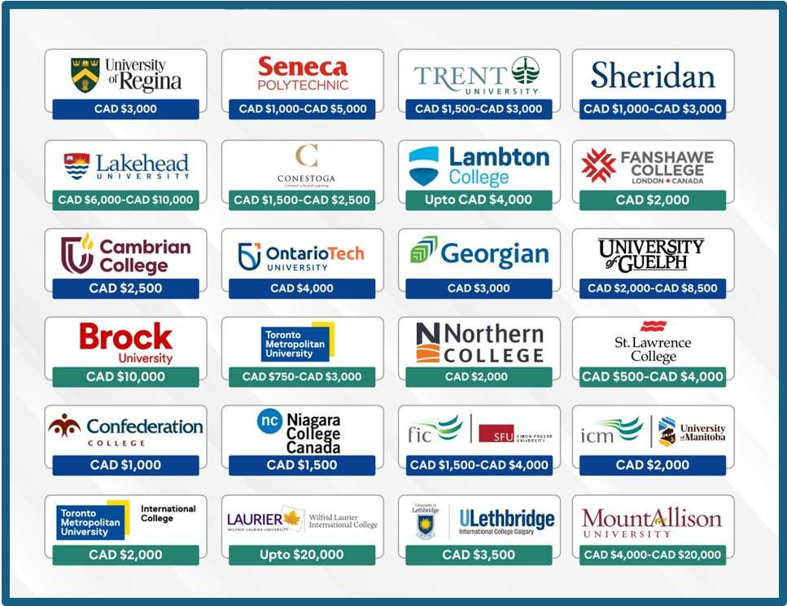
Popular Institutions Offering Scholarships

Slide 55




Points To Remember For Successful Offers And Visas
Do not apply for students who do not meet the IELTS criteria. Minimum 6.0 with no band less than 6.0 for UG and overall 6.5 with no band less than 6.0 for PG.
Do not apply for students who have several failed courses, large gaps of 5 or more years in studies (regardless of
their work experience) and inconsistency in program choice with past studies. Course choice must be relevant.
Good academics of the students: We have seen higher rate of visa approvals for students having 60% and above throughout their academic qualifications.
Also, we have noticed that if a student has low academics as well as a gap of 2-5 years after completion of last
studies, the case is weak, and visa may be refused

Slide 56
Do Universities or Colleges in Canada assist in Job Placements?
Most Institutions have :
A Training and Placement Centre which helps the students in preparing their CV and for Interviews
according to Canadian requirements.
Many institutions conduct Job Fairs in which various local companies participate.
It is quite likely that the students enrolled in a co-op program will get placed in their respective
companies where they have done their co-op.

Slide 57
Sources of Finance
Q: What can be the sources of Funds to study in Canada?

Slide 58



Sources of Finance
Self funded / Parents / Grand Parents.
Fixed Deposits / Government Provident Fund / Public Provident Fund / Funds in Savings Account.
Loans from approved banks. Repayment commences upto one year after graduation or 6 months after securing a job
whichever is earlier. The period for repayment also varies and may be upto 15 years.

Slide 59

Submitting a Winning Application
Completed Application Form
Academic Records
Standardized Examination Scores
Work Experience details if any
Application Fees if applicable
SOP and Recommendation Letters required for universities only.

Slide 60

Counselling Tips
Identify the suitability of the profile for Canada.
Do not accept students below 50% for Colleges and below 65% for Masters in the University.
Do not accept students with long gaps and multiple backlogs.
Check English Language ability.
Tell students about Co-op work opportunities.
Inform the student about the benefits of studying in Canada as compared to other countries.
Most Important – Talk about PR Opportunity, Part time work, full time job opportunities.
Talk about the lesser investment and higher gains.

Slide 61


