Slide 1

General Presentation
1
Destination Australia- General Presentation
Notes:
Talk – We call ourselves one stop solution provider when it comes to Overseas Education.
Overseas Education Counselling, Test Preparation, Country, Course and University Selection, Application and Admission Assistance, Visa Processing, Value Added Services

Slide 2
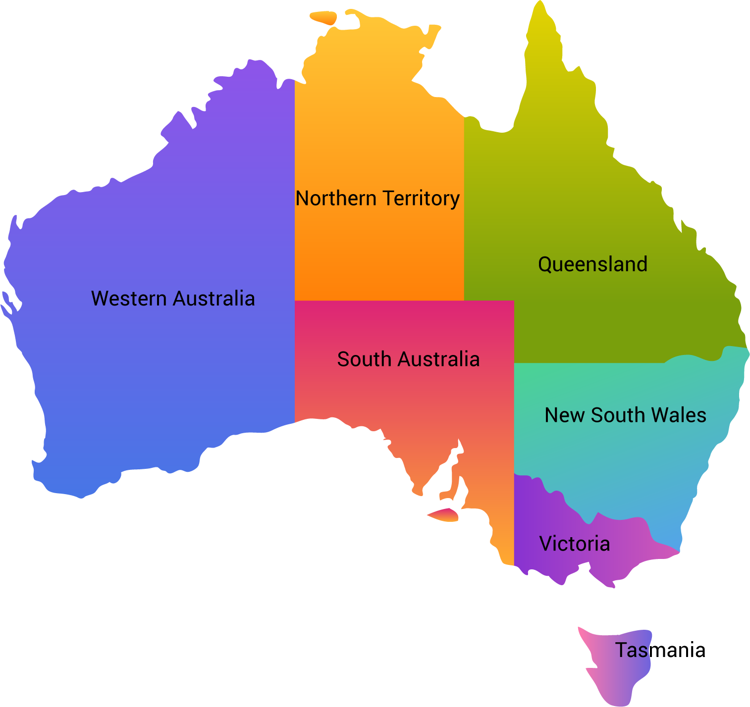
General Presentation
2
Geography of Australia
Darwin
Cairns
Brisbane
Gold Coast
Perth
Sydney
Adelaide
Canberra
Melbourne
Hobart
Notes:
Talk – We call ourselves one stop solution provider when it comes to Overseas Education.
Overseas Education Counselling, Test Preparation, Country, Course and University Selection, Application and Admission Assistance, Visa Processing, Value Added Services

Slide 3

General Presentation
3
Popular cities in Australia
Sydney
Melbourne
Brisbane
Adelaide
Perth

Slide 4

Basics of Australia
General Presentation
4
Official Name: Commonwealth of Australia
Capital: Canberra
Population: 25 million (2025)
Official Language: English
Currency: Australian Dollars (AUD)

Slide 5
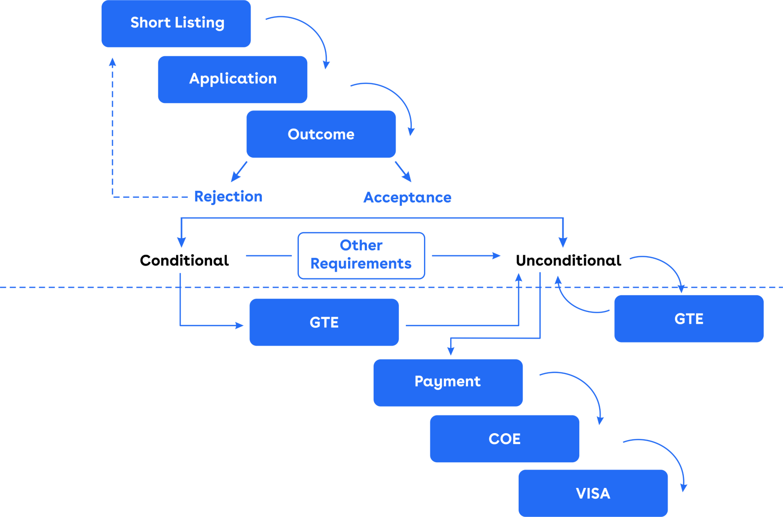
Admission process
General Presentation
5
GS
GS

Slide 6
General Presentation
6
Why Australia
Superior International Rankings
Part-Time Job Opportunities
Post-Study Work Visa up to 5 years
Opportunity for PR
Availability of Pathway Programs
IELTS, PTE, TOEFL accepted
Notes:
Talk – We call ourselves one stop solution provider when it comes to Overseas Education.
Overseas Education Counselling, Test Preparation, Country, Course and University Selection, Application and Admission Assistance, Visa Processing, Value Added Services

Slide 7
General Presentation
7
Why Australia
No application fees*
Flexible deadlines
Lower entry requirement
No visa interviews
Quick visa outcomes
* In most of the universities
Notes:
Talk – We call ourselves one stop solution provider when it comes to Overseas Education.
Overseas Education Counselling, Test Preparation, Country, Course and University Selection, Application and Admission Assistance, Visa Processing, Value Added Services

Slide 8

Intakes available with Australian Universities
General Presentation
8
Major Intakes
  February and July
  Offered by universities and private colleges
  Courses Offered: All courses
Minor Intakes
  October/November/May
  Offered by private colleges and some of the major universities
  Courses offered: Business, IT and Engineering

Slide 9

Type of educational institutes in Australia
General Presentation
9
Universities
colleges

Slide 10
Private Colleges
General Presentation
10
These kind of colleges offer Bachelor’s/Master’s/VET programs
Not affiliated to any university but has CRICOS code
Programs are offered in almost all popular disciplines such as IT, Engineering, Health, Business, Hospitality, etc.
Example: Le Cordon Bleu, Engineering Institute of Technology, Excelsia College

Slide 11
Pathway colleges
General Presentation
11
Maily focused on Foundation/Diploma/MQP programs
Example : Deakin College/Griffith College/Curtin College
The student progresses to a UG/PG program into an Aus University
Programs are offered in almost all popular disciplines such as IT, Engineering, Health, Business, Hospitality, etc.
ELICOS can also studied in a Pathway College

Slide 12
Universities
General Presentation
12
There are a total of 42 universities in Australia
37 Public universities
3 Private universities
2 International universities
The Higher Education Sector in Australia primarily consists of Universities
Australian Universities offer pathway programs, bachelor’s & master’s degrees and doctoral programs

Slide 13
General Presentation
13
Information Technology
Business & Management
Engineering
Education & Teaching
Psychology & Social Work
Nursing & Health
Building & Construction
Hospitality & Tourism
Pharmacy
Media & Communcation
Destination
Australia
Notes:
Talk – We call ourselves one stop solution provider when it comes to Overseas Education.
Overseas Education Counselling, Test Preparation, Country, Course and University Selection, Application and Admission Assistance, Visa Processing, Value Added Services

Slide 14


Popular groups of Universities
General Presentation
14

Slide 15

Pathway programs
General Presentation
16
Pathway programs are a good opportunity to the students who are unable to meet the direct entry requirements of the Australian universities
Students who are not able to meet the direct entry requirements of Australian Universities can be offered ‘Pathway Programs’
These programs can be offered at undergraduate level and postgraduate level
These are also called as ‘Packaged Programs’
Pathway programs are of two types
  Academic pathway
  English language programs

Slide 16

Academic pathways (UG)
General Presentation
17
Students scoring 55% to 64% in HSC can be offered these programs
They are also called as Diploma leading to Degree programs (D to D programs)
Students usually get admission in a college where they study a Diploma Program for one year (e.g., Diploma of Business)
After successful completion of Diploma, they progress to the second year of Bachelor’s degree, eventually completing their graduation in 3/4 years

Slide 17

English language pathways (ELICOS)
General Presentation
18
English Language Pathways are also called as ELICOS, EAP, ELP, etc.
Offered to students falling short of English language requirement
Students have to study English ‘before’ commencing their main program
Duration of ELICOS is restricted to minimum 10 weeks
Tuition Fee of ELICOS: AUD 300 to AUD 400 per week

Slide 18
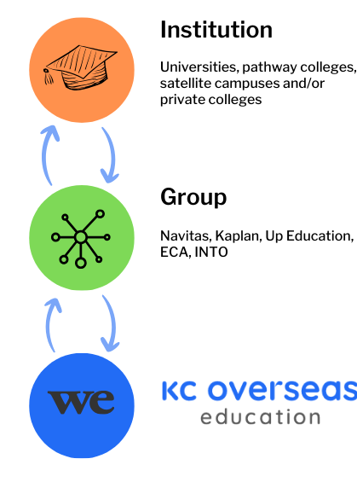
Introduction to Groups
General Presentation
19
Some universities, pathway colleges, satellite campuses or private colleges outsource their recruitment processes to private entities.
These private entities carry out the entire admission process starting from marketing, applications to commissions.
These private entities are called as groups.
Groups represented by KC for Australian institutions:
Navitas
Kaplan
Up Education (UniLink)
INTO
ECA

Slide 19
Timeline for Australia admission process- Feb intake
General Presentation
20
IELTS Coaching | June
Appear for IELTS Test | July
IELTS Test Result | July/August
Submit applications to universities | July to October
Offer Letters | July to November
Arrangement of Funds | August to December
Financial Assessment in the Universities | September to January
Apply for Visas | October to January
Visa Grant | December to February
Fly to Australia | February

Slide 20
Timeline for Australia admission process- July intake
General Presentation
21
IELTS Coaching | January
Appear for IELTS Test | January
IELTS Test Result | January/February
Submit applications to universities | January to April
Offer Letters | January to May
Arrangement of Funds | February to May
Financial Assessment in the Universities | March to May
Apply for Visas | April to June
Visa Grant | April to July
Fly to Australia | July

Slide 21
Annual expenses in Australia
General Presentation
22
Particulars | Amount in AUD
Tuition Fee of Universities | AU$ 35,000
Living Costs | AU$ 29,710
Airfare from India to Australia | AU$ 2,500
Visa Fee | AU$ 2,000
Total Expenses | AU$ 69,210
Less Part Time Earnings @24.94 AUD/hr | AU$ 21,500
Net Cost | AU$ 47,710
Less Scholarship Amount | If Applicable
Total Money to be spent by the student | AU$ 47,710

Slide 22
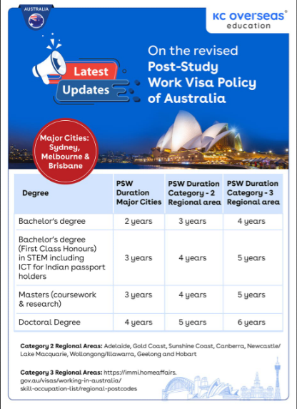
Post study work rights
General Presentation
23

Slide 23
Thank you!
General Presentation
24

